Slide 1
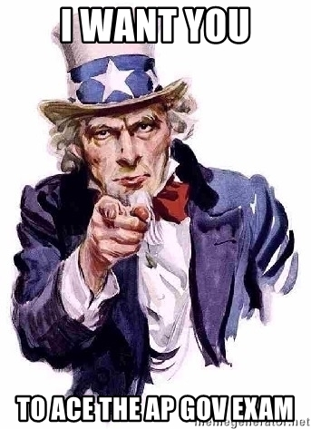
AP GoPo Exam
Cheat Sheet
Required Foundational Documents

Slide 2
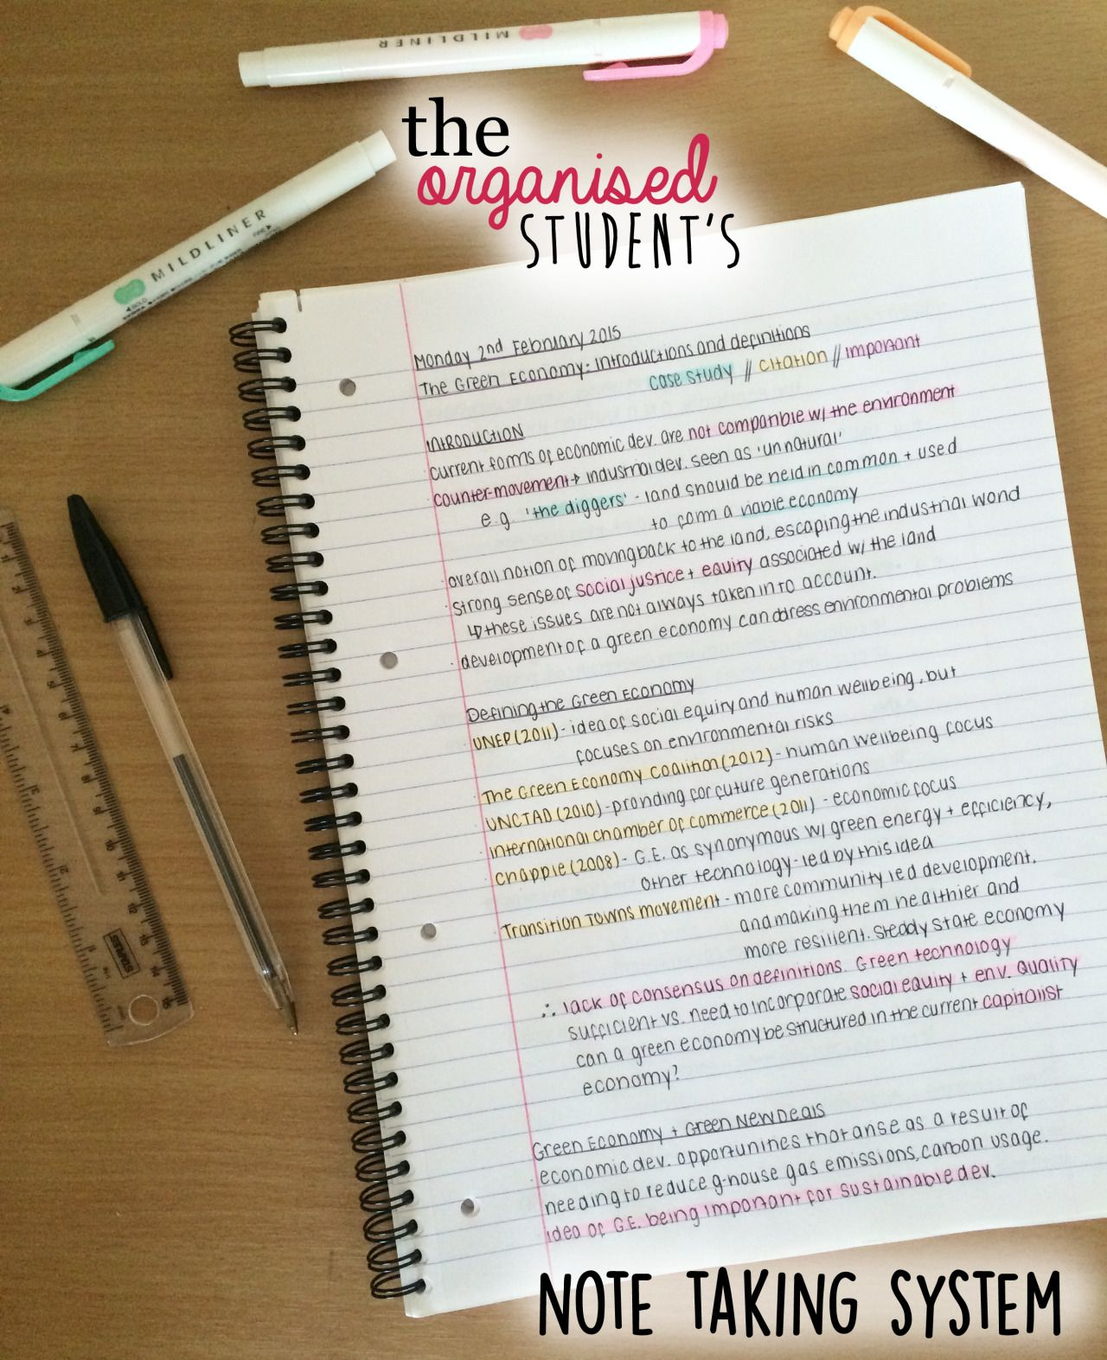
What should you do to review?
Create an organized REVIEW NOTEBOOK just for this OPEN BOOK exam - TIME will be an issue and you can’t waste it looking up info - so have it at your fingertips!
Have clear sections:
Required Docs
Required SCOTUS Cases
Unit 1 - Constitutional Foundations
Unit 2 - Interactions w/ branches of government
Unit 3 - Civil Liberties & Civil Rights

Slide 3
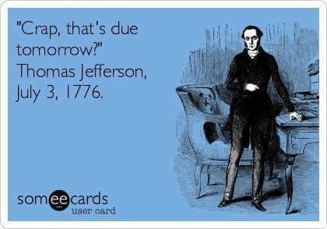
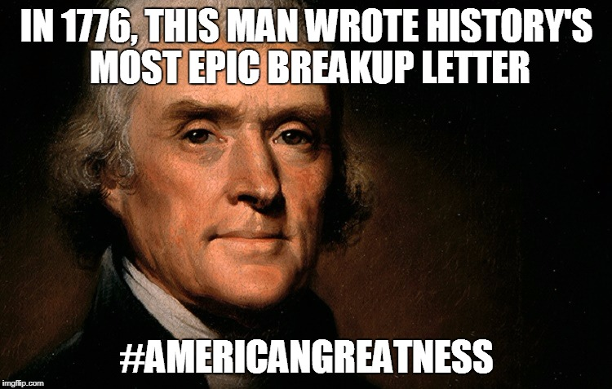
Declaration of Independence
All people created equal (Natural Rights of Life, Liberty, Property)
Governments are created to protect these rights
If Gov’t does not protect these rights, then the People have the duty to change/destroy
Imperfect gov’ts should not be destroyed, only ones that seek to subject the People to Tyranny (destruction of Natural Rights)
BIG IDEA: A balance between governmental power and individual rights has been a hallmark of American political development.

Slide 4
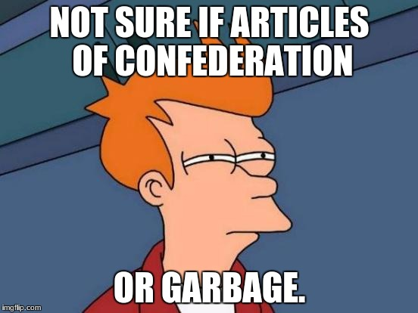
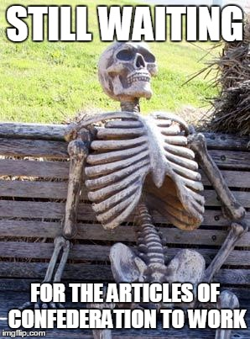
Articles of Confederation
Confederation of states, with an extremely limited central government.
limitations placed upon the central government rendered it ineffective at governing the continually growing American states
Each state remains sovereign
Unicameral legislature, each state one vote
No President, No Judiciary
Could not force taxation; No standing Army
BIG IDEA: A weak national government, states had more power

Slide 5
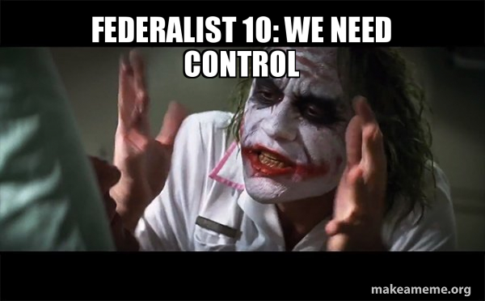
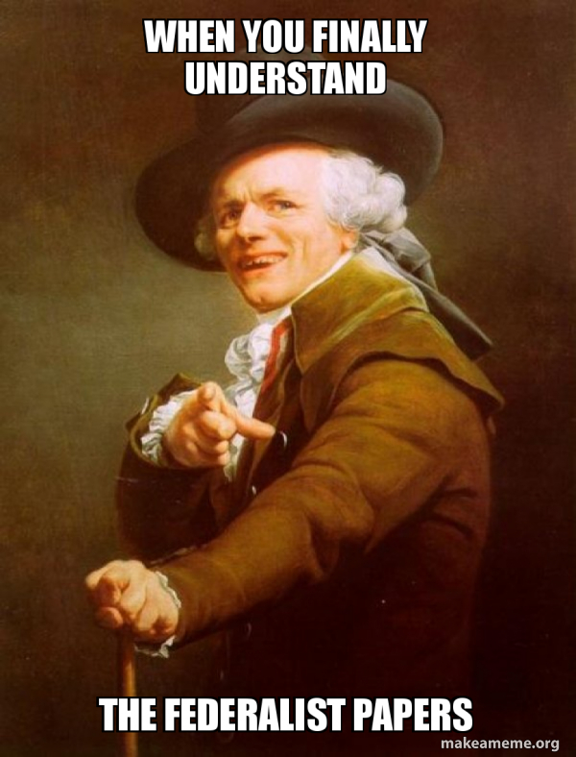
Federalist 10
a strong, united republic would be more effective than the individual states at controlling “factions”
a large republic will help control factions because when more representatives are elected, there will be a greater number of opinions. Therefore, it is far less likely that there will be one majority oppressing the rest of the people.

Slide 6
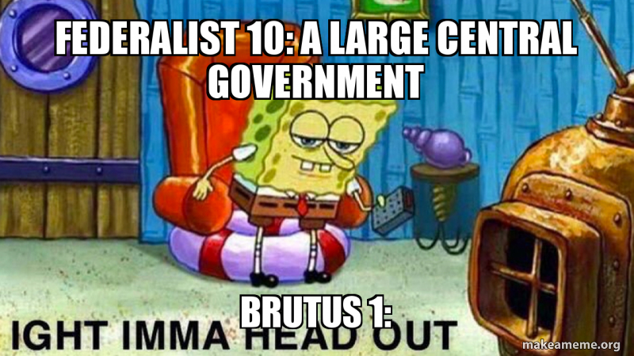
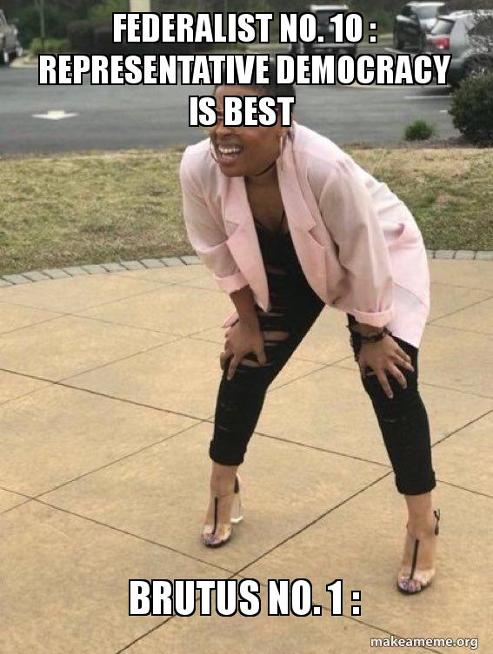
Brutus I
an Antifederalist series of essays designed to
encourage New Yorkers to reject the proposed
Constitution
the immense power of the federal government
requires the people to sacrifice their liberties
a bill of rights was necessary to protect the people from the government
Congress possesses far too much power: taxation, standing army, taxes, Elastic Clause
a free republic cannot exist in such a large territory as the United States
Judicial authority will broaden federal gov’t’s power (thus, tyranny)

Slide 7
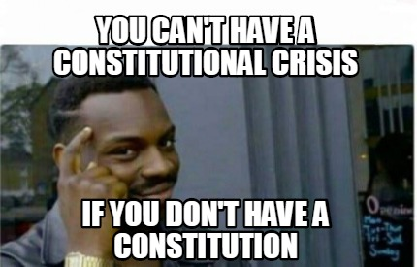
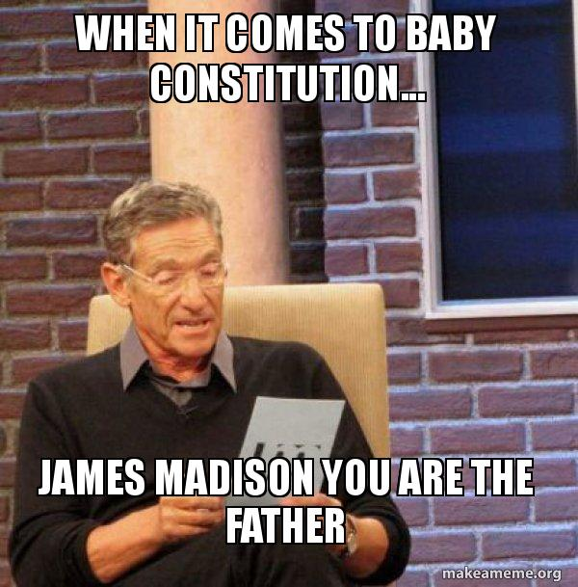
Constitution (+ Bill of Rights
& Other Amendments)
Outline of federal gov’t structure, powers, and limits to those powers
Three branches (L, E, J) [Sep. of P’s] that can limit each other [Ch & B’s]
Federal system of government
Constitution as Supreme Law
Bill of Rights
1-8: Individual Rights
9: Rights not listed are NOT denied to the People
10: Powers not given to Federal Gov’t nor denied to the
states are State Powers
Other Amendments
Generally, amendments are expansions of Peoples’ rights
13, *14*, 15, 17, 19, 22, 24, 26
BIG IDEA: The Constitution emerged from the debate about the weaknesses in the Articles of Confederation as a blueprint for limited government.

Slide 8
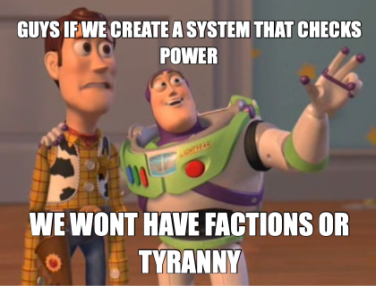
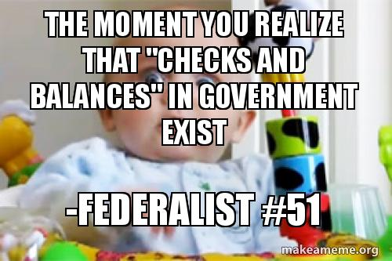
Federalist 51
Proposes a government broken into three branches:
Executive, Legislative, and Judicial.
Each branch should be self-sufficient, but each should have some kind of power over the other in order for them to keep each other from taking over the government.
The Legislative branch needs to be split further into the House of Representatives and the Senate because it's the most powerful branch, and members of the Judicial branch need to be chosen by the President with the Senate's approval because they want qualified candidates for a position that lasts for life.
This style of government also helps keep down the power of factions, a recurring theme from Federalist 10.
BIG IDEA: The Constitution created a competitive policy- making process to ensure the people’s will is accurately represented and that freedom is preserved.

Slide 9
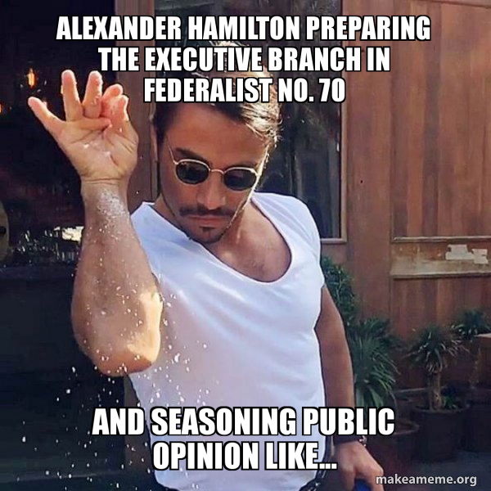
Federalist 70
Argues that unity in the executive branch is a main ingredient for both energy and
safety. Energy arises from the proceedings of a single person, characterized by, "decision, activity, secrecy, and dispatch," while safety arises from the unitary executive's unconcealed accountability to the people.
Justifies executive strength by claiming that the slow-moving Congress, a body designed for deliberation, will be best-balanced by a quick and decisive executive.
Also maintains that governmental balance can only be achieved if each branch of government (including the executive branch) has enough autonomous power such that tyranny of one branch over the others cannot occur.
Makes the case for duration, meaning a presidential term long enough to promote stability in the government.
Support can be defined as a presidential salary, which insulates government officials from corruption by attracting capable, honest men to office.
Support can be defined as a presidential salary, which insulates government officials from corruption by attracting capable, honest men to office.
BIG IDEA: The presidency has been enhanced beyond its expressed constitutional powers.

Slide 10
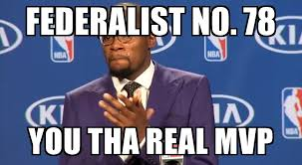
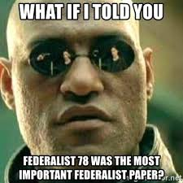
Federalist 78
As “the weakest of the three departments of power,” the
Judiciary needs strengthening.
Without an independent judiciary, any rights reserved to the people by the Constitution “would amount to nothing,” since the legislature cannot be relied upon to police itself.
lifetime appointments, guaranteed “during good behavior” to insure that judges can resist encroachments from the legislature (to which presumably they would be vulnerable by means of bribes or threats)
BIG IDEA: The design of the judicial branch protects the Supreme Court’s independence as a branch of government, and the emergence and use of judicial review remains a powerful judicial practice.

Slide 11
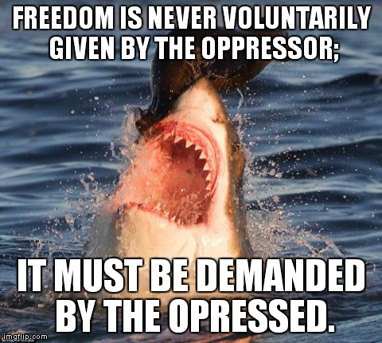
Letter from Birmingham Jail
King argues that he and his fellow demonstrations have a duty to fight for justice.
It is up to the oppressed to take charge and demand equality.
Segregation is used to debase one population (blacks) while uplifting another (whites), which makes it immoral in the eyes of God. Immoral laws are laws that are neither just nor fair. According to St. Augustine's logic, unjust laws aren't actually laws, so they don't have to be followed. King believes people are under a moral obligation to oppose segregation by refusing to abide by the so-called laws that govern the practice.
White Americans who say they agree with the notion of desegregation but criticize the manner in which civil rights activists go about achieving it are the biggest obstacle standing in the way of racial equality. The demeaning and "paternalistic" attitude of white moderates shows a lack of real understanding about the realities of segregation. It is this group that perpetuates the notion that time, not human intervention, will be the great equalizer—which discourages others to join the campaign for civil rights.
The civil rights movement will ultimately be successful because "the goal of America is freedom."
BIG IDEA: The Fourteenth Amendment’s equal protection clause as well as other constitutional provisions have often been used to support the advancement of equality.

