Slide 1
UNIT II: President

Slide 2
Topic 2.4-2.7
The President

Slide 3
Enduring Understanding (Con-4)
The presidency has been enhanced beyond its expressed constitutional powers.

Slide 6
Topic 2.4: Roles and Powers of the President (Con-4.A.1)
Presidents use powers and perform functions of the office to accomplish a policy agenda.

Slide 7
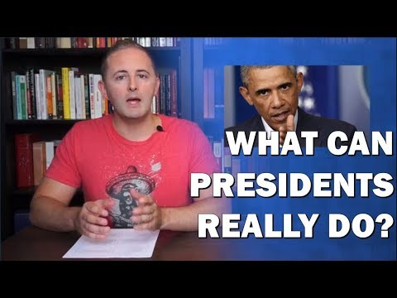
Intro to Topic 2.4
Roles and Power of the President
Carey LaManna
6:06

Slide 8
Topic 2.4: Roles and Powers of the President (Con-4.A.2)
Formal and informal powers of the president include:
Vetoes and pocket vetoes—formal powers that enable the president to check Congress
Foreign policy—both formal (commander- in-chief and treaties) and informal (executive agreements) powers that influence relations with foreign nations
Bargaining and persuasion—informal power that enables the president to secure congressional action
Executive orders—implied from the president’s vested “executive power,” or from power delegated by Congress, executive orders allow

Slide 9
the president to manage the federal government
Signing statements—informal power that informs Congress and the public of the president’s interpretation of laws passed by Congress and signed by the president

Slide 10
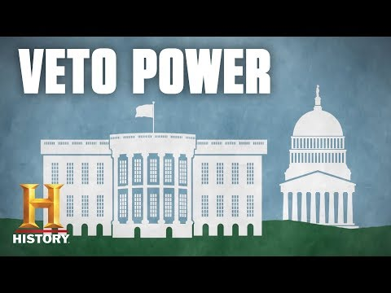
The Veto Power
History
3:01

Slide 11
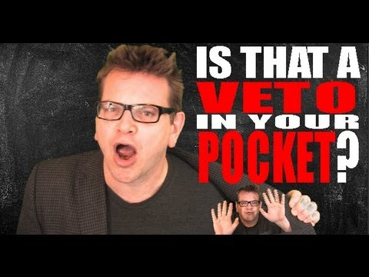
The Pocket Veto
Hip Hughes
5:08

Slide 12
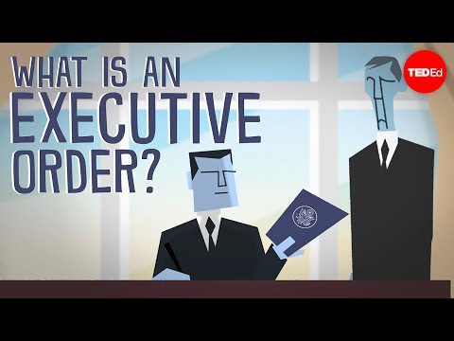
Executive Orders
TED-Ed
4:47

Slide 13
The Executive Agreement
An agreement between the President and another head of government of two or more nations that has not been ratified by the Senate as treaties are ratified.
Considered politically binding to distinguish them from treaties which are legally binding.
Not considered treaties for the purpose of the Treaty Clause of the United States Constitution, which requires the advice and consent of two-thirds of the Senate to qualify as a treaty.

Slide 14
Signing Statements
Khan Academy
5:13

Slide 15
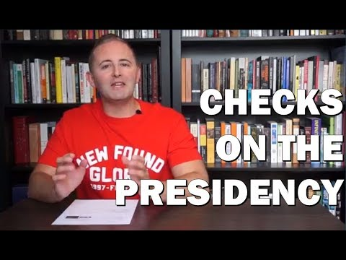
Intro to Topic 2.5
Checks on the Presidency
Carey LaManna
5:37

Slide 16
Topic 2.5: Checks on the Presidency (Con-4.B.1)
The potential for conflict with the Senate depends upon the type of executive branch appointments, including:
Cabinet members
Ambassadors
White House staff

Slide 17
The Cabinet
History
1:47

Slide 18
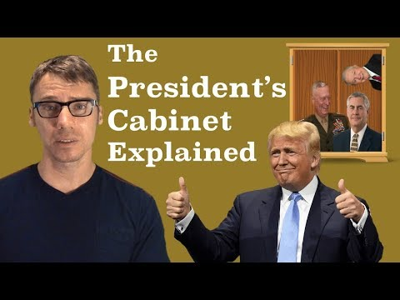
The Cabinet
Mr. Beat
12:38

Slide 19
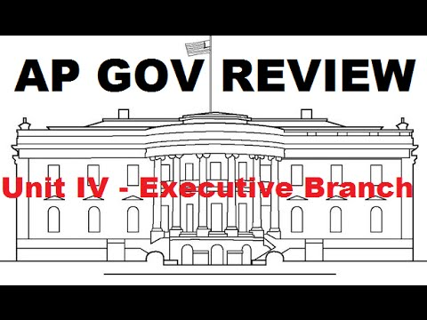
The Cabinet
Kelsey Falkowski
13:54

Slide 20
The Cabinet and White House Staff
Carey LaManna
6:53

Slide 23
Topic 2.5: Checks on the Presidency (Con-4.B.2)
Senate confirmation is an important check on appointment powers, but the president’s longest lasting influence lies in life-tenured judicial appointments.

Slide 24
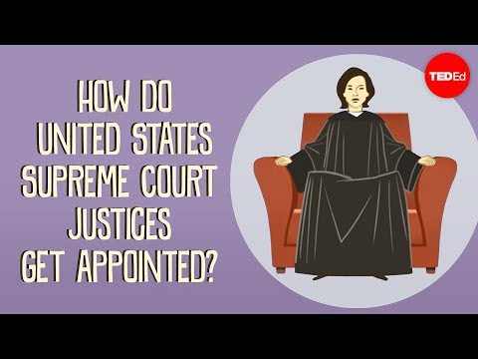
How do US Supreme Court Justices Get Appointed?
TED-Ed
4:25

Slide 25
Topic 2.5: Checks on the Presidency (Con-4.B.3)
Policy initiatives and executive orders promoted by the president often lead to conflict with the congressional agenda.

Slide 26
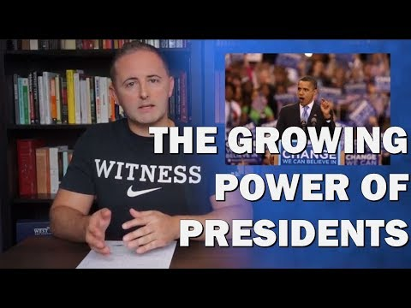
Intro to Topic 2.6
Expansion of Presidential Power
Carey LaManna
4:19

Slide 27
Topic 2.6: Expansion of Presidential Power (Con-4.C.1)
Justifications for a single executive are set forth in Federalist No. 70.

Slide 28
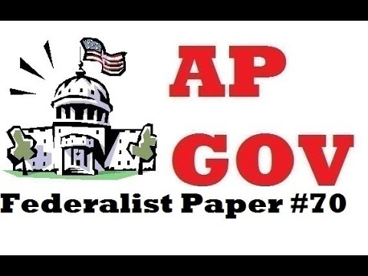
Federalist #70
Kelsey Falkowski
5:05

Slide 29
Federalist #70
Carey LaManna
8:28

Slide 30
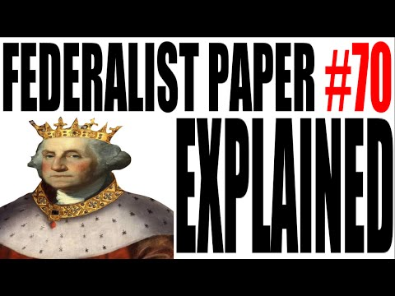
Federalist #70
Hip Hughes
4:12

Slide 31
Topic 2.6: Expansion of Presidential Power (Con-4.C.2)
Term-of-office and constitutional-power restrictions, including the passage of the Twenty-Second Amendment, demonstrate changing presidential roles.

Slide 32
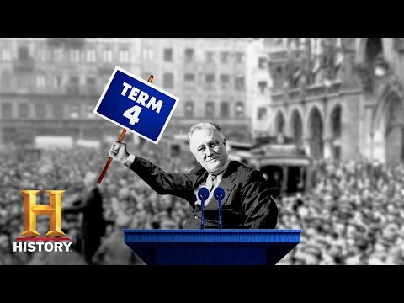
The 22nd Amendment
History
1:38

Slide 33
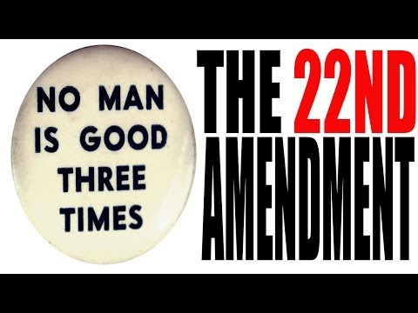
The 22nd Amendment
Hip Hughes
6:08

Slide 34
Topic 2.6: Expansion of Presidential Power (Con-4.C.3)
Different perspectives on the presidential role, ranging from a limited to a more expansive interpretation and use of power, continue to be debated in the context of contemporary events.

Slide 35
Topic 2.7: Presidential Communication (Con-4.D.1)
The communication impact of the presidency can be demonstrated through such factors as:
Modern technology, social media, and rapid response to political issues
Nationally broadcast State of the Union messages and the president’s bully pulpit used as tools for agenda setting.

Slide 36
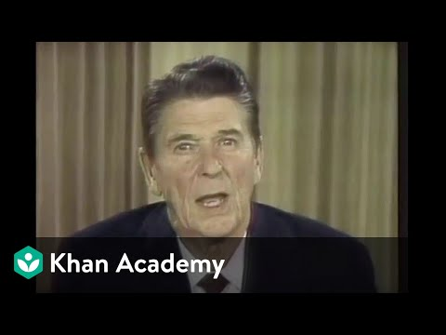
The Bully Pulpit
Khan Academy
5:54

Slide 37
Review
The Executive Branch

Slide 38
Review Questions - The Executive Branch and the President
Explain how the president can implement a policy agenda.. (CON-4.A)
Explain how the president’s agenda can create tension and frequent confrontations with Congress.n. (CON-4.B)
Explain how presidents have interpreted and justified their use of formal and informal powers. (CON 4C)
Explain how communication technology has changed the president’s relationship with the national constituency and the other branches. (CON 4-D)

Slide 39
Explain the extent to which governmental branches can hold the bureaucracy accountable given the competing interests of Congress, the president, and the federal courts. (PMI-2.E)

Slide 40
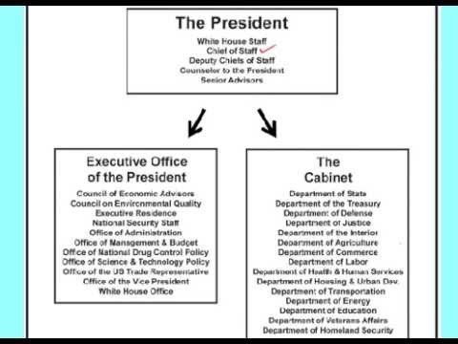

Slide 41
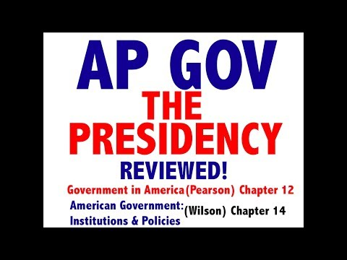
Review
The Executive Branch
Jocz Production
6:07

Slide 42
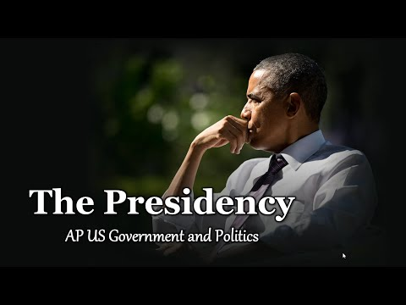
Review
The Executive Branch
Tom Richey
6:07

Slide 43
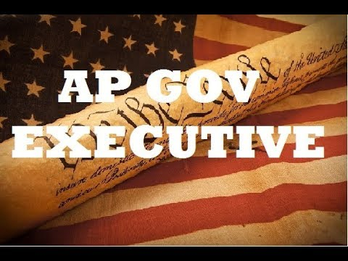
Review
The Executive Branch
Kelsey Falkowski
6:07

