Slide 1
APUSH Thematic Review
Color Coded by Subject

Slide 2
Politics and Parties

Slide 3
British Roots
1215 - Magna Carta: limited gov’t
1640s - English Civil War: replacing leaders
1688 - Glorious Revolution: King in Parliament
Whig Ideology: Keep strict limits on government, lest they take too much

Slide 4
No Taxation without Representation
1764 - Sugar Act and Stamp Act
Sons of Liberty/ Non Importation agreements
Declaration and Resolves of the SA Congress
1773 - Tea Act
Boston Tea Party
1774 - Coercive/Intolerable Acts
Resolutions of the 1st Continental Congress

Slide 5
Independence
1776 - Common Sense/ Declaration of Ind.
Articles of Confederation
Firm league of friendship.
All local power to the states.
State Constitutions
Primary source of government.
Vary in how “radical” they were.

Slide 6
A New Constitution
Virginia Plan
3 branches
Rep. by population
Federal government is “of the people”
New Jersey Plan
3 branches
Rep. by state
Stays a government “of the states”
Great Compromise: Tries to do both.

Slide 7
Ratification
Federalists
Support
Federalist Papers
Most “Founding Fathers.”
Need for stronger nat’l gov’t.
Antifederalists
Oppose
Disorganized
Stick to state politics
Suspicious of nat’l gov’t

Slide 8
Ratification
Federalists
Support
Federalist Papers
Most “Founding Fathers.”
Need for stronger nat’l gov’t.
Antifederalists
Oppose
Disorganized
Stick to state politics
Suspicious of nat’l gov’t

Slide 9
First Political “Parties”
Federalists
Loose construction = more powerful nat’l gov’t
Rallied around Hamilton’s plans
In control until 1800
Dem. Republicans
Strict const. = limited fed. Gov’t
Rallied around Jefferson
Gain control in 1800

Slide 10
Era of Good Feelings
Federalists die out after opposition to War of 1812
Dem. Reps gain popularity with LA Purchase and extension of the franchise
Monroe’s Presidency
Ends largely w/ the disputed election of 1824

Slide 11
Jacksonian Era: First Real Political Parties
Whigs
Oppose Jackson
Clay, Q. Adams
Gov’t to make internal improvements
Nat’l Bank
Democrats
Jackson, Van Buren, Polk
States’ Rights
Westward Expansion
Jackson defies party during nullification crisis.

Slide 12
Slavery Debate
Republicans
Replace the Whigs, who fell apart over slavery
Strong gov’t in order to ensure “Free Soil”
Democrats
States’ Rights
Northern: Pop. Sov. (Douglas)
Southern: Constitutional Right (Calhoun)

Slide 13
Reconstruction
Republicans
Nat’l gov’t to protect freedmen through laws and military
“Radical”
13th, 14th, 15th
Democrats
Reconstruction violates Constitution
States’ Rights to “Home Rule”
Post 1877: “Redeemers”

Slide 14
Gilded Age
Republicans
“Waved the Bloody Flag”
Pro-business, tariffs, gold stan
Mugwumps supported Cleveland
Democrats
Divided on many issues
Anti-tariff
Cleveland was only Pres. during this time
“Solid South”

Slide 15
New Ideas: Expansion of Government
Populists
Grew out of Granger movement
Gov’t ownership of railroads
Free coinage of silver
Progressives
Not a unified group
Expansion of gov’t to right society’s wrongs
Economic focus
Gov’t reform

Slide 16
Party Switch
Democrats: Wilson
Progressive platform
16th, 17th, 18th, 19th
Working hours and wages
Republicans
Roosevelt: Progressive
Taft: Pro-business
1912 - divides the electorate
TR supports go to Dems

Slide 17
Birth of Modern Politics
Democrats
FDR’s New Deal
Johnson’s Great Society
Gov’t intervention to protect “life, liberty, happiness”
Republicans
Harding’s Return to Normalcy
Nixon’s Southern Strategy
Protection from gov’t for “life, liberty, happiness”

Slide 18
Liberals and Conservatives
Liberals
Large role for gov’t in economy
Protection of civil rights
Gov’t funding for education, society
Conservatives
Laissez-faire
Strict construction
States’ Rights

Slide 19
The Economy, Labor, and Migration

Slide 20
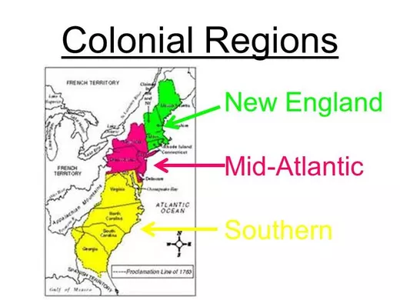
Ship building, trade, fishing, whaling
Wheat, fur, lumber, trade, foodstuffs,
Tobacco, rice, indigo, lumber
Mercantilism Ruled the Economy - But also Salutary neglect

Slide 21
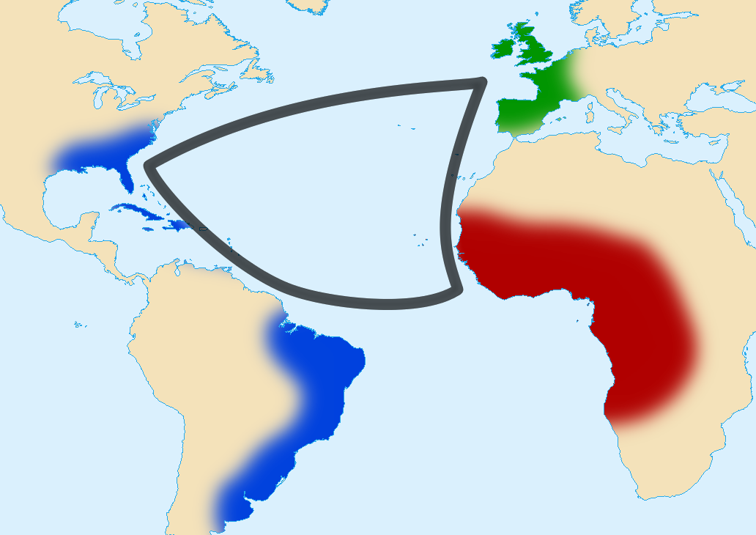
Triangle Trade

Slide 22
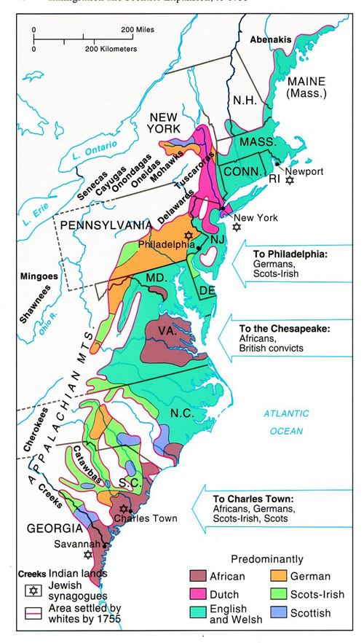
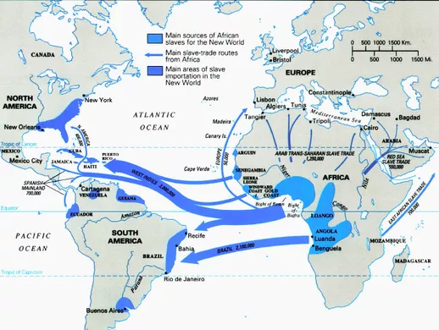
Colonial Settlement

Slide 23
The Market Revolution

Slide 24
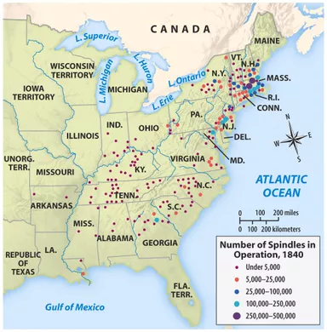
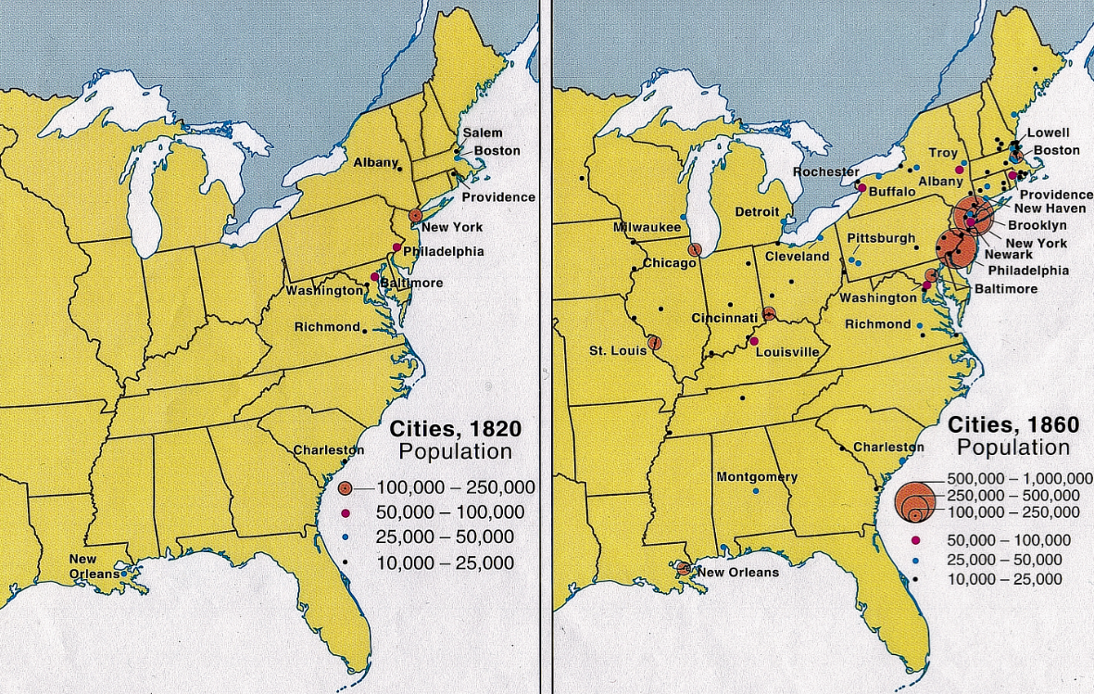
Antebellum Industrialization

Slide 25
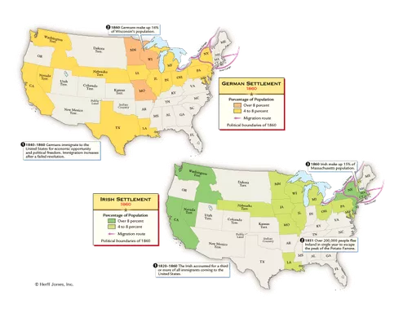
Immigration

Slide 26
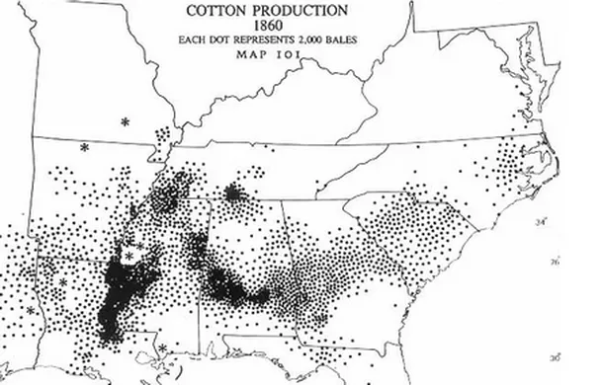
Effects of Cotton Gin

Slide 27
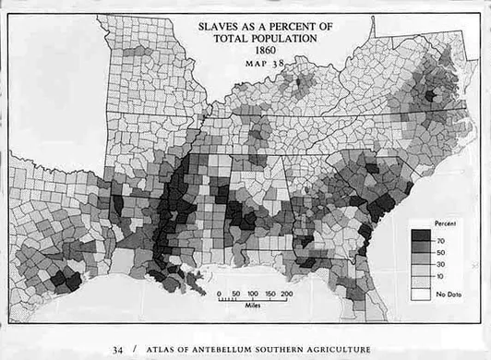
Cotton Gin Con’t

Slide 28
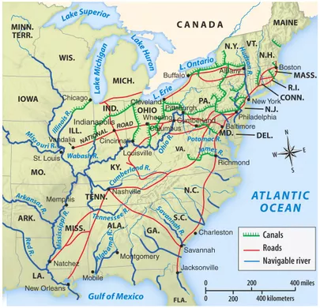
American System in Place

Slide 29
Panics in Antebellum America
1819
Western land speculation
Nat’l bank stops lending
Businesses close/jobs lost
1837
Jackson “closes” the Nat’l bank
Species Circular b/c of land speculation
Massive deflation

Slide 30
Industrialization

Slide 31
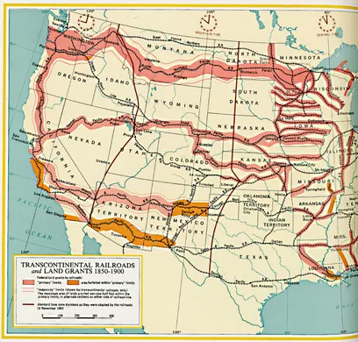
Railroads Open up the West

Slide 32
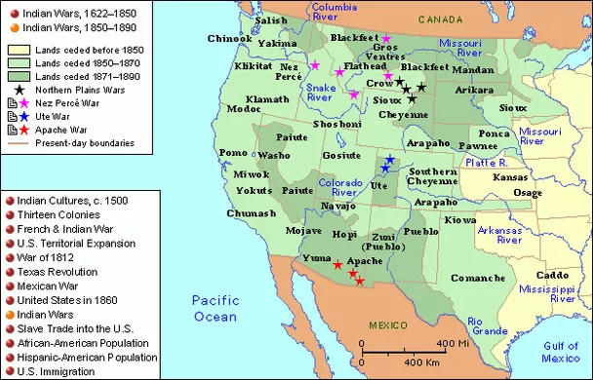
Indian Wars

Slide 33
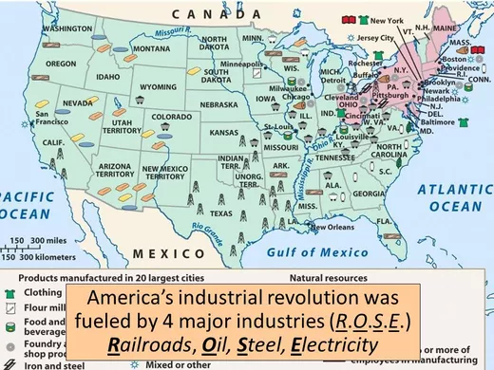
Industry

Slide 34
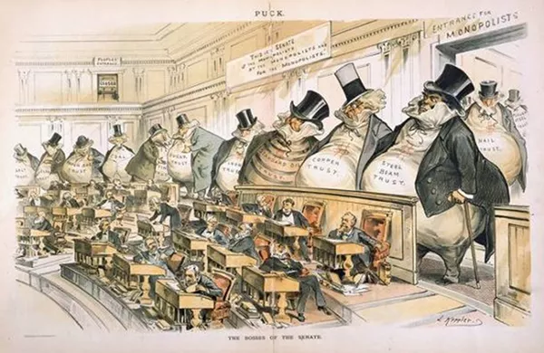
Big
Business

Slide 35
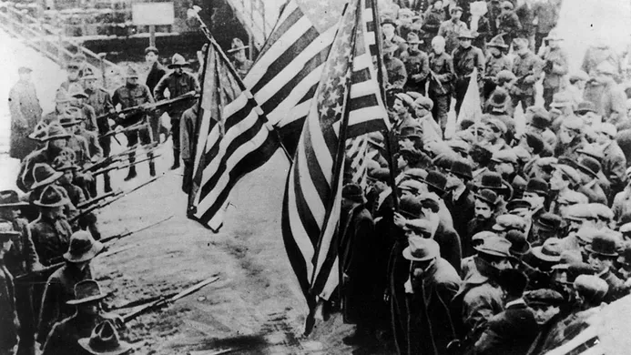
Great Railroad Strike of ‘77
Haymarket Square ‘86
Homestead ‘92
Pullman ‘93
Organized Labor

Slide 36
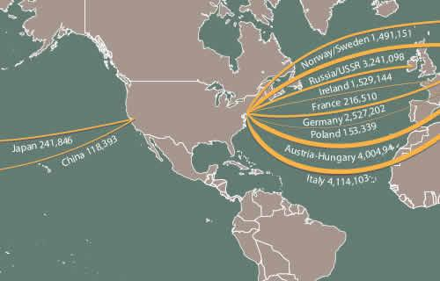
Immigration

Slide 37
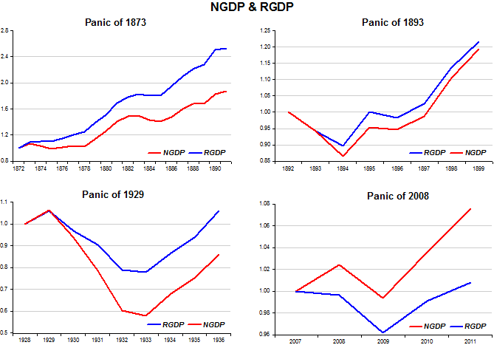
Panic of ‘73 and ‘93

Slide 38
The 20th Century

Slide 39
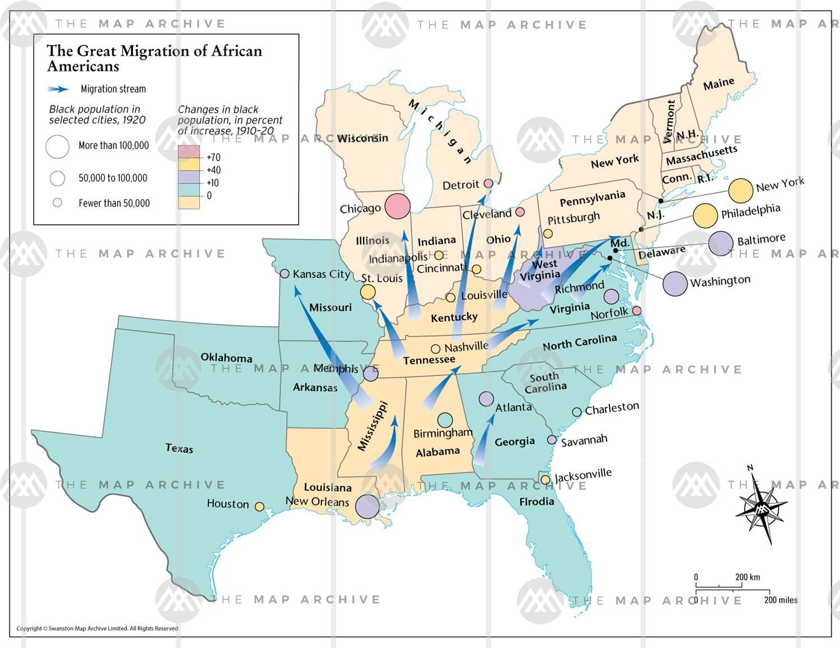
Great Migration

Slide 40
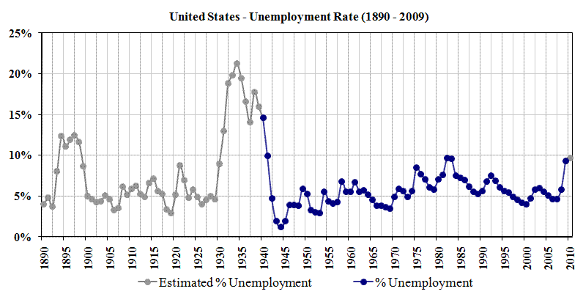

Slide 41
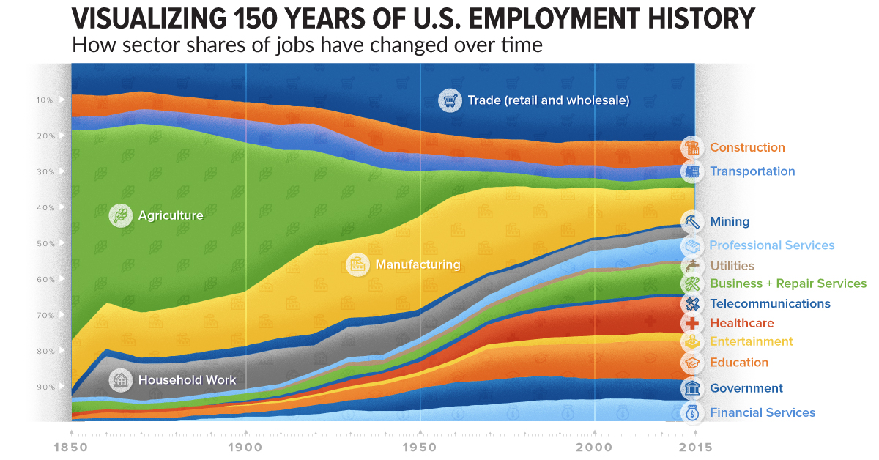

Slide 42
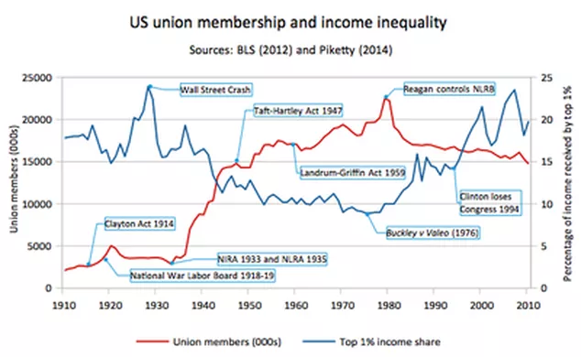

Slide 43
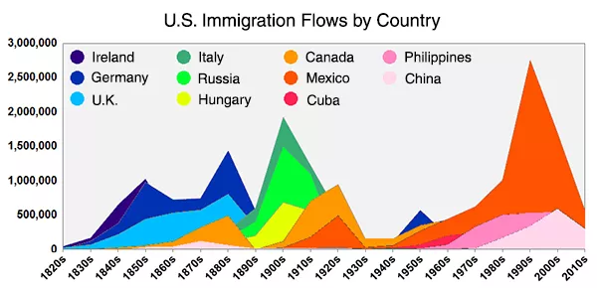

Slide 44
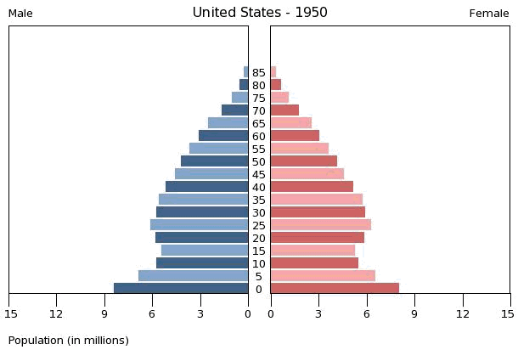
The Baby Boomers and US Population

Slide 45
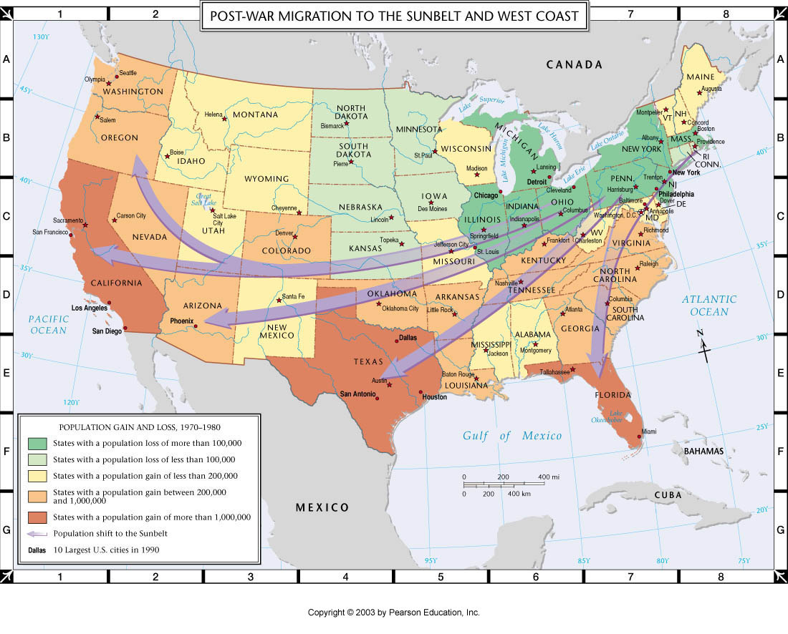
Internal Migration

Slide 46
Social Movements

Slide 47
First Great Awakening
Mid 1700s
Jonathan Edwards
George Whitfield
Salvation is your own personal responsibility.
Impact: Transfer of ideas from religion to politics
Don’t rely on leaders to make decisions for you.

Slide 48
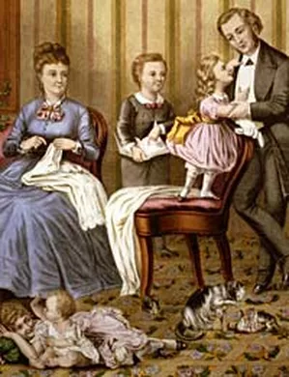
Republican Motherhood
During and after the Revolution
Women should be educated in order to education their sons.
First step...

Slide 49
Second GReat Awakening
1800 - 1820s
Charles Finney
Burned-over district (NY)
Response to Enlightenment Ideas
Christians should impact society:
Abolition
Temperance
Prison reform
Education reform

Slide 50
Abolitionism
Anti-slavery on moral grounds
Wm. Lloyd Garrison
H.B. Stowe
Frederick Douglas
Harriet Tubman
John Brown
Centered in New England
Most people disagree
Pushes the South to declare slavery “positive good”

Slide 51
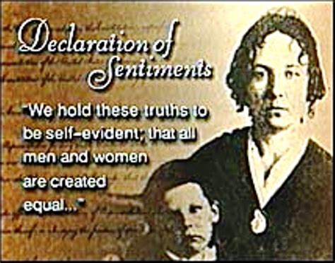
Women’s Rights Part 1
Outgrowth of Abolitionist movement.
Seneca Falls
Eliz. Cady Stanton
Lucretia Mott

Slide 52
Civil Rights Part 1
Fight for equality during/after Reconstruction
Booker T. Washington
W.E.B. DuBois
Ida B. Wells
Divided over “Atlanta Compromise”
Formation of the NAACP
Progressives

Slide 53
Progressivism
Muckrakers: Jacob Riis, Lewis Hine
Social Issues: Jane Addams
Economic Justice: Ida Tarbell
Political Reform: Robert LaFollette
Environment: John Muir
And more: click here

Slide 54
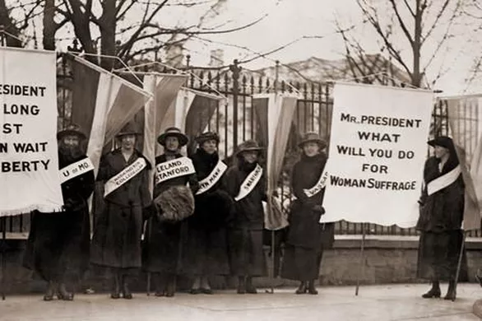
Women’s Rights Part 2: Suffrage
NAWSA: Carrie Chapman Catt
NWP: Alice Paul
19th Amendment

Slide 55
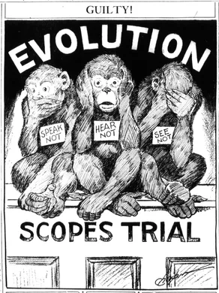
Religious Fundamentalism
1920’s
Reaction against modernization
Billy Sunday: evangelist
Scopes Trial

Slide 56
Civil Rights Part 2
Momentum after WWII
Brown v. Board
Montgomery Bus Boycott
Little Rock Nine
March on Washington
Freedom Summer
Wanted enforcement of 14th and 15th amend.
Success w/
64: Civil Rights Act
65: Voting Rights Act
24th Amendment

Slide 57
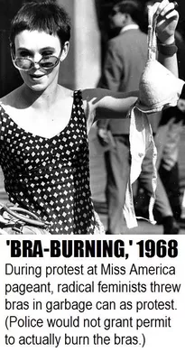
Women’s Rights Part 3
Feminism - sought to gain equality in education and the workplace
N.O.W. - Gloria Steinem
ERA - never passed

Slide 58
The New Left
Movement of “liberal” politics from strictly economic to include social justice.
Antiwar
Anti-nukes
Civil Rights
Feminism
Free Speech
LGBT Rights
Environmentalism
Immigrant Rights

Slide 59
Conservatism
64: Barry Goldwater
68: Richard Nixon
80: Ronald Reagan
Against: Great Society, Roe v. Wade, counterculture
Supported by a growing Christian coalition between Evangelicals and Catholics
Billy Graham

