Slide 1
2020 FRQ # 4: Argumentative Essay How To Tutorital
-25 minutes
-3 paragraphs
-Earn up to 7 Points total

Slide 2
Format of FRQ
The Question: Short Prompt/Scenario that asks you to develop an argument & gives you options of 3 Required Documents in which you have to use at least 1 document listed as a piece of evidence to support your argument.
The Tasks:
-Articulate a defensible claim/thesis responding to the prompt & establish reasoning ( 1 point - must earn this point to earn any more points)
-Support claim/thesis with 2 pieces of evidence (1 piece HAS to come from 1 of the listed required docs & 2nd piece of evidence can come from any other doc, SCOTUS case, law, amendment, fact you learned etc)
-Explain how & why your 2 pieces of evidence supports your claim/thesis (Describe & explain your evidence)

Slide 3
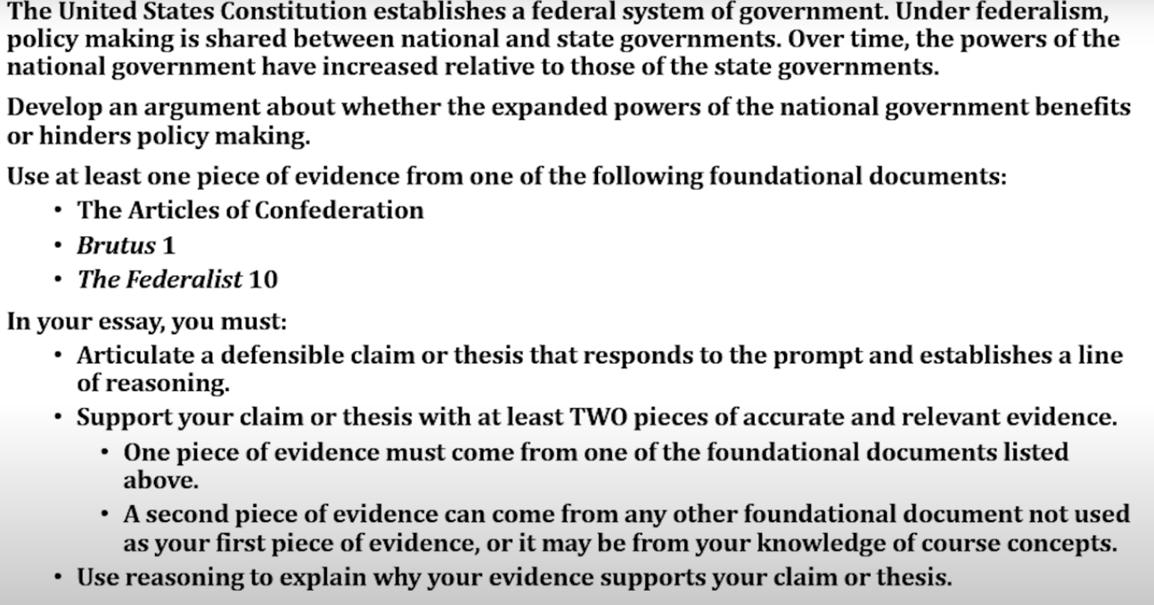

Slide 4
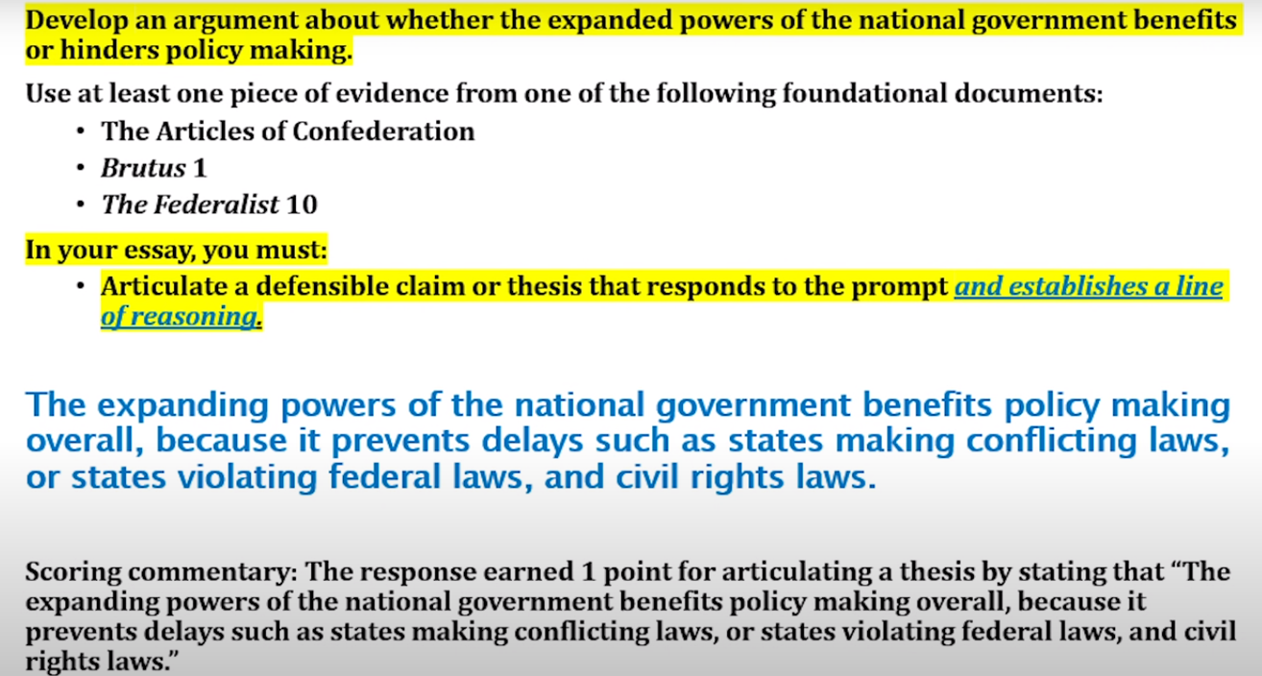
1st Paragraph: Thesis Sentence/Claim (1 Point)
1 sentence is sufficient
Make a CLAIM (based on the prompt) & GIVE REASONING (Use the word “BECAUSE”
Worth 1 point - MOST IMPORTANT POINT!!!! (You HAVE to earn the thesis point in order to earn any of the other points)
EXAMPLE:

Slide 5
2nd Paragraph - 1st Piece of Evidence + description & reasoning (Worth 3 Points)
IDENTIFY the required document you are using (from the list) & identify the evidence you are using from the document - 1 point
DESCRIBE the evidence and show its relevance to your claim/thesis - 1 point
EXPLAIN (elaborate, give examples) how the evidence supports your thesis - 1 point
EXAMPLE - Next Slide

Slide 6
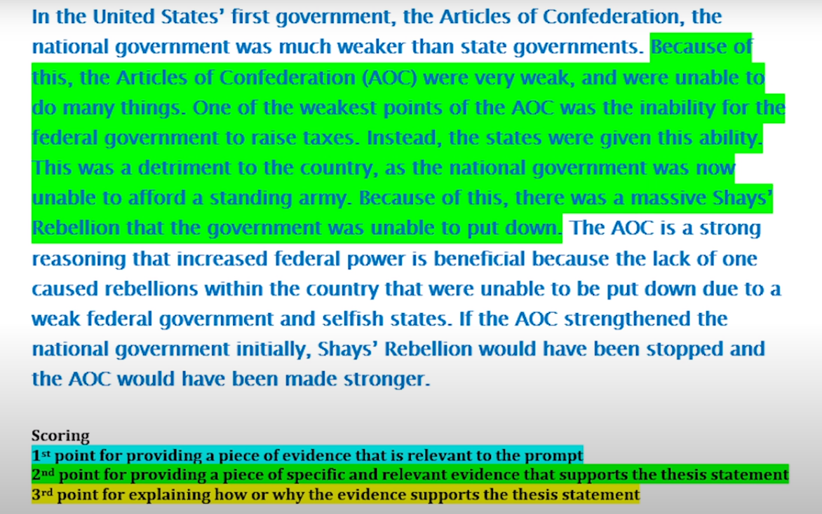
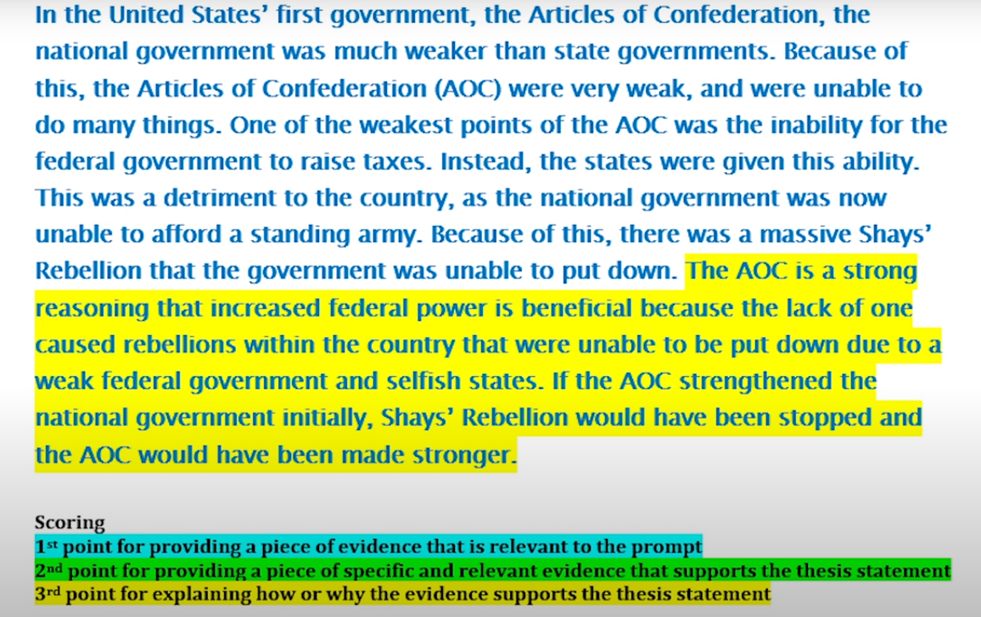
BLUE: IDENTIFY Doc & Evidence
GREEN: DESCRIBE evidence
YELLOW: EXPLAIN how evidence supports thesis

Slide 7
3rd Paragraph: 2nd Piece of Evidence + description & reasoning (Worth 3 Points)
IDENTIFY the document, SCOTUS case, amendment, law, fact from the class, etc you are using & identify the evidence you are using from the document, case, amendment, law, etc - 1 point
DESCRIBE the evidence and show its relevance to your claim/thesis - 1 point
EXPLAIN (elaborate, give examples) how the evidence supports your thesis - 1 point
EXAMPLE - Next Slide

Slide 8
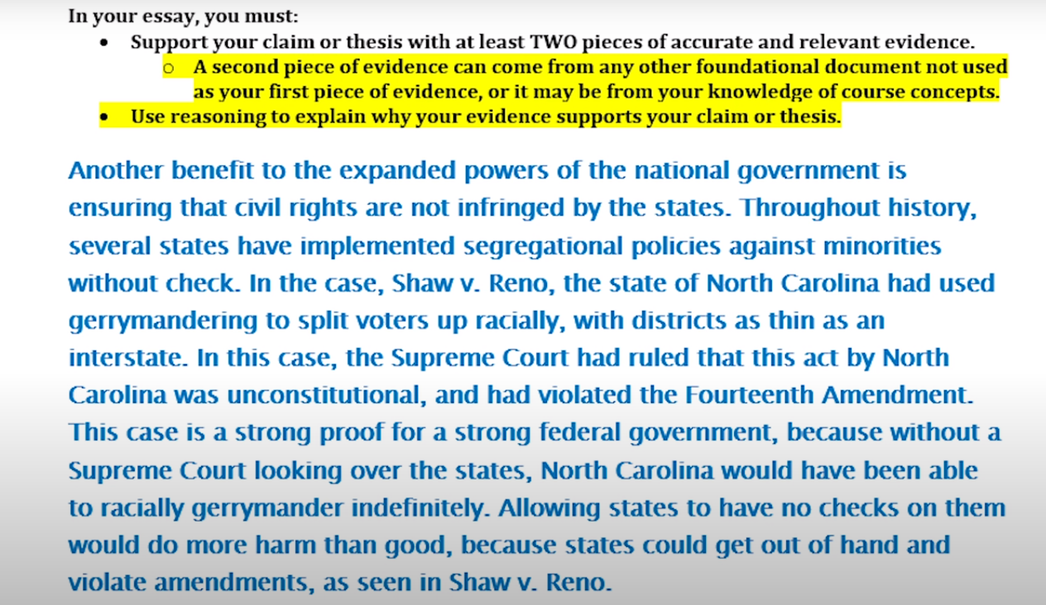

Slide 9
Reminders/Tips
-That’s it! No Conclusion paragraph needed!
-Remember, you only have 25 minutes to write, so you need to keep it straight to the point without getting too “fluffy”
-You also will not have enough time to try to look through the docs/notes/etc and write the essay, so get prepped before May 11!

