Slide 1
Unit III
Civil Liberties and Civil Rights
Twenty-Six (26) Forty-Five Minute Class Periods for the Year-Long Course
Thirteen (13) Forty-Five Minute Class Periods for the Semester-Long Course
Click here to view an outline that corresponds with this slideshow
Created December 2019
Version 1.0
ppaccone@smusd.us

Slide 2
This slideshow has been produced by San Marino High School AP US Government teacher Peter Paccone, with the help of a team of super talented educators and students spread throughout the nation.
Primarily produced for the benefit of AP US Government teachers wanting to present this slideshow in class, this slideshow may also prove of value for AP US Government teachers wanting to flip the learning AND for members of the general public wanting to learn more about civil liberties and civil rights
This slideshow is organized along the lines of what College Board calls the AP Government Topics and Enduring Understanding.
This slideshow uses media that are in the public domain. No graphic violence is shown. No political agenda is intended.
Any/all AP Government teachers should feel free to make a copy of this slideshow and edit in any way.

Slide 3
Topic 3.1
The Bill of Rights

Slide 4
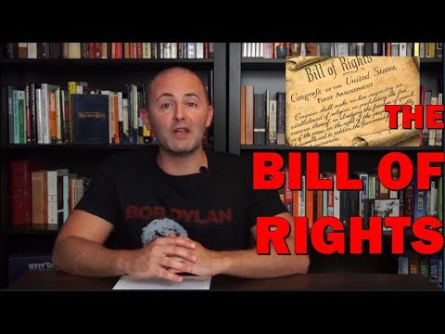
Intro to Section 3.1
The Bill of Rights
Carey LaManna
5:33

Slide 5
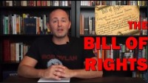

Slide 6
Topic 3.1: The Bill of Rights (LOR-2.A.1)
The U.S. Constitution includes a Bill of Rights specifically designed to protect individual liberties and rights.

Slide 7
Civil Rights v. Civil Liberties
Civil Liberties - Constitutionally established guarantees and freedoms that protect citizens, opinions, and property against arbitrary government interference. Protections against government actions. Generally found in the 1st Amendment. Also the 2nd, 3rd, 4th, 5th, 6th, and 8th Amendment.
Civil Rights - Constitutionally established guarantees and freedoms that protect citizens from discrimination based on such characteristics as race, disability, color, gender, national origin, and others. Generally found in the 14th Amendment.

Slide 8
The Bill of Rights
The first ten amendments to the United States Constitution.
Proposed following the often bitter 1787–88 debate over the ratification of the Constitution, and written to address the objections raised by Anti-Federalists
Guarantee various personal freedoms and rights, place clear limitations on the government's power in judicial and other proceedings, and explicitly declare that all powers not specifically granted to the U.S. Congress by the Constitution are reserved for the states or the people.

Slide 9
Built upon wording found in earlier documents, especially the Virginia Declaration of Rights (1776), as well as the English Bill of Rights (1689) and the Magna Carta (1215).
Due largely to the efforts of James Madison, who studied the deficiencies of the constitution pointed out by anti-federalists and then crafted a series of corrective proposals.
The amendments that were submitted for ratification applied only to the federal government, with the door for their application upon state governments opened in the 1860s, following ratification of the Fourteenth Amendment.
Since the early 20th century both federal and state courts have used the Fourteenth Amendment to apply portions of the Bill of Rights to

Slide 10
. . . state and local governments. The process is known as incorporation.

Slide 11
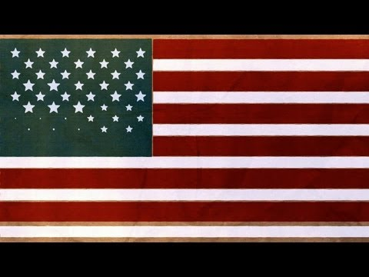
The Bill of Rights
TED-Ed
3:36

Slide 12
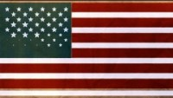
The Bill of Rights
TED-Ed
3:36

Slide 13
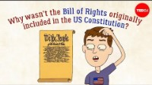
Why Wasn’t the Bill of Rights Originally in the Constitution
TED-Ed
4:42

Slide 14
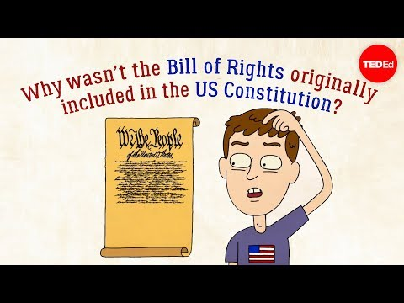
Why Wasn’t the Bill of Rights Originally in the Constitution
TED-Ed
4:42

Slide 15
Topic 3.1: The Bill of Rights (LOR-2.A.2)
Civil liberties are constitutionally established guarantees and freedoms that protect citizens, opinions, and property against arbitrary government interference.

Slide 16
Topic 3.1: The Bill of Rights (LOR-2.A.3)
The application of the Bill of Rights is continuously interpreted by the courts.

Slide 17
Topic 3.1: The Bill of Rights (LOR-2.B.1)
The Bill of Rights consists of the first ten Amendments to the Constitution, which enumerate the liberties and rights of individuals.

Slide 18
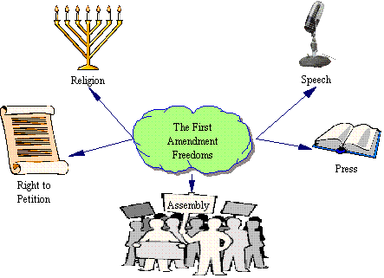
The First Amendment
Freedom of Speech
Freedom of Religion
Freedom of the Press
Freedom of Assembly
Right to petition the government

Slide 19
Topic 3.2
First Amendment
Freedom of Religions

Slide 20
In the Beginning….
Why did many people leave Europe and come to America?
  For religious freedom
Early in America, people could not worship freely
  Anne Hutchinson, banished from Massachusetts

Slide 21
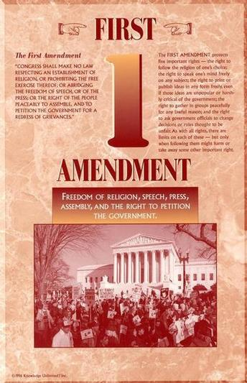
Framers and the constitution
Framers wanted 1st amendment to include freedom of religion
Why was this important to them?
  Religious restrictions in England

Slide 22
Freedom of Religion
“Congress shall make no law respecting an establishment of religion or prohibiting the free exercise there of”
Two clauses:
  Establishment clause
  Free Exercise clause

Slide 23
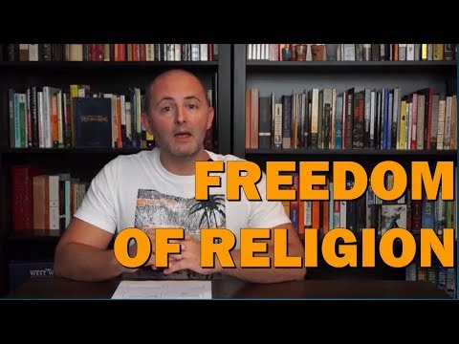
Intro to Section 3.2
Freedom of Religion
Carey LaManna
4:46

Slide 24
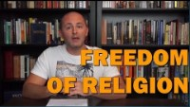

Slide 25
Topic 3.2: First Amendment: Freedom of Religion (LOR-2.C.1)
The interpretation and application of the First Amendment’s establishment and free exercise clauses reflect an ongoing debate over balancing majoritarian religious practice and free exercise, as represented by such cases as:
The Establishment Clause of the Constitution of the United States
The Free Exercise Clause of the Constitution of the United States
Engel v. Vitale (1962)
Wisconsin v. Yoder (1972)

Slide 26
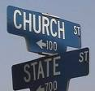
Establishment Clause
What does it mean to establish something?
“Congress shall make no law respecting an establishment of religion.”
NO single church or religion can dominate
“Separation” of church and state

Slide 27
The Establishment Clause
Found in the First Amendment to the United States Constitution.
The relevant constitutional text is: "Congress shall make no law respecting an establishment of religion"
Based on a number of precedents, including the Constitutions of Clarendon, the Bill of Rights 1689, and the Pennsylvania and New Jersey colonial constitutions.
Essentially written by James Madison
Prevents the Congress from passing legislation forcing an establishment of religion, broadly making it illegal for the government

Slide 28
. . . to promote theocracy or promote a specific religion with taxes.
While the Establishment Clause does prohibit Congress from preferring or elevating one religion over another, it does not prohibit the government's entry into the religious domain to make accommodations for religious observances and practices in order to achieve the purposes of the Free Exercise Clause. Furthermore, it does not prevent the placement of religious symbols on government premises.

Slide 29
The Phrase:
Separation of Church and State
This Phrase DOES NOT appear in the constitution, is a phrase used by Thomas Jefferson and others expressing an understanding of the intent and function of the Establishment Clause and Free Exercise Clause of the First Amendment to the Constitution of the United States. The phrase has since been repeatedly used by the Supreme Court of the United States.

Slide 30
Remember: many STATES did have official Religions
Colony | Denomination | Disestablished¹
Connecticut | Congregational | 1818
Georgia | Church of England | 1789²
Maryland | Catholic/Church of England | 1701/1776
Massachusetts | Congregational | 1780 (in 1833 state funding suspended)³
New Brunswick | Church of England
Nova Scotia | Church of England | 1850
Prince Edward Island | Church of England
South Carolina | Church of England | 1790
Canada West | Church of England | 1854
West Florida | Church of England | N/A^{6,7}
East Florida | Church of England | N/A^{6,7}
Virginia | Church of England | 1786⁸
West Indies | Church of England | 1868
y

Slide 31
The Free Exercise Clause
Found in the First Amendment to the United States Constitution.
The relevant constitutional text is: "Congress shall make no law prohibiting the free exercise (of religion)
In 1878, the Supreme Court was first called to interpret the extent of the Free Exercise Clause in Reynolds v. United States, as related to the prosecution of polygamy under federal law. The Supreme Court upheld Reynolds' conviction for bigamy, deciding that to do otherwise would provide constitutional protection for a gamut of religious beliefs, including those as extreme as human sacrifice.

Slide 32
The Court said: "Congress cannot pass a law for the government of the Territory which shall prohibit the free exercise of religion. The first amendment to the Constitution expressly forbids such legislation."[
Of federal territorial laws, the Court said: "Laws are made for the government of actions, and while they cannot interfere with mere religious beliefs and opinions, they may with practices."
Jehovah's Witnesses were often the target of such restriction. Several cases involving the Witnesses gave the Court the opportunity to rule on the application of the Free Exercise Clause. Subsequently, the Warren Court of the 1960’s adopted an expansive view of the clause, the "compelling interest" doctrine (whereby a state must show a compelling interest in restricting religion-related activities), with later decisions having reduced the scope of this interpretation.

Slide 33

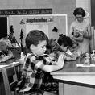
Rights for Religion in schools
Equal Access Act (1984)
  Allowed public high schools to hold religious group meetings in school

Slide 34
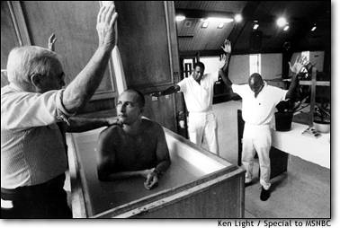
Free exercise of religion

Slide 35
Free Exercise—The person
Can Cannot
Choose whatever religion
Lead a prayer in most examples
Ask questions about religions
Worship who ever you want
Break the law and claim it is religious belief
Raise children without education
Deprave children of basic needs

Slide 36
Check for Understanding
Can they do this?
Congress passes a law banning the Muslim religion.
OK Not OK
The President takes his/her oath of office by swearing on a Christian Bible.
OK Not OK
Governor Martin O’Malley announces that he will only give government jobs to Catholics.
OK Not OK
The pledge of allegiance includes the phrase, “one nation under God,”.
OK Not OK

Slide 37
Engel v. Vitale (1962)
A landmark U.S Supreme Court case
The Court ruled that it is unconstitutional for state officials to compose an official school prayer and encourage its recitation in public schools.
Subject of intense debate.
Almighty God, we acknowledge our dependence upon Thee, and we beg Thy blessings upon us, our parents, our teachers and our country. Amen

Slide 38
Engel v Vitale

Slide 39
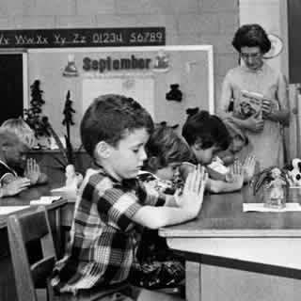
Case Background
1951- The New York State Board of Education issued a short nondenominational prayer for students to voluntary say before each school day.
The parents of 10 students in the New York Hyde Park School filed a lawsuit against the school because the prayer was contrary to their own beliefs.
The New York State Appeals Court ruled in favor of the school, saying that the prayer was only voluntary.

Slide 40
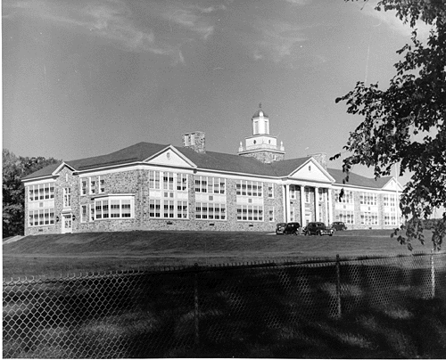
The Prayer
“Almighty God, we acknowledge our dependence upon Thee, and we beg Thy blessings upon us, our parents, our teachers and our Country.”

Slide 41
Arguments
Vitale (The School District)
The main argument of the school was that the prayer was nondenominational so it didn’t show support to one particular religion. Also, because the prayer was voluntary it wasn’t required for students to recite. The Education Board said they hoped the prayer would help the students become better citizens and create better morals.
Engel (The Parents)
Believed that having an established school prayer, even a voluntary one, violated the separation of church and state. Even though the prayer was also nondenominational, it still went against the students first amendment rights because it acknowledged a god.

Slide 42
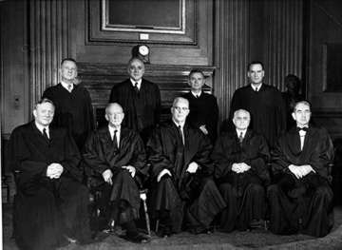
The Supreme Court
Made it to the Supreme Court in 1961
6 votes for Vitale, 1 vote, Justice Black, for Engel.
Justice Felix Frankfurter suffered a cerebral stroke that forced him to retire, and Justice Byron White took no part in the case
Significance- First of many cases where the Supreme Court began eliminating religious themes in many public ceremonies and activities by using the Establishment Clause.

Slide 43
School Prayer
Court banned school-sponsored Bible reading and recitation of Lord’s prayer
1985- Court ruled unconstitutional moment of silence for “mediation or voluntary prayer”
  Also, banned clergy-led prayer at graduation
  IN 2000, Supreme Court ruled against student led prayer in stadiums before football games

Slide 44
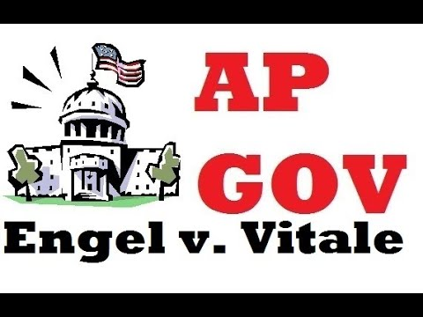
1962
Engel v. Vitale
Kelsey Falkowski
4:46

Slide 45
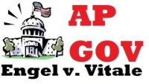

Slide 46
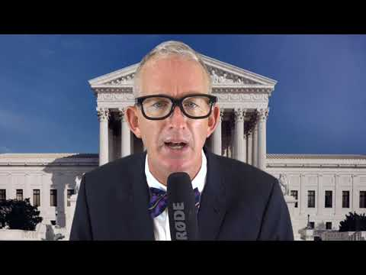
1962
Engel v. Vitale
My CitizenU
3:42

Slide 47
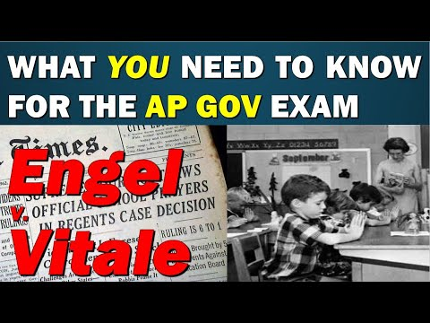
1962
Engel v. Vitale
Carey LaManna
5:47

Slide 48
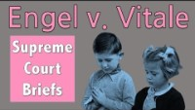

Slide 49
Wisconsin v. Yoder (1972)
A landmark U.S. Supreme Court case
The Court rule that Amish children could not be placed under compulsory education past 8th grade.
The Court determined that the parents' fundamental right to freedom of religion outweighed the state's interest in educating their children.
The case is often cited as a basis for parents' right to educate their children outside of traditional private or public schools.

Slide 50
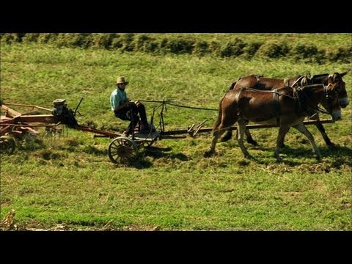
The Amish
Smithsonian Channel
2:28

Slide 51
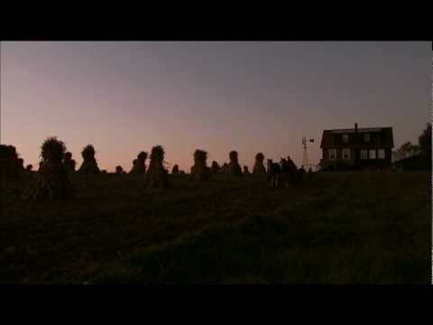
The Amish
American Experience
12:30

Slide 52
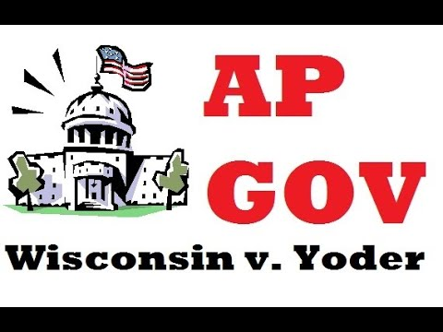
1972
Wisconsin v. Yoder
Kelsey Falkowski
5:04

Slide 53
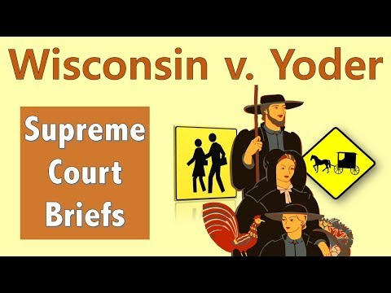
1972
Wisconsin v. Yoder
Mr. Beet
5:37

Slide 54
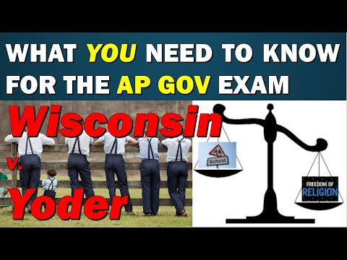
1972
Wisconsin v. Yoder
Carey LaManna
3:49

Slide 55
Establishment and free exercise clause often conflict with each other
In schools, the religion issue is most prevalent
If a student raises his hand and says “teacher, can we say an opening prayer before this test”
If the teacher says:
“Yes”, It looks like establishment of religion
“No”, It is deigning a student free exercise.

Slide 56
Establishment clause-Government
Cans Cannot
Teach about religions in school
Allow voluntary prayer in many examples
Transport students to a religious school
Read Bible for culture or literacy content
Set a state religion
Government cannot order a prayer
Teach religious doctrine in the school
Pay seminary teachers
Teach creationism

Slide 57
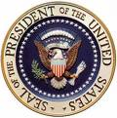



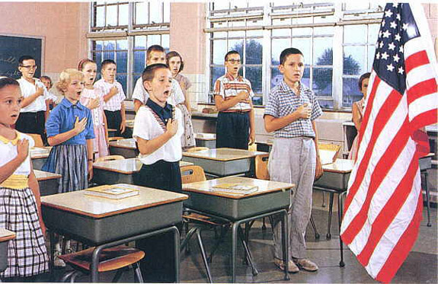
Religion in Public life
Presidential Inauguration
Money
Pledge of Allegiance...
  “one nation under GOD”

Slide 58
Does Government support Religion????
No, not directly
  Government officials don’t say “GO TO CHURCH”
Yes, indirectly
  Chaplains in the armed services

Slide 59

What do you think?
Should states give money to fund parochial schools?
The Lemon Test (1971) Lemon v Kurtzman
  State $$ doesn’t violate Establishment clause if…
    1. State aid must be secular
    2. Neither advance or inhibit religion
    3. Avoid excessive government entanglement with religion

Slide 60

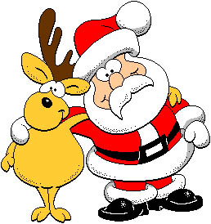

A few examples of the Lemon Test
bad
good
In County of Allegheny v. ACLU (1989), the Supreme Court ruled that a nativity scene in a county building was unconstitutional because the display included only the nativity scene and poinsettias, with no secular symbols.
In Lynch v. Donnelly (1984), the Supreme Court ruled that a nativity scene displayed in Pawtucket, Rhode Island, did not violate the Establishment Clause because it included secular symbols such as Santa Clause and reindeers. The Court concluded that the Pawtucket display was simply a celebration of the season, and so it was fine.
Also in Allegheny, the Court ruled that a Pittsburgh display of a giant menorah on public property was constitutional because it also included a 45-foot Christmas tree, thus “minimizing the likelihood” that the menorah would be taken as an endorsement of Judiasm.

Slide 61
Topic 3.3
First Amendment
Freedom of Speech

Slide 62

Basics of Free Speech:
Every American wants the right to speak freely
But….
Some Americans want to deny others their right to speak freely if they disagree with their views
  Ex. Religion, War, Politics

Slide 63

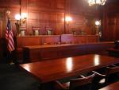
Courts distinguish different types of Speech
Many actions can be a type of speech
  Verbal
  Non-verbal – Wearing a shirt, shaving your head

Slide 64

Protected Speech
2 types of speech protected by 1stAmendment

Slide 65

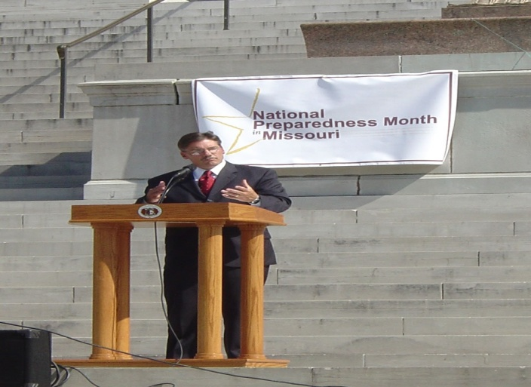

Pure Speech
Verbal expression of thought or opinion before an audience that has chosen to listen
Examples: dinner table, church, political assembly

Slide 66
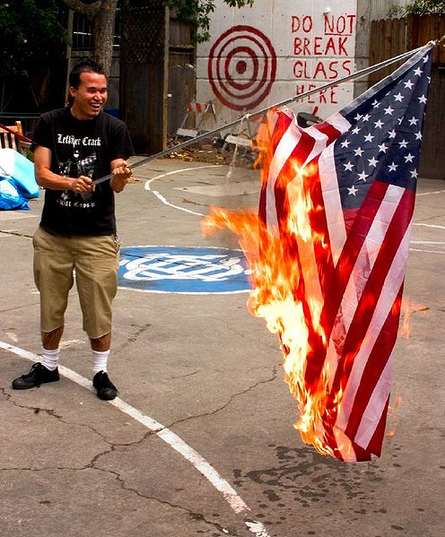
Symbolic Speech
Using actions or symbols, with or without words, to express opinions
  Ex. Burning US flags to protest Vietnam War
  Restrictions??
    Ex. Attacks on Abortion Clinics
    Court has ruled 1st Amendment does not permit actions that threaten public safety

Slide 67
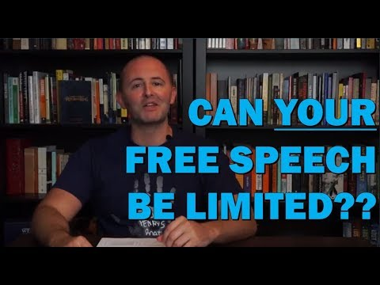
Intro to Section 3.3
Freedom of Speech
Carey LaManna
5:52

Slide 68
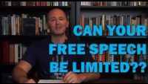

Slide 69
Freedom of Speech
In the United States, freedom of speech and expression is strongly protected from government restrictions by the First Amendment to the United States Constitution, many state constitutions, and state and federal laws.
The Supreme Court of the United States has recognized several categories of speech that are given lesser or no protection by the First Amendment and has recognized that governments may enact reasonable time, place, or manner restrictions on speech.
The First Amendment's constitutional right of free speech only

Slide 70
. . . prevents government restrictions on speech, not restrictions imposed by private individuals or businesses unless they are acting on behalf of the government.
Categories of speech that are given lesser or no protection by the First Amendment include obscenity, fraud, child pornography, speech integral to illegal conduct, speech that incites imminent lawless action, and regulation of commercial speech such as advertising.
Within these limited areas, other limitations on free speech balance rights to free speech and other rights, such as rights for authors over their works (copyright), protection from imminent or potential violence against particular persons, restrictions on the use of untruths to harm

Slide 71
others (slander and libel), and communications while a person is in prison.

Slide 72
The Free Speech Clause
Found in the First Amendment to the United States Constitution.
The relevant constitutional text is: "Congress shall make no law abridging the freedom of speech.

Slide 73
Topic 3.3: First Amendment: Freedom of Speech (LOR-2.C.2)
The Supreme Court has held that symbolic speech is protected by the First Amendment, demonstrated by Tinker v. Des Moines Independent Community School District (1969), in which the court ruled that public school students could wear black armbands in school to protest the Vietnam War.

Slide 74
Tinker v. Des Moines (1969)
A landmark U.S Supreme Court case
The Court ruled that the First Amendment applied to public schools, and that administrators have to demonstrate constitutionally valid reasons for any specific regulation of speech in the classroom.
"It can hardly be argued,” said the majority opinion, “that either students or teachers shed their constitutional rights to freedom of speech or expression at the schoolhouse gate."
The Court went on to say that for school officials to justify censoring speech, they "must be able to show that [their] action was caused by

Slide 75
. . . something more than a mere desire to avoid the discomfort and unpleasantness that always accompany an unpopular viewpoint," that the conduct that would "materially and substantially interfere with the requirements of appropriate discipline in the operation of the school."
The “Tinker Test”, also known as the "substantial disruption" test, is still used by courts today to determine whether a school's interest to prevent disruption infringes upon students' First Amendment rights.

Slide 76
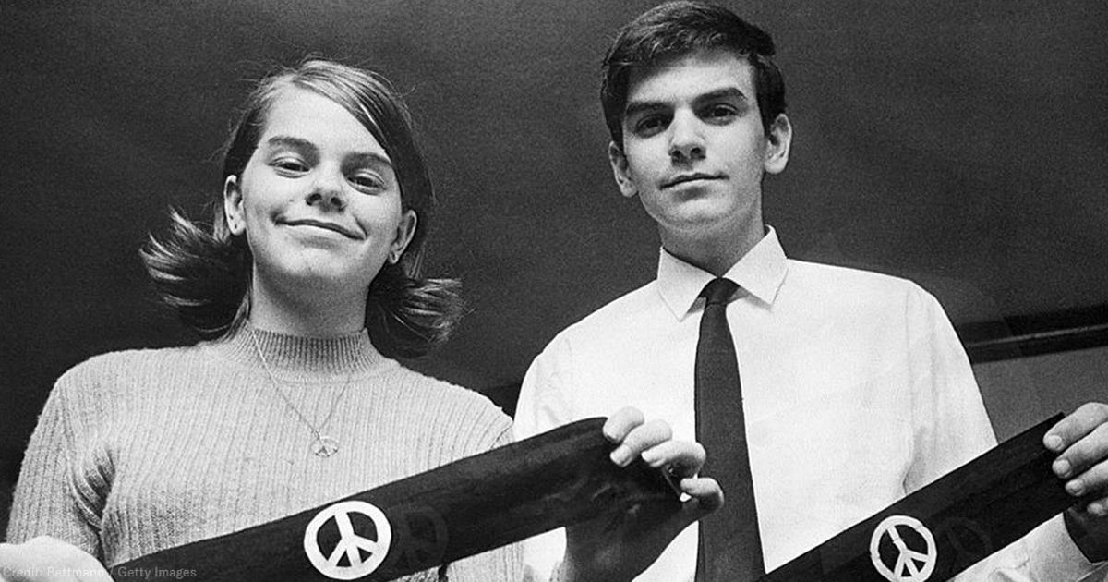

Slide 77
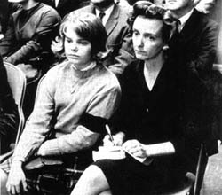
Tinker v Des Moines (1969)
Students wore black arm band to protest Vietnam War.
The students were suspended from school for violating the school’s dress code.
Their parents sued the school district!
The Tinkers claimed suspension violated their first amendment right to Free Speech.
What do you think? Can the school district tell kids what they can and can not wear?

Slide 78
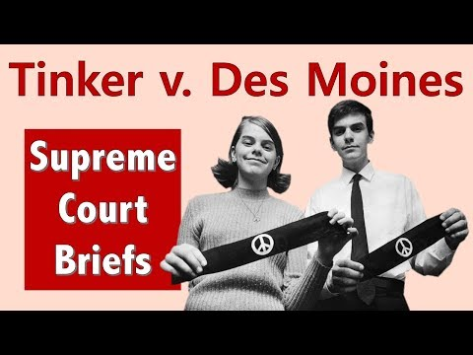
1969
Tinker v. Des Moines
Mr. Beet
5:05

Slide 79
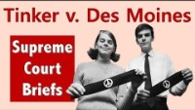

Slide 80
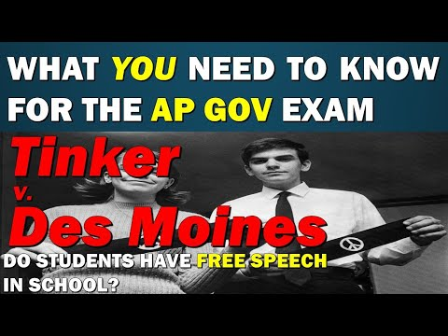
1969
Tinker v. Des Moines
Carey LaManna
6:03

Slide 81
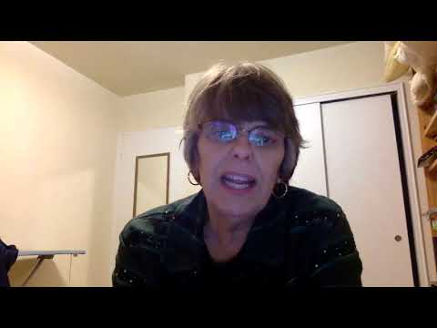
Mary Beth Tinker and the Question of Whether She Ever Received any Hate Mail?
Peter Paccone
1:01

Slide 82
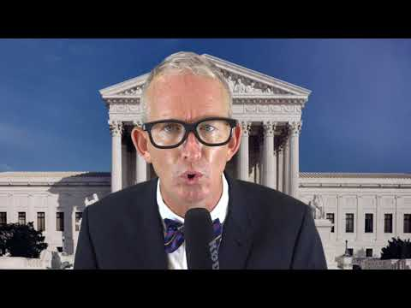
1969
Tinker v. Des Moines
MyCitizenU
3:07

Slide 83
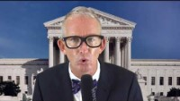

Slide 84
7-2 Decision in favor of the Tinkers
Majority Opinion
Students keep their constitutional right of freedom of speech while in public School
School officials must provide constitutionally valid reasons for regulating student expression
School officials must show: “material and substantial disruption” with the discipline and education of students
Wearing armbands was a “silent, passive expression of opinion”
Students do not “shed their constitutional rights to freedom of speech or expression at the schoolhouse gate.”
Dissenting (minority) Opinion
“myth to say that any person has a constitutional right to say, what he pleases, where he pleases and when he pleases.”
Armbands were a distraction taking students minds off their school work
Ruling too restrictive on school officials- limiting control over their schools
There must be recognition of authority of schools and school officials.

Slide 85
Tinker v. Des Moines
What happened?
The famous quote…
"It can hardly be argued that either students or teachers shed their constitutional rights to freedom of speech or expression at the schoolhouse gate.“
The famous quote…
Administrators "must be able to show that [their] action was caused by something more than a mere desire to avoid the discomfort and unpleasantness that always accompany an unpopular viewpoint,"
Information obtained from: http://www.splc.org

Slide 86
Topic 3.3: First Amendment: Freedom of Speech (LOR-2.C.3)
Efforts to balance social order and individual freedom are reflected in interpretations of the First Amendment that limit speech, including:
Time, place, and manner regulations
Defamatory, offensive, and obscene statements and gestures
Tinker v. Des Moines Independent Community School District (1969)
Schenck v. United States (1919)

Slide 87
Schenck v. United States (1919)
A landmark U.S. Supreme Court case
Related enforcement of the Espionage Act of 1917 during World War
A unanimous Supreme Court ruled that in the circumstances were the speech posed a "clear and present danger" of succeeding, the speech could be punished.

Slide 88
Attacks on
Civil Liberties
( Bill of Rights )

Slide 89
National Security vs. Civil Liberties
Espionage Act – 1917
forbade actions that obstructed recruitment or efforts to promote insubordination in the military.
ordered the Postmaster General to remove Leftist materials from the mail.
fines of up to $10,000 and/or up to 20 years in prison.

Slide 90
US ENTRY INTO WWI
Espionage & Sedition Act, 1918
Provided for up to $10,000 in fines and 20 years in prison for interfering with the war effort or using disloyal language.
At least 1,597 persons were arrested, and 41 received prison sentences; newspapers criticizing the government lost mailing privileges.
Congress and President Wilson enacted this law to promote patriotism, nationalism and protect the National Security of the US during WWI.
congress actions

Slide 91
National Security vs. Civil Liberties
Sedition Act – 1918
It was a crime to speak against the purchase of war bonds or willfully utter, print, write or publish any disloyal, profane, scurrilous, or
abusive language about this form of US Govt.,
the US Constitution, or the US armed forces or to willfully urge, incite, or advocate any curtailment of production of things necessary or essential to the prosecution of the war…with intent of such curtailment to cripple or hinder, the US in the prosecution of the war.

Slide 92

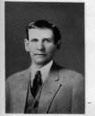
Schenk vs. United States, 1919
In 1917 the United States was at War with Germany. WWI
Charles Schenk, a member of the Socialist Party, handed out leaflets condemning the war and urging young men to resist the military draft.
He was arrested and convicted for violating the Espionage and Sedition Act of 1917.
Schenk took his case to the United States Supreme Court arguing that his constitutional right to freedom of speech had been violated.

Slide 93
Schenk vs. United States, 1919
Issue
Can “free speech” be censored or restricted during war time?

Slide 94
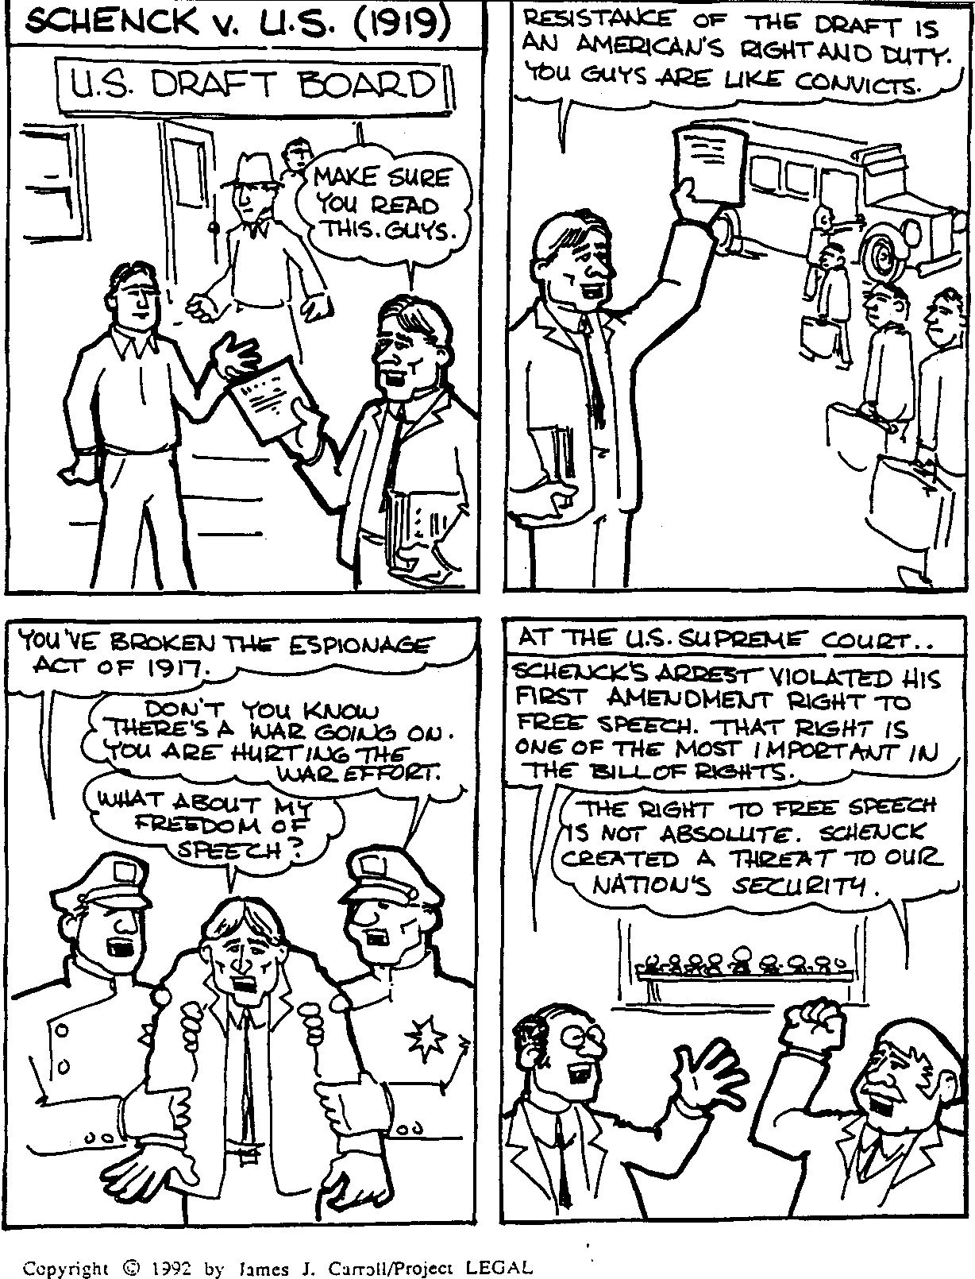

Slide 96
Schenk vs. United States, 1919
SC ruling: Disagreed with Schenk
Majority opinion
Oliver Wendel Holmes
BUT, every act of speech must be judged according to the circumstances in which it was spoken.
The most stringent protection of free speech would not protect a man in falsely shouting fire in a theater and causing a panic.
"Words can be weapons . . .The question in every case is whether the words used in such circumstances are of such nature as to create a clear and present danger that they will bring about the substantive evils that Congress has the right to prevent."

Slide 97
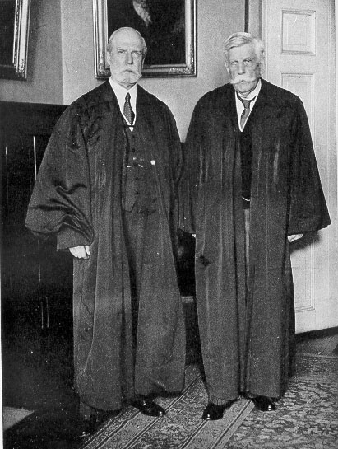
Schenk vs. United States, 1919
Under normal circumstances, his actions would have been protected by 1st amendment
The country was at war, Schenk's freedom of speech was not protected.
SC ruling meant there were limits to freedom of speech in war time.
From the ruling, the Court established the "clear and present danger" principle to decide whether or not certain kinds of speech are protected.

Slide 98
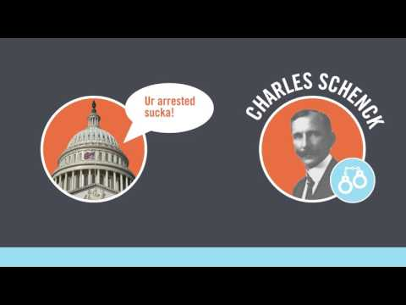
1919
Schenck v. US
Bill of Rights Institute
3:17

Slide 99
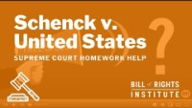

Slide 100
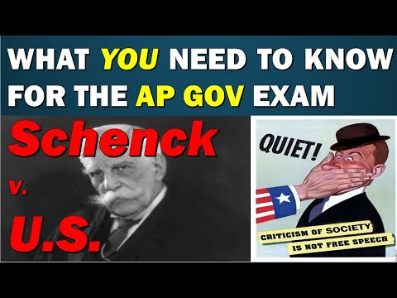
1919
Schenck v. US
Carey LaManna
5:59

Slide 101
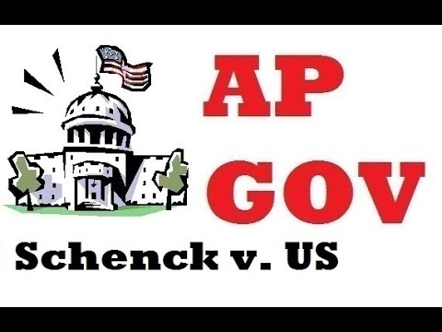
1919
Schenck v. US
Kelsey Falkowski
4:36

Slide 102
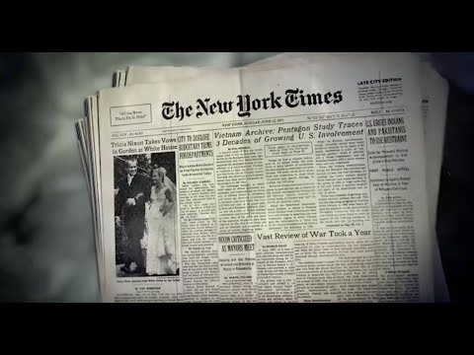
1919
Schenck v. US
Annenberg Classroom
25:18

Slide 103

Texas vs. Johnson
Argued: March 21, 1989
Decided: June 21, 1989

Slide 104
Constitutional Issue
First Amendment
  Congress shall make no law respecting an establishment of religion, or prohibiting the free exercise thereof; or abridging the freedom of speech, or of the press; or the right of the people peaceably to assemble, and to petition the Government for a redress of grievances.
  — The First Amendment to the U.S. Constitution

Slide 105
Litigant # 1
The criminal appeals of Texas
  Texas court convicted Johnson for 1 year with a 2,000 dollar fine for desecration of a venerated object (U.S flag) in violation of a Texas law
Litigant # 2
Gregory Lee Johnson
  Burned the American flag as means of protest against Reagan administration policies violating Texas law

Slide 106
Background of Case
They were marching for protest of Reagan's election, at one point a flag was stolen from a flagpole and handed to Johnson where he started burning it. He appealed his conviction to the Fifth court of Appeals of Texas, but he lost this appeal. The Texas Court of Criminal Appeals would then see his case. This was the highest court in Texas that would see Criminal Appeals. That court overturned his conviction, saying that the State could not punish Johnson for burning the flag because the First Amendment protects such activity as symbolic speech.

Slide 107
Majority Opinion
5 votes for Johnson
4 votes against
The Government may not prohibit the verbal or nonverbal expression of an idea merely because society finds the idea offensive or disagreeable, even where our flag is involved. Nor may a State foster its own view of the flag by prohibiting expressive conduct relating to it, since the Government may not permit designated symbols to be used to communicate a limited set of messages.

Slide 108
Other Opinions
Chief Justice Dissented
  Chief Justice believes that Johnson's conduct may have been prohibited and, indeed, criminally sanctioned, because "his act passed on nothing good to the rest of the people

Slide 109
Significance
The case was important because it showed people that you have the right to show your opinion in many different ways. And that you have the right to do it according to the 1st amendment.

Slide 110
Regulating Speech
Rights Of
Free Speech
Need To
Protect Society

Slide 111
Court’s decisions based on 3 views
“Clear and Present Danger”- if speech presents an immediate danger it is not protected by the 1st amendment
  Ex. Public Safety Issue- Terrorist Threat

Slide 112
View #2-
Bad Tendency Doctrine
Restricted even more speech
  Example: If speech might lead to illegal action
  Q: What do supporters of this view consider more important, maintaining social order or protecting basic freedoms?
  A: Maintaining Social Order

Slide 113

View #3-
Preferred Position Doctrine
1st Amendment freedoms are more fundamental than any other freedoms
SO… if a law prohibits freedoms it must be absolutely necessary or it is unconstitutional

Slide 114


Types of Speech NOT Protected
1. Defamatory Speech- false speech that damages a person’s good name, character, or reputation
  2 Types
    Slander- Spoken
    Libel- written

Slide 115

Types of Speech NOT Protected
2. “Fighting Words”- insulting words that provoke immediate violence
    “any offensive, derisive, or annoying word to any other person who is lawfully in any street or public place”

Slide 116

Types of Speech NOT Protected
3. Student Speech- profane and indecent speech on school property or at school events is subject to suspension
The same speech is
protected outside school

Slide 117

Student Speech
Tinker v. Des Moines- ruled that students do not give up all their freedoms in school
Bethel School District v. Fraser (1986)- ruled that school officials can decide what manner of speech is appropriate in school
Court established a distinction between
  Student’s personal expression
  Speech appropriate in school

Slide 118

https://www.cnn.com/videos/tv/2021/01/02/cheerleaders-first-amendment-case-could-go-to-scotus.cnn

Slide 119
Free speech– The individual can:
Say any political belief
Protest (without getting out of control)
Say things about someone that are true
Burn the flag
Say racist and hate slogans
Free speech means someone might say something you disagree with

Slide 120
Free speech— limits on the person
Cannot threaten to blow up airplanes, schools or the president
Sexual harassment
Create too much social chaos
Extremely crude language in a public form
Disrespectful, vulgar language in schools
Hate crimes

Slide 121
Online Free Speech
Osborne v. Ohio
Communications Decency Act ( CDA )
Child Online Protection Act ( COPA )
Child Pornography Prevention Act ( CPPA )

Slide 122
Topic 3.4
First Amendment
Freedom of the Press

Slide 123

Intro to Section 3.4
Freedom of the Press
Carey LaManna
2:43

Slide 124
New York Times v Sullivan

Slide 125
NYT v Sullivan
January 6, 1964
Full page ad in the Times asking for money to defend MLK against perjury charges
Ad said that MLK had been arrested 7 times, which was untrue (actually 4)
L.B. Sullivan, Montgomery Safety Commissioner, considered the ad defamatory, as he was in charge of the police (libel)

Slide 126
Sullivan, contd
Sullivan asked the Times to retract the ad
They refused, but later acquiesced upon request from Alabama governor John Patterson
Case went to Supreme Court, where they ruled 9-0 in favor of the Times
No “actual malice” was found, so, under the 1st and 14th amendments, no damages can be awarded
Term “actual malice” was adopted, was given meaning and importance

Slide 127





What is, or who is, the "Press"?

Slide 128
Topic 3.4: First Amendment: Freedom of the Press (LOR-2.C.4)
In New York Times Co. v. United States (1971), the Supreme Court bolstered the freedom of the press, establishing a “heavy presumption against prior restraint” even in cases involving national security.
New York Times Co. v. United States (1971)

Slide 129
Freedom of the Press
Freedom of the press is legally protected by the First Amendment to the United States Constitution.
Nevertheless, freedom of the press In the United States is subject to certain restrictions, such as defamation law, a lack of protection for whistleblowers, barriers to information access and constraints caused by public hostility to journalists.
The principle that communication and expression through various media, including printed and electronic media, especially published materials, should be considered a right to be exercised freely.

Slide 130
Such freedom implies the absence of interference from an overreaching state; its preservation may be sought through constitutional or other legal protections.

Slide 131



In today’s world the press includes magazines, radio, and television along with newspapers.
Prior Restraint Forbidden
In many nations prior restraint, censorship of information before it is published, is a common way for the government to control information and limit freedom.
The Supreme Court has ruled that the press may be censored in advance only in cases relating directly to national security.

Slide 132
Prior Restraint
Also referred to as pre-publication censorship is censorship imposed by the government on expression
It is in contrast to censorship which establishes general subject matter restrictions and reviews a particular instance of expression only after the expression has taken place.
In the United States prior restraint by the government is forbidden, subject to certain exceptions (such as classifying certain matters of national security)

Slide 133
Prior restraint can be effected in a number of ways.
  The exhibition of works of art or a movie may require a license from a government authority before it can be published, and the failure or refusal to grant a license is a form of censorship as is the revoking of a license.
  It can take the form of a legal injunction or government order prohibiting the publication of a specific document.
  It can also take the form of a (usually secret) policy imposed by a commercial corporation upon its employees, requiring them to obtain written permission to publish a given written work, even one authored outside of work hours produced using their own computing resources.

Slide 134
The Free Press Clause
Found in the First Amendment to the United States Constitution.
The relevant constitutional text is: "Congress shall make no law abridging the freedom of the press

Slide 135


Near v. Minnesota (1931)
This case involved a law prohibiting the publication of “malicious, scandalous, or defamatory” newspapers or magazines.
The Court ruled the law unconstitutional because it involved prior restraint.
The Court stressed that a free press means freedom from government censorship.
New York Times Co. v. United States (1971)
This case involves leaked U.S. involvement in the Vietnam War from the Pentagon.
It is also known as the Pentagon Papers case.
The Court ruled that the government cannot stop further publication of the papers by arguing that national security would be endangered.
The Court determined that stopping publication would be prior restraint.

Slide 136
“Pentagon Papers,”
1971
Former defense analyst Daniel Ellsberg
leaked govt. docs. regarding war efforts during Johnson’s administration to the
New York Times.
Docs.→ Govt. misled Congress & Amer. People regarding its intentions in Vietnam during mid-1960s.
  Primary reason for fighting not to
  eliminate communism, but to avoid humiliating defeat.
  New York Times v. United States (1971) *
Notes:
Nixon resigns over the Watergate Scandal in 1974.
Ford takes the helm.

Slide 137
New York Times Co. v. United States (1971)
A landmark U.S. Supreme Court case
The ruling made it possible for The New York Times and The Washington Post newspapers to publish the then-classified Pentagon Papers without risk of government censorship or punishment.
President Richard Nixon had claimed executive authority to force the Times to suspend publication of classified information in its possession. The question before the court was whether the constitutional freedom of the press, guaranteed by the First Amendment, was subordinate to a claimed need of the executive

Slide 138
branch of government to maintain the secrecy of information. The Supreme Court ruled that the First Amendment did protect the right of The New York Times to print the materials.

Slide 139

What Were the Pentagon Papers?
History
3:57

Slide 140

1971
New York Times v. US
Mr. Beat
6:09

Slide 141

New York Times v.United States (1971)
What happened???
  Former Pentagon employee
  Secret Government info
  LEAKED to PRESS!!!!
  U.S. officials were LIARS!!!
  Government mad ☹
  Court Ruled ☺

Slide 142

1971
New York Times v. US
Carey LaManna
5:42

Slide 143

Gag orders unconstitutional
Judge prevents press from publishing certain types of info about a pending court case

Slide 144
Richmond Newspapers v. Virginia
Press under First Amendment has a right to attend a trial.
The constitutionally protected right to free discussion of governmental affairs embraces the right of access.
Judge for “good cause” may close a portion of a trial.

Slide 145
Gag Orders
Trial judge has authority to limit information that the parties and counsel may provide to the media.
Sheppard v. Maxwell
  The movies and television series of the fugitive
Violation of gag order punished by contempt.

Slide 146
Sheppard v Maxwell
An 8-1 Supreme court ruling on a case reviewing freedom of press

Slide 147


The Facts
He was accused→ of Killing Her→
because they→ became too influential

Slide 148
The Problem…
The press got too involved during the court case and freedom of press came into question.
According to oyez.com the press had
“repeated broadcasts of Sheppard confessing in detail to crimes he was later charged with, the blatant and hostile trial coverage by Cleveland's radio and print media, and the physical arrangement of the courtroom itself”
Due to the media’s influence, convicted of second degree murder.
trial was unfair because:
  the press had interfered with his right in the 5th amendment
  They had overstepped their privileges given by the 1st amendment

Slide 149
The reasoning
1st amendment states the freedom of the press, overstepping of boundaries.
the media overstepped their boundaries by interfering with Sheppard’s 5th amendment.
The press had influenced the jurors instead of participating in an objectionable, unbiased, calm, courtroom.(oyez.com)
  Papers told police to bring him in and they did.

Slide 150
The ruling
The final ruling was an overwhelming 8 votes to 1 ruling for Sheppard, stating that the media did create an unfair trial for him.
So this case showed that the press did overstep their privilege from the 1st amendment.

Slide 151


Fair Trials and Free Press
In recent years the 1st Amendment right of free press an the 6th Amendment right to a fair trial have sometimes conflicted.
Sheppard v. Maxwell (1966)
Pretrial and courtroom publicity and news stories about a crime can make it difficult to secure a jury capable of fairly deciding a case.
The Court overturned the conviction of Samuel Sheppard because press coverage had interfered with his right to a fair trial.
The Court described measures to ensure a defendant has a fair criminal trial:
  Move the trial to reduce publicity
  Limit number of reporters in the room
  Place controls on reporters conduct in the room
  Keep the jury isolated or sequestered

Slide 152
Gannett Co. v. DePasquale
Press and public may be excluded from pretrial hearings.
Adverse publicity prior to trial may hinder right of defendant to a fair trial.
General rule, no closed hearings without a strong showing of prejudice to the requesting party (defendant or prosecutor).

Slide 153


Gag Orders Unconstitutional
After the Sheppard case, a number of trial judges began to use gag orders to restrain the press.
A gag order is an order by a judge barring the press from publishing certain types of information about a pending case.
The Court has ruled that vague or broad gag orders are unconstitutional.
Press Access to Trials
The Court ruled in the late 1970s that the public and the press could be barred from certain pretrial hearings.
The press can be barred only if the trial judge found a “reasonable probability” that publicity would harm the defendant’s right to a fair trial.

Slide 154







Free Press Issues
If the Founding Fathers only knew….
  Email
  Motion Pictures
  Advertising
FCC
  Government regulation of radio and TV

Slide 155


Protecting News Sources
Many reporters argue that they have the right to refuse to testify in order to protect confidential information and its source.
The Court has determined that reporters do not have such a right.
40 U.S. states, including California, have shield laws.
Shield laws give reporters some means of protection against being forced to disclose confidential information or sources in state courts.
Free Press Issues
In writing the 1st Amendment, the Founders thought of the press as printed material.
They could not foresee the growth of technology and the new issues regarding the freedom of the press.

Slide 156



Radio and Television
Because radio and broadcast television use public airwaves, they do not enjoy as much freedom as other press media.
Stations must obtain a license from the Federal Communications Commission (FCC), a government agency that regulates their actions.
The FCC may punish stations that broadcast obscene or indecent language.
The Court determined in the late 1990s that cable operators are not entitled to maximum 1st Amendment protections because there is typically only one cable operator in a community.
Motion Pictures
The Court decided in the early 1950s that “liberty of expression by means of motion pictures is guaranteed by the 1st and 14th Amendments.”

Slide 157



E-Mail and the Internet
Congress passed the Communications Decency Act to try to prevent children from having access to indecency.
The Court in the late 1990s struck down portions of this law and stated that speech on the Internet was entitled to 1st Amendment protection.
Obscenity
In Miller v. California (1973) the Court ruled that, in effect, local communities should set their own standards for obscenity.
The Court may still overrule specific acts made by local authorities.

Slide 158



Advertising
Advertising is considered “commercial speech” and is given less protection under the 1st Amendment than pure speech.
Since the mid-1970s the Court has relaxed controls for advertising for abortion clinics, prescription drug pricing, legal services, and medical services.
It has also limited regulation of billboards, “for sale” signs, and lawyer’s advertisements.

Slide 159
https://timeline.com/skokie-trial-white-supremacy-aclu-free-speech-history-4f71f0a12025

Slide 160


Rightness to Peaceably Assemble Challenged: The Skokie March
What was this event??
Who is this??

Slide 161

The Nazis in Skokie
In 1977 the American Nazi Party planned to
have a rally in the largely Jewish suburb of Skokie, Chicago.
This outraged the residents of which many were Holocaust survivors.
To prevent the march, the city required the American Nazi Party to post a $300,000 bond and get a permit.
The Nazis claimed the high bond interfered with their freedoms of speech and assembly.
The federal court of appeals ruled that no community could use parade permits to interfere with free speech and assembly.
The Skokie case illustrates the heckler’s veto problem.
A heckler’s veto is when the public vetoes the free speech and assembly rights of unpopular groups by claiming demonstrations will result in violence.

Slide 162


Rightness to Peaceably Assemble Challenged: The Skokie March
Illinois, Chicago is largest city
Village of Skokie, in Chicago

Slide 163


Sadness in Skokie
Frank Joseph Collin
Skokie residents,
Holocaust survivor

Slide 164

Skokie Ruling
NATIONAL SOCIALIST PARTY v. SKOKIE (1977)
The Supreme Court ruled they were allowed to march without wearing Swastika Armbands.
First Amendment freedoms must apply to EVERYONE, if those with whom we disagree!

Slide 165


Freedom of Assembly
Freedom of Assembly = Freedom of Speech ????? =

Slide 166



Mall Bans Teens
3,000 Saturday night
Under 16??
No go, without adult

Slide 167
The Right to Assemble and
Petition the Governor
  The Supreme Court has held that state and local governments cannot bar individuals from assembling. State and local governments can require permits for such assembly so that order can be maintained. However the government cannot be selective as to who receives the permit.
    Street Gangs.
    Online Assembly

Slide 168





The 1st Amendment guarantees “the right of the people peaceably to assemble, and to petition the government for a redress of grievances.”
It protects the right to make views known to public officials and others by such means as petitions, letters, lobbying, carrying signs in a parade, or marching.
Protecting Freedom of Assembly
Freedom of assembly is a right closely related to freedom of speech because most gatherings involve some form of protected speech.

Slide 169


DeJonge v. Oregon (1937)
Dirk DeJonge was convicted for conducting a public meeting sponsored by the Communist party.
The Court ruled that the Oregon law was unconstitutional.
The DeJonge case established two principles:
  The right of assembly was as important as the rights of free speech and free press.
  The due process clause protects
  freedom of assembly from state
  and local governments.
  Without freedom of assembly
  there would be no political parties
  or interest groups to influence the
  actions of government.

Slide 170





Assembly on Public Property
Freedom of assembly includes the right to parade and demonstrate in public.
Because these forms of assembly usually occur in parks, streets, or on sidewalks, it makes it possible that they could interfere with the rights of others to use the same facilities.
Conflict may also arise during demonstrations for unpopular causes.
For such reasons, they are subject to greater government regulation than exercises of pure speech.

Slide 171



Limits on Parades and Demonstrations
Currently, the Court maintains that states or cities may require permits and other restrictions for parades and demonstrations.
The decision is not intended to silence unpopular ideas but to provide for public order and safety.
Additional Limits on Public Assembly
In the mid-1960s the Court decided that:
  Demonstrators could not enter the grounds of a county jail without permission.
  Demonstrations and parades are not allowed near courthouses if they could interfere with the trial.
In the early 1970s the Court voided a city law that banned all demonstrations near school buildings except in the case of picketing by labor unions.
Picketing is patrolling an establishment to convince workers and the public not to enter it.

Slide 172


Assembly and Property Rights
The right to assemble does not allow a group to convert private property to its own use, even if the property is open to the public.
For example, protesters cannot gather in shopping malls and pro-life protestors cannot block the entrance to abortion clinics.
Public Assembly and Disorder
Police sometimes have difficulty protecting our right to assemble when public assemblies threaten public safety.

Slide 173


Freedom of Assembly does NOT allow…
Assembly on Private property
Parade or Demonstration
without a permit

Slide 174


Feiner v. New York (1951)
The Court ruled that the police can limit freedom of assembly to preserve public order.
Gregory v. City of Chicago (1969)
The Court overturned the disorderly conduct conviction of Gregory and ruled that the demonstrators had been peaceful and had not done more than exercise their 1st Amendment rights.
It was the neighborhood residents, not the marchers, that caused the disorder.
Protection for Labor Picketing
The Court has decided:
  Peaceful picketing is a from of free speech (1940)
  Cannot picket to force a business to hire African American workers (1950)
  Cannot picket unless there is a labor dispute (1957)

Slide 175


Freedom of Association
In the DeJonge v. Oregon (1937) case, the Court extended the right to freely assemble to protect the right of individuals to freedom of association.
Individuals may freely join a political party, interest group, or other organization.
Whitney v. California (1927)
The Court ruled that the government must show a clear and present danger exists to limit Constitutional freedoms.
In later cases, the Court ruled that only actual preparations for the use of force against the government were punishable.

Slide 176

???? Questions ????
A local policeman arrests you and your friends for driving four wheelers on the highway in Midland. To get back at him you hold an assembly on his lawn to protest his actions.
  Can you do this???
  NO!!! You can’t hold an assembly on private property, even if he did confiscate your four wheelers.

Slide 177

???? Questions ????
Lee starts the “America Against Old Ladies” group. This group is VERY unpopular with the public, but continues to exist and dislike old ladies, especially their driving. Lee’s group decides to have a demonstration in Ft. Lauderdale, Florida, an old folks community. The old folks oppose this event.
  Can Lee’s group have this demonstration?
  Yes, even unpopular groups have the right to assemble!

Slide 178

???? Questions ????
Danielle and Jodie skip school to hold a parade on Main Street. Although the parade is just the two of them, a large crowd forms to watch them march. Several cars veer off the road to avoid hitting the two girls, unfortunatley the car takes out a Pizza shop (RELAX, there are 10 more) and part of the crowd of onlookers.
  What document could the girls have gotten to avoid this mess???
  A Permit!

Slide 179

???? Questions ????
Your uncle’s wife’s brother’s step-son’s dog was found digging up questionable smoking materials in your best friend’s yard. Your friend is arrested and charged with possession. The next day the Cumberland Times News has an article about the incident on the front page. Your friend is released from jail, but is fired from his job.
  Did the newspaper have the right to print the arrest and charges so that all local readers would see???
  Yes!!! Freedom Of Press!!!

Slide 180
Topic 3.5
First Amendment
Right to Bear Arms

Slide 181


Slide 182

Intro to Section 3.5
Right to Bear Arms
Carey LaManna
3:59

Slide 183
Topic 3.5: First Amendment: The Right to Bear Arms (LOR-2.C.5
The Supreme Court’s decisions on the Second Amendment rest upon its constitutional interpretation of individual liberty

Slide 184
The Right to Keep and Bear Arms Clause
Found in the Second Amendment to the United States Constitution.
The relevant constitutional text is: "A well regulated Militia, being necessary to the security of a free State, the right of the people to keep and bear Arms, shall not be infringed.”

Slide 185


The Second Amendment
History
4:23

Slide 186


History of Guns in America
Steve Heimler
10:32

Slide 187
The Regulation of Firearms
A firearm is a gun (a barreled ranged weapon) that inflicts damage on targets by launching projectiles driven by rapidly expanding high-pressure gas produced by exothermic combustion (deflagration) of chemical propellant.
A small arm is a portable firearm that shoots non-explosive munitions (kinetic projectiles) and is designed to be used conveniently by a single infantryman

Slide 188

History of Guns in America
CBS
7:15

Slide 189

Should More Gun Laws Be Enacted?
ProCon.org
To view this website click here

Slide 190
Topic 3.6
Balancing Individual Freedom
With Public Order and Safety

Slide 191


Intro to Section 3.6
Balancing Individual Freedom with Public Order and Safety
Carey LaManna
6:15

Slide 192
Topic 3.6: Amendments: Balancing Individual Freedom with Public Order and Safety (LOR-2.D.1)
Court decisions defining cruel and unusual punishment involve interpretation of the Eighth Amendment and its application to state death penalty statutes.

Slide 193
The Eighth Amendment
Prohibits the federal government from imposing cruel and unusual punishments.
Also prohibits the federal government from imposing excessive bail and excessive fines.
Courts have held that the Constitution totally prohibits certain kinds of punishment, such as drawing and quartering.
The Supreme Court has ruled that the death penalty does not violate the Eighth Amendment's ban on cruel and unusual punishment, but the Eighth Amendment does shape certain procedural aspects

Slide 194
. . . regarding when a jury may use the death penalty and how it must be carried out.
Because of the Fourteenth Amendment's Due Process Clause, the Eighth Amendment applies against the states, as well as the federal government.

Slide 195
Topic 3.6: Amendments: Balancing Individual Freedom with Public Order and Safety (LOR-2.D.2
The debate about the Second and Fourth Amendments involves concerns about public safety and whether or not the government regulation of firearms or collection of digital metadata promotes or interferes with public safety and individual rights.

Slide 196
The Regulation of Firearms
A firearm is a gun (a barreled ranged weapon) that inflicts damage on targets by launching projectiles driven by rapidly expanding high-pressure gas produced by exothermic combustion (deflagration) of chemical propellant.
A small arm is a portable firearm that shoots non-explosive munitions (kinetic projectiles) and is designed to be used conveniently by a single infantryman

Slide 197
The Collection of Digital Metadata
Metadata is "data that provides information about other data.” (aka data about data.)
Digital = electronic technology that generates, stores, and processes data.
Many distinct types of metadata exist, including descriptive metadata, structural metadata, administrative metadata, reference metadata and statistical metadata.
  Descriptive metadata is descriptive information about a resource. It is used for discovery and identification. It includes elements s

Slide 198
. . . such as title, abstract, author, and keywords.
  Structural metadata is metadata about containers of data and indicates how compound objects are put together, for example, how pages are ordered to form chapters. It describes the types, versions, relationships and other characteristics of digital materials.
  Administrative metadata is information to help manage a resource, like resource type, permissions, and when and how it was created.
  Reference metadata is information about the contents and quality of statistical data.
  Statistical metadata, also called process data, may describe processes that collect, process, or produce statistical data.^{[6]}

Slide 199
Topic 3.7
Selective Incorporation

Slide 200

Intro to Section 3.7
Selective Incorporation
Carey LaManna
6:55

Slide 201
Topic 3.7: Selective Incorporation (LOR-3.A.1
The doctrine of selective incorporation has imposed limitations on state regulation of civil rights and liberties as represented by McDonald v. Chicago (2010), which ruled the Second Amendment’s right to keep and bear arms for self-defense in one’s home is applicable to the states through the Fourteenth Amendment.
McDonald v. Chicago (2010)

Slide 202
Selective Incorporation
A constitutional doctrine that ensures states cannot enact laws that take away the constitutional rights of American citizens that are enshrined in the Bill of Rights.
Not a law, but has been established over time through court cases and rulings by the United States Supreme Court.
At its heart, selective incorporation is about the ability of the federal government to limit the states' lawmaking powers.
Notes:
https://info.legalzoom.com/meant-selective-incorporation-20152.html

Slide 203
Origins of Selective Incorporation
Selective incorporation has its origins in the very beginnings of the United States.
During the drafting of the Constitution, there was heated debate over the relationship between the rights of state governments and the federal government.
One early political party, the Federalists, insisted that the Bill of Rights guarantee that the federal government could not limit certain rights before they would sign the constitution. Yet after the constitution was signed and came into force, questions remained over the degree to which federal laws were incorporated into state laws.
Notes:
https://info.legalzoom.com/meant-selective-incorporation-20152.html

Slide 204
Selective Incorporation and the 14th
One early Supreme Court case, Barron v. Baltimore, in 1833, ruled that the Bill of Rights only applies to the national government. As such, to prevent states from limiting the rights granted in the constitution, a new law was needed.
In 1868, Congress passed the 14th amendment to the constitution. This amendment contains a clause that prevents states from making any law limiting the rights granted to citizens in the constitution. The amendment was designed to protect the rights of former slaves to life, liberty and property, but it also overruled the decision in Barron and incorporated the rights granted in the constitution into state law.
Notes:
https://info.legalzoom.com/meant-selective-incorporation-20152.html

Slide 205
Selective Incorporation in the Late 1800’s
In 1873, the Supreme Court gave its first ruling on the 14th Amendment, and selective incorporation, in the Slaughterhouse cases.
The cases stemmed from a 1869 Louisiana law granting a monopoly on the slaughter of livestock to one New Orleans slaughterhouse, and banning any other slaughterhouses from operating in New Orleans. By a 5 to 4 vote, the Court narrowly interpreted the Privileges and Immunities Clause, thought to be the most likely basis for enforcing individual rights against states. According to the ruling, Louisiana could grant a business monopoly, as this was not expressly forbidden in the Constitution.
Notes:
https://info.legalzoom.com/meant-selective-incorporation-20152.html

Slide 206
Expansion of Selective Incorporation
From the 1920s onward, the Supreme Court broadened its stance on the doctrine of selective incorporation and has gradually extended the protection granted in the Bill of Rights to many aspects of state government.
For example, in Gitlow v. New York (1925), the Court ruled state and local governments could not limit the right to freedom of speech. Additionally, in Gideon v. Wainwright (1963), the Court ruled that states must provide legal counsel to indigent criminal defendants, while Brown v. the Board of Education (1954) struck down a state's
Notes:
https://info.legalzoom.com/meant-selective-incorporation-20152.html

Slide 207
. . . ability to discriminate in public education on the basis of race. The result of these and other Supreme Court rulings over time has limited the right of states to make laws that limit the rights and privileges granted to citizens in the Constitution.
Notes:
https://info.legalzoom.com/meant-selective-incorporation-20152.html

Slide 208
McDonald v. Chicago (2010)
A landmark Supreme Court case
The court ruled that the right of an individual to "keep and bear arms," as protected under the Second Amendment, is incorporated by either the Due Process Clause or Privileges or Immunities Clause of the Fourteenth Amendment against the states.

Slide 209


2010
McDonald v Chicago
Kelsey Falkowski
5:00

Slide 210


2010
McDonald v Chicago
Carey LaManna
5:13

Slide 211

2010
McDonald v Chicago
My CitizenU
3:13

Slide 212


Selective Incorporation
Kelsey Falkowski
4:55

Slide 213

Selective Incorporation
MyCitizenU
4:55

Slide 214


Selective Incorporation
Cram for the Exam
1:01

Slide 215
Khan Academy - Lesson
Intro
Since the 1960s, the issue of gun control legislation has continued to surface in Congress and the Supreme Court. The Court has been consistent in their commitment to individual liberty and upholding an individual’s right to own a gun with little to no government interference. The Supreme Court will most likely continue to hear cases that question the balance of the government’s power to pass gun control legislation and the individual liberty to own guns with limited restrictions.

Slide 216
The Supreme Court’s interpretation of the Second Amendment
In recent decades, states have attempted to pass gun control legislation that would limit an individual’s access to guns or to particular types of guns. Between 1791 and 2007, the Supreme Court issued rulings on four cases dealing with the Second Amendment. Since 2008, the Supreme Court has issued rulings on two landmark cases District of Columbia v. Heller (2008) and McDonald v. Chicago (2010).
In both District of Columbia v. Heller (2008) and McDonald v. Chicago (2010), the Court struck down laws that placed restrictions on gun ownership. The majority in both cases argued that gun control legislation gave the government too much power and violated individual liberties. Click here to learn more about Heller

Slide 217
Why These Cases Matter?
The importance of McDonald v. Chicago has to do with the fact that Constitutional rights don't automatically apply to state and local governments. So, even though the decision in DC v. Heller had granted individuals the right to own operative had guns in their home in the District of Columbia, it was the McDonald decision that extended this right to state and local governments. The decision was based on the principle of "selective incorporation" of the Due Process Clause of the Fourteenth Amendment. We'll discuss this principle more in a future lesson.

Slide 218
Review questions
What does the Second Amendment protect?
When hearing cases on the Second Amendment, how has the Supreme Court balanced the power of the government and the individual right to bear arms?
Using examples from TWO specific rulings, compare how the Supreme Court’s interpretation of the Second Amendment has shown a commitment to individual liberty in different ways.

Slide 219
Topic 3.8
Amendments
Due Process and the Rights of the Accused

Slide 220


Intro to Section 3.8
Amendments Due Process and the Rights of the Accused
Carey LaManna
7:15

Slide 221
Rights of the Accused
  Fourth Amendment
    No unreasonable or unwarranted search or seizure.
    No arrest except on probable cause.
  Fifth Amendment
    No coerced confessions.
    No compulsory self-incrimination.

Slide 222
Rights of the Accused (cont.)
  Sixth Amendment
    Legal counsel.
    Informed of charges.
    Speedy and public jury trial.
    Impartial jury by one’s peers.
  Eighth Amendment
    Reasonable bail.
    No cruel or unusual punishment.

Slide 223
The Death Penalty
  Is the death penalty cruel and unusual punishment or is it a useful method for dealing with the worst criminals?

Slide 224


Slide 225
The Death Penalty Today
  37 states allow the death penalty.
  Time Limits for Death Row Appeals.
  The 1996 Anti-Terrorism and Effective Death Penalty Act limits appeals from death row.
  Recently, DNA testing has led to the freeing of about a hundred death row inmates who were wrongly convicted, throwing doubt on the death penalty.

Slide 226
Questions for Critical Thinking
What do you think is the historical basis for civil liberties? Are people as concerned today about the protection of their civil liberties as were the founders?
Do you think the libel laws restrict a free press? Should the press be allowed to publish anything it wants about a person? Should the press have to prove that everything published is absolutely true?

Slide 227
Questions for Critical Thinking
Why are the rights of the accused so important? Is there any way to strike a balance between the rights of victims and the rights of the accused?

Slide 228
Topic 3.8: Due Process and the Rights of the Accused (LOR-3.B.1)
The Court has on occasion ruled in favor of states’ power to restrict individual liberty, as, for example, when speech can be shown to increase the danger to public safety:

Slide 229
Topic 3.8: Due Process and the Rights of the Accused (LOR-3.B.2)
The Miranda rule involves the interpretation and application of accused persons’ due process rights as protected by the Fifth and Sixth Amendments, yet the Court has sanctioned a “public safety” exception that allows unwarned interrogation to stand as direct evidence in court.

Slide 230

Miranda v. Arizona

Slide 231


Facts of the Case
Police arrest Ernesto Miranda after the victim identifies him in lineup
Police interrogate Miranda for two hours

Slide 232
Facts
Ernesto Miranda was arrested in 1966 for the kidnapping and rape of an 18 year old woman
After being interrogated by police, Miranda provided the police with both an oral and written confession, however, he was never informed of his right to an attorney
Miranda was originally convicted but during an appeal his case was taken to the supreme court

Slide 233

Facts of the Case
Miranda confesses to charges of rape and kidnapping.
At trial, the prosecutor uses confession to obtain conviction.
Miranda is sentenced to 20-30 yrs on each count.

Slide 234
The Miranda Rule (aka Miranda Warning)
A type of notification customarily given by police to criminal suspects in police custody (or in a custodial interrogation) advising them of their right to silence; that is, their right to refuse to answer questions or provide information to law enforcement or other officials.
The purpose of such notification is to preserve the admissibility of their statements made during custodial interrogation in later criminal proceedings.
Derived from the 1966 U.S. Supreme Court case Miranda v. Arizona
The specific language used in the warning varies between

Slide 235
Jurisdictions, but the warning is deemed adequate as long as the defendant's rights are properly disclosed such that any waiver of those rights by the defendant is knowing, voluntary, and intelligent.
The warning may be phrased as follows:

Slide 236


Slide 237
Topic 3.8: Due Process and the Rights of the Accused (LOR-3.B.3)
Pretrial rights of the accused and the prohibition of unreasonable searches and seizures are intended to ensure that citizen liberties are not eclipsed by the need for social order and security, including:
The right to legal counsel, speedy and public trial, and an impartial jury
Protection against warrantless searches of cell phone data under the Fourth Amendment
Limitations placed on bulk collection of telecommunication metadata (Patriot and USA Freedom Acts)

Slide 238
Right to Counsel Clause
Found in the 6th Amendment and provides that ‘in all criminal prosecutions, the accused shall enjoy the right…to have the Assistance of Counsel for his defence.”
Today means that a defendant has a right to have the assistance of counsel (i.e., lawyers) and, if the defendant cannot afford a lawyer, requires that the government appoint one or pay the defendant's legal expenses.

Slide 239
Speedy and Pulic Trial Clause
Found in the 6th Amendment and provides that ‘in all criminal prosecutions, the accused shall enjoy the right…to have the Assistance of Counsel for his defence.”
Today means that a defendant has a right to have the assistance of counsel (i.e., lawyers) and, if the defendant cannot afford a lawyer, requires that the government appoint one or pay the defendant's legal expenses.

Slide 240
Question Before Court
What is the role of the police in protecting the rights of the accused, as guaranteed by the Fifth and Sixth Amendments to the Constitution?

Slide 241
5th & 6th Amendments
Fifth Amendment: no person "shall be compelled in any criminal case to be a witness against himself. . . ."
Sixth Amendment: "In all criminal prosecutions, the accused shall enjoy the right . . . to have the assistance of counsel for his defense."

Slide 242
Issues
The issues addressed in this case had to do with the fifth and sixth amendments
  These both deal with the rights of the accused
The fifth amendment:
      Miranda was not informed of his right against self incrimination
The sixth amendment:
      Miranda was not given the right to have an attorney present during his interrogation

Slide 243
Supreme Court Decision
The court voted 5-4 in favor
Chief Justice Earl Warren ruled:
        “The person in custody must, prior to interrogation, be clearly informed that he has the right to remain silent, and anything he says will be used against him in court; he must be clearly informed that he has the right to consult with a lawyer and to have the lawyer with him during interrogation, and that, if he is indigent, a lawyer will be appointed to represent him.”
Miranda’s conviction was later overturned
The court also said that if a defendant chose to initially waive their rights, they can exercise them at any time

Slide 244
Legal Precedents
Fifth Amendment protects individuals from forced confessions. (Brown v Mississippi, 1936)
Persons accused of felonies have a fundamental right to an attorney (Gideon v Wainwright, 1963)
When an accused person is denied the right to consult with his attorney, his/her Sixth Amendment right to counsel is violated (Escobedo v. Illinois, 1964).

Slide 245
Ruling
5-4 ruling in favor of Miranda
Police must ensure that defendants are aware of their rights before they are interrogated in custody.
  They have the right to remain silent
  Anything they say may be used against them in court
  They have the right to an attorney, either retained by them or appointed by the court
  They may waive these rights, but they retain the right to ask for an attorney any time during the interrogation
Notes:
Dissenting opinion: Written by Justice Harlan who argued that the new rules did not protect suspects from police brutality.
Do you think the Miranda ruling is clear? Is there anything that may be confusing or may lead to future legal questions? What is meant by “in custody?” How about “interrogation”?

Slide 246

The Bill of Rights and the Accused
  Miranda v. Arizona: requires the police to inform suspects of their rights (Miranda v. Arizona 1966).
  Exceptions to the Miranda Rule. These include a “public safety” exception, a rule that illegal confessions need not bar a conviction if other evidence is strong, and that suspects must claim their rights unequivocally.

Slide 247
The Bill of Rights and the Accused (cont.)
  Video Recording of Interrogations. In the future, such a procedure might satisfy Fifth Amendment requirements.
  The Exclusionary Rule. This prohibits the admission of illegally seized evidence (Mapp v. Ohio 1961).

Slide 248

Mapp v. Ohio (1961)
Landmark Supreme Court Case

Slide 249
Background Information
Police were investigating a recent bombing
Informant reported…
  a person wanted for questioning in the bombing was hiding in the home of Dollree Mapp
  Mapp had equipment for a “numbers game” which was a form of illegal gambling
May 23, 1957
  Three Cleveland policemen demanded entry
  Mapp called her attorney, insisted they have a search warrant
  Officers radioed headquarters, cased the house for hours, then more police arrived
  Knocked, waited a minute, then forced entry
  Mapp’s attorney arrived, was denied entry to house

Slide 250

Background Information (cont.)
Search of House
  Mapp asked to see warrant
    police waved a piece of paper
    Mapp shoved it down her dress
    Struggle ensued, police retrieved the paper, and arrested Mapp for her resistance
  Search began in bedrooms upstairs and included:
    Suitcases, closets, chests of drawers
    Photo albums, personal papers
    Ended in basement – found a large trunk with books, pictures and photographs of an “obscene” nature

Slide 251
Ohio’s Side
Charges against Mapp
  Violated Ohio statue that prohibits possession of “lewd or lascivious” books and pictures
  Simple possession is a crime
Evidence was admissible in a state case (even if illegally obtained)
  1949 decision by the Supreme Court in Wolf v. Colorado
  Exclusionary rule not required in state cases…

Slide 252
Mapp’s Side
Claimed the trunk was not hers
  (stored in the basement by a former boarder)
  But possession in Ohio is the crime
  Mapp found guilty, 1 to 7 year sentence
Prosecution never produced the search warrant
  Materials found during the search were the only evidence
  Exclusionary rule established by Weeks v. US states that evidence obtained by illegal searches or seizures cannot be admitted in court
Appealed to state court based on 1st amendment
  Ohio statue on obscene literature unconstitutional?
  Court denied the appeal – but three dissented
  Acknowledged material was “unlawfully seized during an unlawful search”

Slide 253


Slide 254

Supreme Court Outcome
Appealed base on 1st, 4th, 5th, and 14th amendments
  Justices focused on 4th – protection from illegal search and seizure (right to privacy)
  “Is evidence obtained in violation of the search and seizure provision of the 4th amendment admissible in a state court?”
6-3 majority, reversed state’s decision
(three dissenting justices through state courts should decide their own rules for evidence)

Slide 255
Lasting Effects
4th amendment rules for admissible evidence are now applied to the states through the due process clause of the 14th amendment
Thus limits on using illegal evidence now apply to states (exclusionary rule)
Goal is to prevent law enforcement officials from violating citizens’ constitutional rights (“police lawlessness”)

Slide 256
USA Patriot Act (2001)
Stands for Uniting and Strengthening America by Providing Appropriate Tools Required to Intercept and Obstruct Terrorism Act of 2001
Passed in response to the September 11 attacks and the 2001 anthrax attacks
Sought to strengthen national security.

Slide 257
USA Freedom Acts (2015)
A law of Congress
Restored and modified several provisions of the Patriot Act, which had expired the day before.
Imposes some new limits on the bulk collection of telecommunication metadata on U.S. citizens by American intelligence agencies, including the National Security Agency. It also restores authorization for roving wiretaps and tracking lone wolf terrorists.
USA FREEDOM stands for Uniting and Strengthening America by Fulfilling Rights and Ensuring Effective Discipline Over

Slide 258
The USA-Patriot Act
The Basics for Information Technologies and Higher Education

Slide 259
USA-Patriot Act:
Basics
Uniting and Strengthening America by Providing Appropriate Tools Required to Intercept and Obstruct Terrorism Acts
Signed into law on October 26, 2001
One of the longest pieces of emergency legislation passed in one of the shortest periods of time in American history

Slide 260
History of Emergency Acts and Government Actions
Alien and Sedition Acts of 1790’s
Suspension of Habeas Corpus during Civil War
Abrams: Muting of Free Speech during WWI
Red Scare and Palmer Raids in post WWI period

Slide 261
History of Emergency Acts and Government Actions
FDR, Great Depression New Deal Legislation
Internment of Japanese during the WWII
Blacklisting and Congressional Hearings in the McCarthy, Anti-Communist Era, Post WWII era
Wiretapping and general harassment of government critics in civil rights and Vietnam War era

Slide 262
USA-Patriot Act:
Basics
Ten Sections covering a variety of areas, including banking, money laundering, surveillance, border protection, victims’ support, information sharing within the infrastructure and the strengthening of criminal laws against terrorism.
Severability clause
  To protect against the whole the potential constitutional violation of a single section

Slide 263
Definition of Terrorism
Act divides definition into two parts
  Foreign
  Domestic
For the purposes of our discussion, the definition for domestic terrorism is the more helpful to keep in mind.

Slide 264
Definition of Terrorism
Domestic
  “the term `domestic terrorism' means activities…[that ] involve acts dangerous to human life that are a violation of the criminal laws of the United States or of any State; appear to be intended (i) to intimidate or coerce a civilian population; (ii) to influence the policy of a government by intimidation or coercion; or (iii) to affect the conduct of a government by mass destruction, assassination, or kidnapping; and occur primarily within the territorial jurisdiction of the United States.

Slide 265
Enhanced Surveillance Procedures
Sharing of Information
  Law enforcement with federal agencies
Obtaining Records
  FERPA (507 of Title V)
  FISA
  ECPA
Rewording to Include Electronic Communications
  “routing,” “network addresses,” “signaling”

Slide 266
Enhanced Surveillance Procedures
Computer Trespass
  Deputizing owners and operators of IT
New Access
  “Rubber Stamp” and National Service for Subpoenas
Compensations
  FBI compensate ISP
  Civil actions for computer abuse over $5,000 (814 of Title VIII).

Slide 267
Patriot Act Amends Existing Legislation
FERPA
  Family Education Records and Privacy Act 1974
FISA
  Foreign Intelligence Surveillance Act 1978
ECPA
  Electronic Communications Privacy Act 1986

Slide 268
Electronic Communications Privacy Act of 1986
What is it?
  Wiretapping Act for the Internet
What is the “Wiretapping Act?”
  Olmstead 1928
  Katz 1967
  Omnibus Crime Control and Safe Streets Act of 1968 is the actual “Wiretapping Act”
ECPA brings those same legal protections of telephonic communications to electronic environment

Slide 269
ECPA: What Does It Protect?
Ideally the privacy of communications in electronic media
Pre-Patriot Act list of exceptions
  Usual course of business
    But not disclosure to third parties
    Wireless: distinction between listening and disclosing
  Authorized law enforcement
    Court or Administrative Order
    Search Warrant or Subpoena
    Executive Order 12333 Letter

Slide 270
ECPA: To Whom Does It Apply?
Statutory Language:
    “…providers of Internet service to the public”
Does it apply to colleges and universities?
    No case law on point
    Anderson Consulting: EPCA does not apply
    Digital Millennium Copyright Act as potential “safe harbor” model of distinction between students and staff/faculty?
    Areas where there is service to the public, i.e. list serves?
General Rule
    Act as if it does, but hold question as potential defense

Slide 271
Patriot Act Amendments of ECPA
New “emergency” disclosure
    “Imminent danger to life and limb”
New “required disclosure”
    “Rubber-stamping subpoenas”
      Below “probable cause”
      “Routing:” Pen registers and trap and trace devices
      Content is the constitutional question

Slide 272
Required Disclosure: Voice Mail 209 Patriot Act/2703
Pre-Patriot Act
  Obtainable only through highest level of court order corresponding to transmission (real time) of communications
    Like telephone wiretap order
Post Patriot
  Now obtainable like any e-mail
    Still with court order, but lower standard

Slide 273
Nation-Wide Service for Electronic Search Warrants
Creates a “national subpoena” obtainable from magistrates in federal district courts which can be extended to any other jurisdiction
  i.e. if FBI in Washington want something in California, they can apply for warrant in Washington federal court and have it apply to California.

Slide 274
Patriot Act Amendments of ECPA
Computer Trespass
    Owner/Operator consent for federal intervention
    So long as owner/operator reasonably believes investigation is relevant to computer trespass
    Investigation of it and no other
    No authorization required
    No limits set, e.g. stop
    No restraint on return with authorization based on information gathered during the invited investigation
    No guarantee it is constitutional
    Sunset provision

Slide 275
Areas of Potential Abuse and/or Concern
Constitutional
  First Amendment; speech
  Fourth, Fifth and Sixth criminal procedure
  Separation of powers (agencies as 4th branch)
Privacy
  Colleges/University Autonomy
  FISA “business records”
  FERPA new exception
  ECPA disclosures

Slide 276
Areas of Potential Abuse and/or Concern
Federalism
  National service
Case law definitions
  “Public”
  “Emergency”
  “Color of law”
  “Network Addresses,” “Routing,” “Customer Information”
Deputized “Owner”
  Computer Trespass
  Policy and Procedure

Slide 277
Monitoring Act of 2015.
The bill was originally introduced in both houses of the Congress following publication of classified NSA memos describing bulk data collection programs leaked by Edward Snowden.

Slide 278
Topic 3.8: Due Process and the Rights of the Accused (LOR-3.B.4)
The due process clause has been applied to guarantee the right to an attorney and protection from unreasonable searches and seizures, as represented by::
Gideon v. Wainwright (1963)

Slide 279
Gideon v. Wainwright (1963)
A landmark U.S Supreme Court case
The Court unanimously ruled that states are required under the Sixth Amendment of the U.S. Constitution to provide an attorney to defendants in criminal cases who are unable to afford their own attorneys.
The case extended the right to counsel, which had been found under the Fifth and Sixth Amendments to impose requirements on the federal government, by imposing those requirements upon the states as well.

Slide 280


1963
Gideon v. Wainwright
Kelsey Falkowski
4:32

Slide 281

1963
Gideon v. Wainwright
Carey LaManna
4:32

Slide 282

1963
Gideon v. Wainwright
MyCiizenU
3:18

Slide 283

1963
Gideon’s Arrest, Trial, Conviction, and Sentencing, Jailing, and Appeal
Slick Swift Production
Part I
9:54

Slide 284

Gideon’s Arrest, Trial, Conviction, and Sentencing, Jailing, and Appeal
Slick Swift Production
Part 2
9:54

Slide 285

Gideon’s Arrest, Trial, Conviction, and Sentencing, Jailing, and Appeal
Slick Swift Production
Part 3
9:54

Slide 286

Gideon’s Retrial
Slick Swift Production
Part 1 - start at 2:18
9:54

Slide 287

Gideon’s Retrial
Slick Swift Production
Part 2
9:54

Slide 288

Gideon’s Retrial
Slick Swift Production
Part 3
3:29

Slide 289
Topic 3.9
Amendments
Due Process and the Right to Privacy

Slide 290
Topic 3.9: Due Process and the Right to Privacy (LOR-3.A.1
While a right to privacy is not explicitly named in the Constitution, the court has interpreted the due process clause to protect the right off privacy from state infringement. This interpretation of the due process clause has been the subject of controversy, such as has resulted from:
Roe v. Wade (1973), which extended the right of privacy to a woman’s decision to have an abortion while recognizing compelling state interests in potential life and maternal health

Slide 291
The Due Process Clause (of the 14th Amendment)
States that No person shall ... be deprived of life, liberty, or property, without due process of law.

Slide 292
Sometimes expressed as a command that the government must not be unfair to the people or abuse them physically.

Slide 293
Roe v. Wade (1973)
A landmark U.S. Supreme Court case
The Court ruled that the Constitution of the United States protects a pregnant woman's liberty to choose to have an abortion without excessive government restriction.
Struck down many U.S. state and federal abortion laws,and prompted an ongoing national debate in the United States about whether and to what extent abortion should be legal, who should decide the legality of abortion, what methods the Supreme Court should use in constitutional adjudication, and what the role of religious and moral views in the political sphere should be.

Slide 294
Roe v. Wade reshaped U.S. politics, dividing much of the United States into pro-life and pro-choice camps, while activating grassroots movements on both sides.
Some have called the decision a form of judicial activism.
Judicial activism = Refers to judicial rulings that are suspected of being based on personal opinion, rather than on existing law. It is sometimes used as an antonym of judicial restraint. The definition of judicial activism and the specific decisions that are activist are controversial political issues.
Detractors of judicial activism charge that it usurps the power of the elected branches of government or appointed agencies, damaging the rule of law

Slide 295
and democracy.[11] Defenders of judicial activism say that in many cases it is a legitimate form of judicial review, and that the interpretation of the law must change with changing times.

Slide 296


Intro to Section 3.9
Amendments Due Process and the Right to Privacy
Carey LaManna
2:51

Slide 297

Personal Liberty:
The
Right to
Privacy
The Bill of Rights Institute
Charlotte, NC
September 30, 2008

Slide 298

Where Does the
Right to Privacy Come From?
Does the word “privacy” appear in the Constitution?
Some argue that the right to privacy emanates from various specific provisions of the Bill of Rights:
1st Amendment: freedom of association
3rd Amendment: prohibition against quartering soldiers
4th Amendment: prohibition against unlawful search and seizure
5th Amendment: guarantees against self-incrimination
9th Amendment: unenumerated rights
14th Amendment: liberty and due process guarantee

Slide 299

Olmstead v. United States (1928)
Justice Louis Brandeis, Dissenting
Dissenting from a 5-4 decision upholding government wiretaps, Justice Brandeis wrote: “The protection guaranteed by the amendments is much broader in scope. The makers of our Constitution undertook to secure conditions favorable to the pursuit of happiness. They recognized the significance of man’s spiritual nature, of his feelings and of his intellect. They knew that only a part of the pain, pleasure and satisfactions of life are to be found in material things. They sought to protect Americans in their beliefs, their thoughts, their emotions and their sensations. They conferred, as against the government, the right to be let alone--the most comprehensive of rights and the right most valued by civilized men. To protect, that right, every unjustifiable intrusion by the government upon the privacy of the individual, whatever the means employed, must be deemed a violation of the Fourth Amendment. And the use, as evidence in a criminal proceeding, of facts ascertained by such intrusion must be deemed a violation of the Fifth.”

Slide 300

The Warren Court
Top row (L-R): Byron White, William Brennan, Abe Fortas, Arthur Goldberg.
Bottom row (L-R): Tom Clark, Hugo Black, Earl Warren, William O. Douglas, John Marshall Harlan II

Slide 301

Griswold v. Connecticut (1965)
At issue was an 1879 Connecticut law prohibiting the aiding, abetting, counseling or use of birth control, even by married couples.
The Director of Planned Parenthood, Estelle Griswold who was also a physician, opened a clinic to purposely challenge the law. She was arrested, tried, and convicted of violating the law.

Slide 302

Griswold v. Connecticut (1965)
Justice William O. Douglas for the 7-2 Majority
Douglas began by listing individual rights that were recognized by courts but that were not specifically listed in the Constitution.
“The foregoing cases suggest that specific guarantees in the Bill of Rights have penumbras, formed by emanations from those guarantees that help give them life and substance. Various guarantees create zones of privacy.”
“The present case, then, concerns a relationship lying within the zone of privacy created by several fundamental constitutional guarantees.”
“Would we allow the police to search the sacred precincts of marital bedrooms for telltale signs of the use of contraceptives? The very idea is repulsive to the notions of privacy surrounding the marriage relationship.”

Slide 303


Griswold v. Connecticut (1965)
The Other Justices Weigh In
Justice Arthur Goldberg, Chief Justice Earl Warren, and Justice William Brennan concurred and explained that the concept of liberty includes the marital right of privacy. They also cited the 9th Amendment, which they argued showed that the framers believed there were additional fundamental rights existing alongside those specifically listed in the Bill of Rights.
Justice John Marshall Harlan II concurred and explained that the 14th Amendment’s due process clause was the proper grounding for the issue. Justice White also wrote a separate concurring opinion also relying on the due process clause of the 14th Amendment.
Justices Hugo Black and Potter Stewart dissented and charged the majority of inventing a general right to privacy that encompasses whatever they choose to say it includes.
In his separate dissent, Justice Stewart noted that “this is an uncommonly silly law” but one which is not prohibited by the Constitution.
Griswold articulated a right to privacy, but how broad was this right? Certainly it protected “notions of privacy surrounding the marriage relationship” but what else? The next case helped answer that question.
Arthur Goldberg
Hugo Black

Slide 304
Privacy Rights
  There is no explicit Constitutional right to privacy, but rather the right to privacy is an interpretation by the Supreme Court.
  From the First, Third, Fourth, Fifth, and Ninth Amendments.
  The right was established in 1965 in Griswold v. Connecticut.

Slide 305


Roe v. Wade (1973)
An 1857 Texas law (revised in 1879) made it a crime to attempt to “procure an abortion” except for the purpose of saving the life of the mother. Similar statutes were in place in a majority of states.
Norma McCorvey (top left), 21, claimed to have been raped and became pregnant. Her doctor refused to perform the abortion citing the Texas law.
Her attorneys—including Sarah Weddington (bottom left)—argued that abortion was a fundamental right under the Griswold privacy doctrine
Texas countered that it had a compelling interest in protecting human life.

Slide 306

Justice Harry Blackmun Delivered the Opinion of the Court
The Court struck down the statute by a vote of 7-2.
Blackmun began by noting that anti-abortion laws were a relatively recent phenomenon. They were enacted in the latter half of the 19th century and reached their apex in the late 1950s. There has been a slight trend toward liberalization since.
The "right of privacy, whether it be founded in the Fourteenth Amendment's concept of personal liberty and restrictions upon state action, as we feel it is, or, as the District Court determined, in the Ninth Amendment's reservation of rights to the people, is broad enough to encompass a woman's decision whether or not to terminate her pregnancy."
“A state criminal abortion statute of the current Texas type, that excepts from criminality only a life-saving procedure on behalf of the mother, without regard to pregnancy stage and without recognition of the other interests involved, is violative of the Due Process Clause of the Fourteenth Amendment.”
Blackmun explained that the fetus was not a person under the meaning of the 14th Amendment. "We need not resolve the difficult question of when life begins. When those trained in the respective disciplines of medicine, philosophy, and theology are unable to arrive at any consensus, the judiciary, at this point in the development of man's knowledge, is not in a position to speculate as to the answer."
"We, therefore, conclude that the right of personal privacy includes the abortion decision, but that this right is not unqualified and must be considered against important state interests in regulation.“

Slide 307

Justice Harry Blackmun Delivered the Opinion of the Court
Blackmun balanced the competing interests by drawing on the medical literature about the stages of pregnancy—The Trimester Framework:
“For the stage prior to approximately the end of the first trimester, the abortion decision and its effectuation must be left to the medical judgment of the pregnant woman’s attending physician.”
“For the stage subsequent to approximately the end of the first trimester, the State, in promoting its interest in the health of the mother, may, if it chooses, regulate the abortion procedure in ways that are reasonably related to maternal health.”
“For the stage subsequent to viability, the State in promoting its interest in the potentiality of human life may, if it chooses, regulate, and even proscribe, abortion except where it is necessary, in appropriate medical judgment, for the preservation of the life or health of the mother.”

Slide 308

Justice Byron White Dissenting
Filing his dissent “with all due respect,” White found “nothing in the language or history of the Constitution to support the Court’s judgments.”
“The Court simply fashions and announces a new constitutional right for pregnant women and, with scarcely any reason or authority for its action, invests that right with sufficient substance to override most existing state abortion statutes. The upshot is that the people and the legislatures of the 50 States are constitutionally disentitled to weigh the relative importance of the continued existence and development of the fetus, on the one hand, against a spectrum of possible impacts on the mother, on the other hand. As an exercise of raw judicial power, the Court perhaps has authority to do what it does today; but in my view its judgment is an improvident and extravagant exercise of the power of judicial review.”

Slide 309
Justice Byron White Dissenting
White was particularly concerned that the Court, through the second trimester of a pregnancy, “values the convenience of the pregnant woman more that the continued existence and development of the life or potential life that she carries.”
“The common claim before us is that for any [reason]…, or for no reason at all, and without asserting or claiming any threat to life or health, any woman is entitled to an abortion at her request if she is able to find a medical adviser willing to undertake the procedure…. Whether or not I might agree with that marshaling of values, I can in no event join the Court’s opinion because I find no constitutional warrant for imposing such an order of priorities on the people and legislatures of the States. In a sensitive area such as this, involving as it does issues over which reasonable men may easily and heartedly differ, I cannot accept the Court’s exercise of its clear power of choice by interposing a constitutional barrier to state efforts to protect human life and by investing women and doctors with the constitutionally protected right to exterminate it. This issue, for the most part, should be left with the people and to the political processes the people have devised to govern their affairs.”

Slide 310

Justice William H. Rehnquist Dissenting
“To reach its result, the Court necessarily has had to find within the scope of the Fourteenth Amendment a right that was apparently completely unknown to the drafters of the Amendment. As early as 1821, the first state law dealing directly with abortion was enacted by the Connecticut Legislature. By the time of the adoption of the Fourteenth Amendment in 1868, there were at least 36 laws enacted by state or territorial legislatures limiting abortion. While many States have amended or updated their laws, 21 of the laws on the books in 1868 remain in effect today.”
From this historical record, Rehnquist concluded that, "There apparently was no question concerning the validity of this provision or of any of the other state statutes when the Fourteenth Amendment was adopted." Therefore, "the drafters did not intend to have the Fourteenth Amendment withdraw from the States the power to legislate with respect to this matter."

Slide 311

Aftermath

Slide 312

One unforeseen outcome of the case was the anti-abortion movement that exploded in the wake of the decision. In this Jan. 22, 1975 photo “Face to Face on Abortion” the caption read: “Bill Baird, left with arm raised, and his pro-abortion demonstrators parade with a cross outside the State House in Boston Wednesday as an anti-abortion group protests across the street. Wednesday was the second anniversary of the U.S. Supreme court decision liberalizing abortion laws. The opposing groups did not clash.”

Slide 313
Conclusion: Controversy
The “right to privacy” has a controversial history in the U.S. Supreme Court with both liberal and conservative justices debating its meaning.
While privacy implies the freedom or “liberty” to act without government prohibition, the question of which liberties are protected is an open one.
Abortion has remained constitutionally protected despite numerous legal challenges over the years.
Is there a right to physician-assisted suicide? Medical marijuana? So far, the Supreme Court has said “no” but these issues remain controversial.

Slide 314
Privacy Rights and Abortion
Roe v. Wade. In Roe v. Wade (1973) the court held that governments could not totally prohibit abortions because this violates a woman’s right to privacy. Government action was limited depending on the stage of the pregnancy.
The controversy continues

Slide 315
Cruzan v. Director, Missouri Dept. of Health
  Facts: Nancy Cruzan was involved in a car accident. She was thrown from her car and landed face down in a water-filled ditch. She was found by paramedics with no vitals signs, but was successfully resuscitated. She was in a coma and after two weeks, she was diagnosed as being in a persistent vegetative state. The doctors inserted a feeding tube for her long term care. After four years, her condition did not improve. Nancy’s parents decided it was time to withdraw the feeding tube. Hospital staff refused, because it would result in Nancy’s death.
Notes:
End Result – the family was finally able to provide enough evidence and the feeding tube was removed. Nancy Cruzan died 12 days later.
Held that competent individuals have a constitutional right to refuse medical treatment.
Incompetent persons, however, must exercise that right through a “surrogate” decision maker, if permitted by State law.

Slide 316
Cruzan v. Director, Missouri Dept. of Health
  Missouri State Court: Authorized the removal of the feeding tube based on evidence that showed Nancy would not have wanted to live in this condition.
  Missouri Supreme Court: Overturned the lower court’s decision. The evidence presented was not “clear and convincing” of Nancy’s wishes regarding the withdrawal of the feeding tube.
Notes:
Missouri required that in situations where a person could not make decisions for themselves, “clear and convincing” evidence that the person would want removal of life-sustaining treatment would be required and the parents had no such evidence.
The State did not have to accept the “substituted judgment”/wishes of the parents in the absence of substantial proof that their wishes reflected that of the patient.

Slide 317
Cruzan v. Director, Missouri Dept. of Health
1990 U.S. Supreme Court
  Recognized that competent individuals have a constitutional right to refuse medical treatment.
  States, however, have an interest in preserving human life, so with incompetent persons, must look to State Law.
  Missouri Law required a showing by “clear and convincing” evidence that Nancy would have wanted removal of life-sustaining treatment. Parents did not have it. Upheld the decision of the Supreme Ct.
Notes:
States have an interest in preserving and protecting human life.
The States must develop procedures that will protect a person’s right to refuse medical treatment while also protecting the individual when he cannot protect himself.
Nancy informed a roommate about one year prior to the accident that “she would not wish to continue her life if sick or injured unless she could live at least halfway normally.”
After 3 years of litigation, her Parents were eventually able to come up with sufficient evidence and the feeding tube was removed. Nancy died 12 days later.

Slide 318
PROBLEMS
No guaranty that your wishes will be met.
Court may get involved if disputes arise.
Could result in someone you do not know or do not like making decisions on your behalf.
Notes:
Dispute over who can make decisions.
Dispute over the decision being made.
No one is available or willing to make decisions for you and someone has to be appointed.

Slide 319
Privacy Rights and The Right to Die
  Cruzan v. Director, Missouri Department of Health (1997): a patient’s life support could be withdrawn at the request of a family member if there was “clear and convincing evidence” that the patient did not want the treatment. This has led to the popularity of “living wills.”
    What If There Is No Living Will? For married persons, the spouse is the relative with authority in this matter.

Slide 320
Privacy Rights and The Right to Die (cont.)
  Physician-Assisted Suicide. The Constitution does not include a right to commit suicide. This decision has left states much leeway to legislate on this issue. Since that decision in 1997, only the state of Oregon has legalized physician-assisted suicide.

Slide 321

1973
Roe v. Wade
Carey LaManna
4:32

Slide 322

1973
Roe v. Wade
MyCitizenU
3:21

Slide 323

1973
Roe v. Wade
Mr. Neat
6:19

Slide 324


Slide 325


