Slide 1
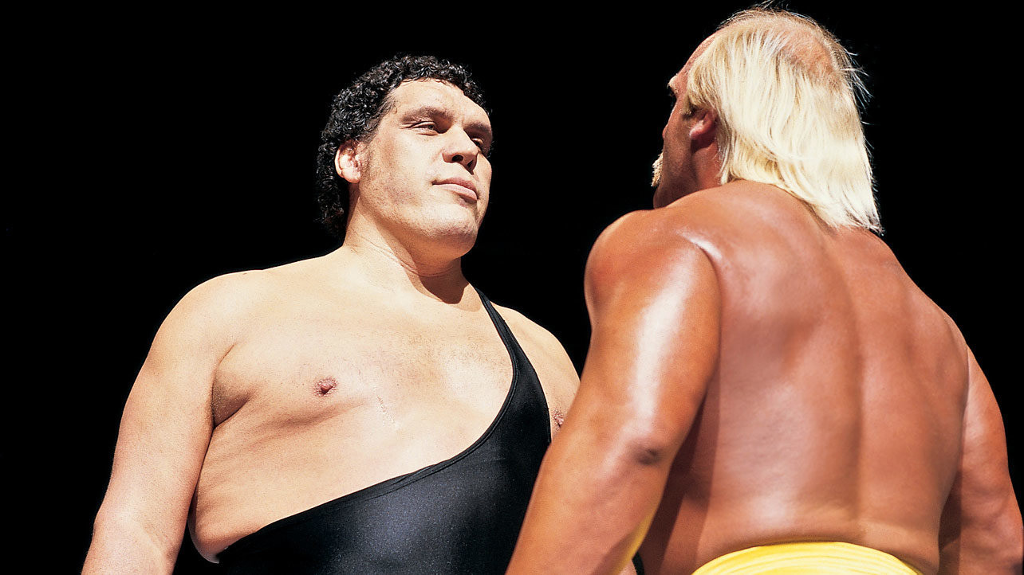
DBQ

Slide 2
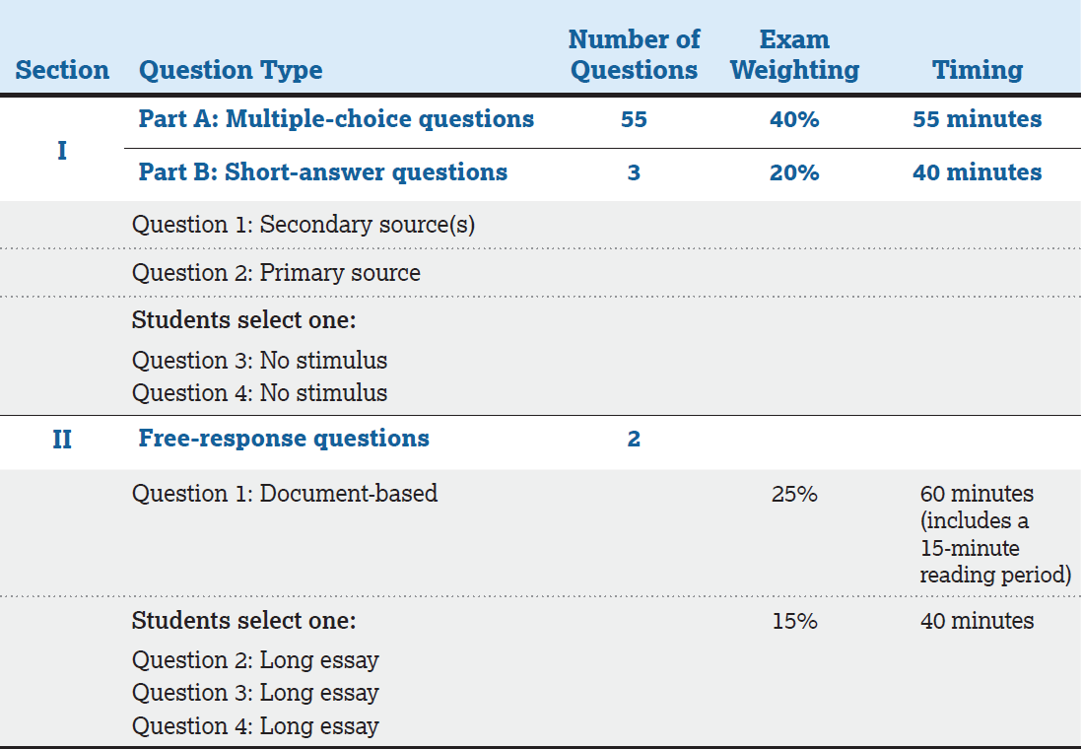
“Doing the DBQ”

Slide 3
Section | Points | Notes
Thesis | 1 | To earn this point, the thesis must make a claim that responds to the prompt rather than restating or rephrasing the prompt. The thesis must consist of one or more sentences located in one place, either in the introduction or the conclusion.
Contextualization | 1 | To earn this point, the response must relate the topic of the prompt to broader historical events, developments, or processes that occur before, during, or continue after the time frame of the question. This point is not awarded for merely a phrase or reference.
Evidence | 1 or 2 | -Uses the content of at least three documents to address the topic of the prompt. To earn 1 point the response must accurately describe — rather than simply quote — the content from at least three of the documents. -Supports an argument in response to the prompt using at least six documents.
Evidence Beyond the Documents | 1 | Uses at least one additional piece of specific historical evidence (beyond that found in the documents) relevant to an argument about the prompt. (1 point) To earn this point, the evidence must be described and must be more than a phrase or reference. This additional piece of evidence must be different from the evidence used to earn the point for contextualization.
Sourcing | 1 | For at least three documents, explains how or why the document’s point of view, purpose, historical situation, and/or audience is relevant to an argument.
Complexity | 1 | Demonstrates a complex understanding of the historical development that is the focus of the prompt, using evidence to corroborate, qualify, or modify an argument that addresses the question.

Slide 4
Non-Negotiables!
Avoid the THESIS KILLERS
Be Specific…be complex.
Make it debatable – you are not making an argument if it is not debatable!
lots
A lot
stuff
very
Ways
good
many
Bad
really
things
several

Slide 5
The Thesis Statement
A Formula:
X. However, A, B, and C. Therefore, y.
X = counter argument (what you don’t agree with)
Y = YOUR argument
A, B, C = support for YOUR position

Slide 6
The Thesis Formula
Prompt: Assess the validity of the following statement.
“Teaching is the most important profession in the world and everyone should consider it as a possible career choice.”

Slide 7
The Thesis Formula
Prompt: Assess the validity of the following statement, “Teaching is the most important profession in the world and everyone should consider it as a possible career choice.”
Thesis Statement:
Teaching is an emotionally satisfying profession. However, because teachers rank consistently at the bottom of the pay scale, often work at home without just compensation, and receive a lack of respect in our society, teaching is clearly not the most important profession and would, therefore, be an unwise career choice for some professionals.

Slide 8
Simple vs. Complex
“Analyze the ways in which the Vietnam War heightened social, political, and economic tensions in the United States. Focus your answer on the period 1964 – 1975.”
Simple:
The Vietnam war was only one phase in a greater struggle with communism that ended with the collapse of the Soviet Union. However, there was an increase in social, political, and economic tensions in the United States from 1964 – 1975. In the end, the war damaged America’s confidence in themselves and their government.

Slide 9
Simple vs. Complex
“Analyze the ways in which the Vietnam War heightened social, political, and economic tensions in the United States. Focus your answer on the period 1964 – 1975.”
Complex:
The Vietnam war was only one phase in a greater struggle with communism that ended with the collapse of the Soviet Union. However, during the period 1964 – 1975 America was racked by growing unrest and disenchantment over why the war was being fought, who should run it and how it should be waged, and how much American economic investment should be expanded into winning the war. Therefore, in the end, the war damaged America’s confidence in themselves and their government.

Slide 10
Section | Points | Notes
Thesis | 1 | To earn this point, the thesis must make a claim that responds to the prompt rather than restating or rephrasing the prompt. The thesis must consist of one or more sentences located in one place, either in the introduction or the conclusion.
Contextualization | 1 | To earn this point, the response must relate the topic of the prompt to broader historical events, developments, or processes that occur before, during, or continue after the time frame of the question. This point is not awarded for merely a phrase or reference.
Evidence | 1 or 2 | -Uses the content of at least three documents to address the topic of the prompt. To earn 1 point the response must accurately describe — rather than simply quote — the content from at least three of the documents. -Supports an argument in response to the prompt using at least six documents.
Evidence Beyond the Documents | 1 | Uses at least one additional piece of specific historical evidence (beyond that found in the documents) relevant to an argument about the prompt. (1 point) To earn this point, the evidence must be described and must be more than a phrase or reference. This additional piece of evidence must be different from the evidence used to earn the point for contextualization.
Sourcing | 1 | For at least three documents, explains how or why the document’s point of view, purpose, historical situation, and/or audience is relevant to an argument.
Complexity | 1 | Demonstrates a complex understanding of the historical development that is the focus of the prompt, using evidence to corroborate, qualify, or modify an argument that addresses the question.

Slide 11
Section | Points | Notes
Thesis | 1 | To earn this point, the thesis must make a claim that responds to the prompt rather than restating or rephrasing the prompt. The thesis must consist of one or more sentences located in one place, either in the introduction or the conclusion.
Contextualization | 1 | To earn this point, the response must relate the topic of the prompt to broader historical events, developments, or processes that occur before, during, or continue after the time frame of the question. This point is not awarded for merely a phrase or reference.
Evidence | 1 or 2 | -Uses the content of at least three documents to address the topic of the prompt. To earn 1 point the response must accurately describe — rather than simply quote — the content from at least three of the documents. -Supports an argument in response to the prompt using at least six documents.
Evidence Beyond the Documents | 1 | Uses at least one additional piece of specific historical evidence (beyond that found in the documents) relevant to an argument about the prompt. (1 point) To earn this point, the evidence must be described and must be more than a phrase or reference. This additional piece of evidence must be different from the evidence used to earn the point for contextualization.
Sourcing | 1 | For at least three documents, explains how or why the document’s point of view, purpose, historical situation, and/or audience is relevant to an argument.
Complexity | 1 | Demonstrates a complex understanding of the historical development that is the focus of the prompt, using evidence to corroborate, qualify, or modify an argument that addresses the question.

Slide 12
Section | Points | Notes
Thesis | 1 | To earn this point, the thesis must make a claim that responds to the prompt rather than restating or rephrasing the prompt. The thesis must consist of one or more sentences located in one place, either in the introduction or the conclusion.
Contextualization | 1 | To earn this point, the response must relate the topic of the prompt to broader historical events, developments, or processes that occur before, during, or continue after the time frame of the question. This point is not awarded for merely a phrase or reference.
Evidence | 1 or 2 | -Uses the content of at least three documents to address the topic of the prompt. To earn 1 point the response must accurately describe — rather than simply quote — the content from at least three of the documents. -Supports an argument in response to the prompt using at least six documents.
Evidence Beyond the Documents | 1 | Uses at least one additional piece of specific historical evidence (beyond that found in the documents) relevant to an argument about the prompt. (1 point) To earn this point, the evidence must be described and must be more than a phrase or reference. This additional piece of evidence must be different from the evidence used to earn the point for contextualization.
Sourcing | 1 | For at least three documents, explains how or why the document’s point of view, purpose, historical situation, and/or audience is relevant to an argument.
Complexity | 1 | Demonstrates a complex understanding of the historical development that is the focus of the prompt, using evidence to corroborate, qualify, or modify an argument that addresses the question.

Slide 13
Section | Points | Notes
Thesis | 1 | To earn this point, the thesis must make a claim that responds to the prompt rather than restating or rephrasing the prompt. The thesis must consist of one or more sentences located in one place, either in the introduction or the conclusion.
Contextualization | 1 | To earn this point, the response must relate the topic of the prompt to broader historical events, developments, or processes that occur before, during, or continue after the time frame of the question. This point is not awarded for merely a phrase or reference.
Evidence | 1 or 2 | -Uses the content of at least three documents to address the topic of the prompt. To earn 1 point the response must accurately describe — rather than simply quote — the content from at least three of the documents. -Supports an argument in response to the prompt using at least six documents.
Evidence Beyond the Documents | 1 | Uses at least one additional piece of specific historical evidence (beyond that found in the documents) relevant to an argument about the prompt. (1 point) To earn this point, the evidence must be described and must be more than a phrase or reference. This additional piece of evidence must be different from the evidence used to earn the point for contextualization.
Sourcing | 1 | For at least three documents, explains how or why the document’s point of view, purpose, historical situation, and/or audience is relevant to an argument.
Complexity | 1 | Demonstrates a complex understanding of the historical development that is the focus of the prompt, using evidence to corroborate, qualify, or modify an argument that addresses the question.

Slide 14
Section | Points | Notes
Thesis | 1 | To earn this point, the thesis must make a claim that responds to the prompt rather than restating or rephrasing the prompt. The thesis must consist of one or more sentences located in one place, either in the introduction or the conclusion.
Contextualization | 1 | To earn this point, the response must relate the topic of the prompt to broader historical events, developments, or processes that occur before, during, or continue after the time frame of the question. This point is not awarded for merely a phrase or reference.
Evidence | 1 or 2 | -Uses the content of at least three documents to address the topic of the prompt. To earn 1 point the response must accurately describe — rather than simply quote — the content from at least three of the documents. -Supports an argument in response to the prompt using at least six documents.
Evidence Beyond the Documents | 1 | Uses at least one additional piece of specific historical evidence (beyond that found in the documents) relevant to an argument about the prompt. (1 point) To earn this point, the evidence must be described and must be more than a phrase or reference. This additional piece of evidence must be different from the evidence used to earn the point for contextualization.
Sourcing | 1 | For at least three documents, explains how or why the document’s point of view, purpose, historical situation, and/or audience is relevant to an argument.
Complexity | 1 | Demonstrates a complex understanding of the historical development that is the focus of the prompt, using evidence to corroborate, qualify, or modify an argument that addresses the question.

Slide 15
Section | Points | Notes
Thesis | 1 | To earn this point, the thesis must make a claim that responds to the prompt rather than restating or rephrasing the prompt. The thesis must consist of one or more sentences located in one place, either in the introduction or the conclusion.
Contextualization | 1 | To earn this point, the response must relate the topic of the prompt to broader historical events, developments, or processes that occur before, during, or continue after the time frame of the question. This point is not awarded for merely a phrase or reference.
Evidence | 1 or 2 | -Uses the content of at least three documents to address the topic of the prompt. To earn 1 point the response must accurately describe — rather than simply quote — the content from at least three of the documents. -Supports an argument in response to the prompt using at least six documents.
Evidence Beyond the Documents | 1 | Uses at least one additional piece of specific historical evidence (beyond that found in the documents) relevant to an argument about the prompt. (1 point) To earn this point, the evidence must be described and must be more than a phrase or reference. This additional piece of evidence must be different from the evidence used to earn the point for contextualization.
Sourcing | 1 | For at least three documents, explains how or why the document’s point of view, purpose, historical situation, and/or audience is relevant to an argument.
Complexity | 1 | Demonstrates a complex understanding of the historical development that is the focus of the prompt, using evidence to corroborate, qualify, or modify an argument that addresses the question.

Slide 16
What is the Reasoning Process? Cause & Effect, Comparing, Change over Time.
Categorize documents thematically:
-Look for themes: society, religion, economics, politics, etc.
Amazing thesis here:
Topic 1
Topic 2
Give rationale
Give rationale
Give rationale
Strongest Points
Give rationale
Give rationale
Weakest Points

Slide 17
With respect to the federal Constitution, the Jeffersonian Republicans are characterized as strict constructionists who were opposed to the broad constructionism of the Federalists. To what extent was this characterization of the two parties accurate during Jefferson and Madison?
Amazing thesis here:
Topic 1
Topic 2
As a group, go through the documents after reading the prompt and group the documents in order to support your argument.
Cut the excerpts and place them on one side or the other. Once you have them placed correctly, glue them down.
Once they are all down and glued, come up with a thesis
Give rationale
Give rationale
Give rationale
Strongest Points
Give rationale
Give rationale
Weakest Points

Slide 18
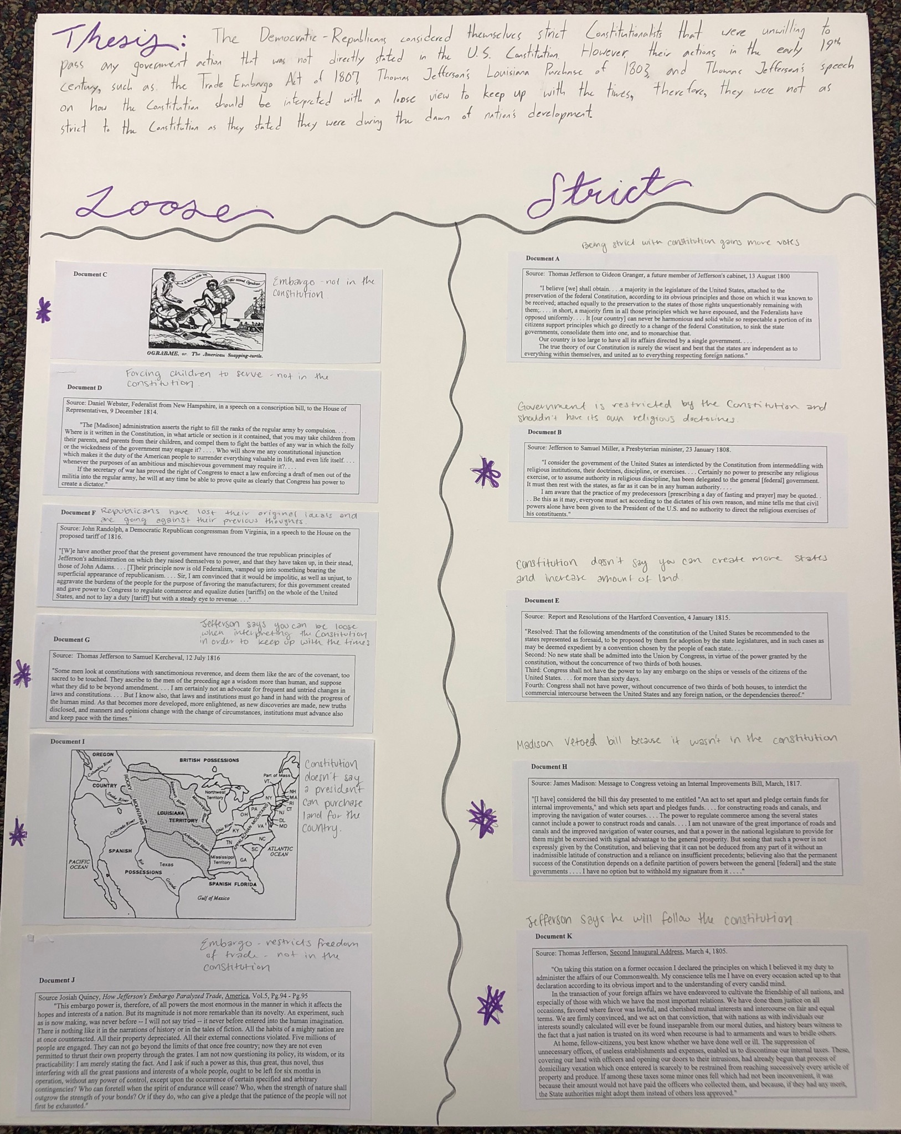

Slide 19
DBQ Format
Contextualize – background and setting
Thesis – a claim that will be supported by 3 points of evidence.
1st paragraph
Evidence #1 – Historically correct and supports claim using document/s. Bring in outside knowledge.
2nd paragraph
Evidence #2 – Historically correct and supports claim using document/s. Bring in outside knowledge.
sourcing
3rd paragraph
Evidence #3 – Historically correct and supports claim using document/s. Bring in outside knowledge.
4th paragraph
Conclusion – restates thesis (not word for word)
5th paragraph

Slide 20
DBQ
DBQ

