Slide 1
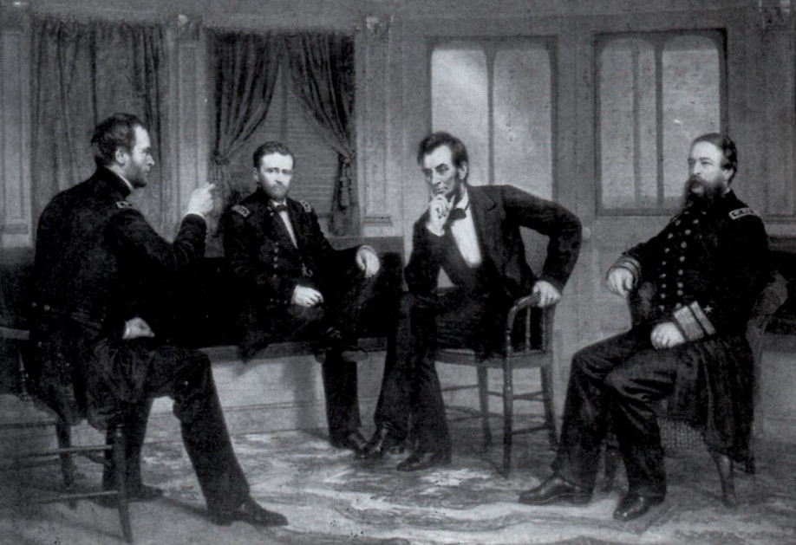
P5 DBQ Review
Learning Target: I will evaluate the extent of differences in progress between whites and blacks in Southern society during the period of 1865-1900.

Slide 2
Intro: Make a list of what you remember about Period 5 (1848-1877).
Major Events | Important People | Influential Ideas
Notes:
🍐 This is a Pear Deck Text Slide
🍐 To edit the type of question, go back to the "Ask Students a Question" in the Pear Deck sidebar.

Slide 3
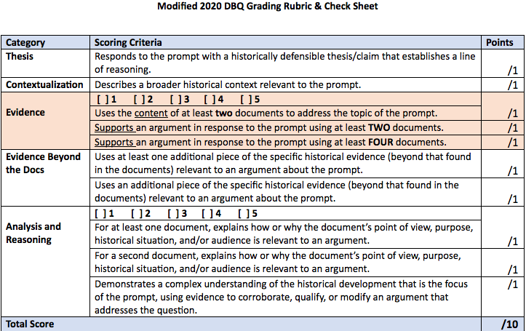
DBQ Rubric 2020 (Tom Richey PDF)

Slide 4
DBQ Breakdown Directions
Before writing a full DBQ again, we’re going to breakdown each skill of a DBQ.
Most of the prompts we will use will be from prior AP tests and modified to the correct number of documents for 2020.
General Reminders→ DBQ Overview Doc
You’ll be given certain slides to complete each day to practice specific DBQ skills.
Also, we will possibly analyze examples from other APUSH students from prior APUSH exams to judge good and bad examples.
Complete the following modified DBQ planning chart. You may list your categories, documents, and outside information, but please write out your thesis, context, and complexity. Some Reminders:
When trying to determine categories ask yourself, “Do the documents fit together in three different ways?” Generally, you’ll be able to find a way to separate them into 3 categories. Once you have done that, then work on giving a label to that category. Try to use ALL 5 docs.
Remember, outside evidence must be specific and cannot be tied to the analysis of your docs. Ask yourself, “What are the documents ‘forgetting’ about this topic that would help prove your argument or bring in a counter argument?”

Slide 5
PROMPT: Evaluate the extent of differences in progress between whites and blacks in Southern society during the period of 1865-1900.

Slide 6
PROMPT: Evaluate the extent of differences in progress between whites and blacks in Southern society during the period of 1865-1900.
Answer the following questions about the prompt:
What topic/content is this prompt addressing?
What is the time period?
Which historical reasoning process is this prompt asking you to address (Comparison, Causation, CCOT)?
Notes:
🍐 This is a Pear Deck Text Slide
🍐 To edit the type of question, go back to the "Ask Students a Question" in the Pear Deck sidebar.

Slide 7
DOC Analysis Directions: Answer all of the following questions for each document.
Describe the document and explain how it supports the argument to respond to the prompt.
Attribution and citation to the author/source is important!
NO QUOTES
Choose one HAPP skill to analyze the document and create a HAPP statement to prove your argument.
What outside evidence could enhance your argument or bring in a counter argument?
What grouping could you use to categorize this document? (may be hard to answer right away)

Slide 8
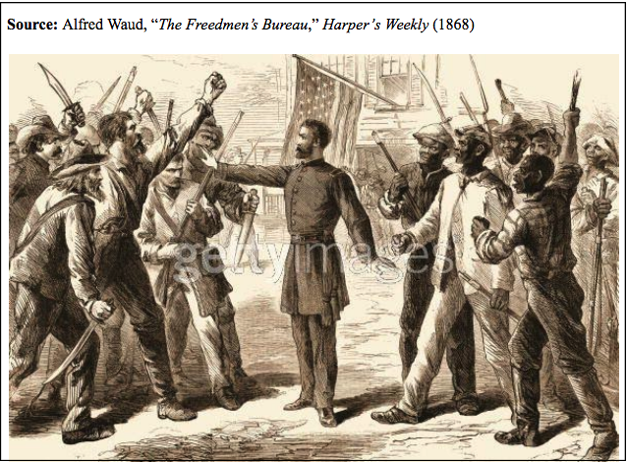
DOCUMENT 1
Notes:
🍐 This is a Pear Deck Text Slide
🍐 To edit the type of question, go back to the "Ask Students a Question" in the Pear Deck sidebar.

Slide 9
DOCUMENT 2
Notes:
🍐 This is a Pear Deck Text Slide
🍐 To edit the type of question, go back to the "Ask Students a Question" in the Pear Deck sidebar.

Slide 10
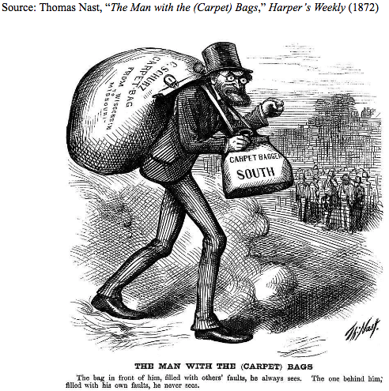
DOCUMENT 3
Notes:
🍐 This is a Pear Deck Text Slide
🍐 To edit the type of question, go back to the "Ask Students a Question" in the Pear Deck sidebar.

Slide 11
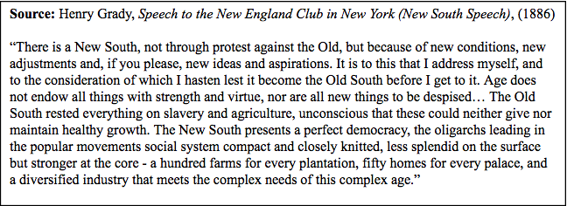
DOCUMENT 4
Notes:
🍐 This is a Pear Deck Text Slide
🍐 To edit the type of question, go back to the "Ask Students a Question" in the Pear Deck sidebar.

Slide 12
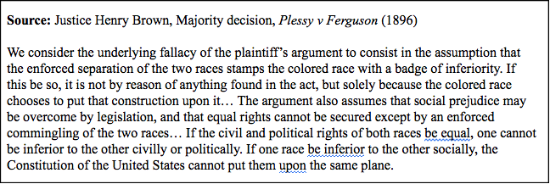
DOCUMENT 5
Notes:
🍐 This is a Pear Deck Text Slide
🍐 To edit the type of question, go back to the "Ask Students a Question" in the Pear Deck sidebar.

Slide 13
PROMPT: Evaluate the extent of differences in progress between whites and blacks in Southern society from 1865-1900.
Now that you have analyzed the documents, write an introduction paragraph that includes your context and thesis.
CONTEXT: Relate the topic to broaders historical events, developments, or processes that occur before and during the time frame of the question. This point is not awarded for merely a phrase or reference. Remember to funnel the context (big→ small picture) and connect it to your thesis.
THESIS: Respond to the prompt with a historically defensible complex-split thesis that establishes a line of reasoning and an essay plan (must do more than simply restate the prompt).
Notes:
🍐 This is a Pear Deck Text Slide
🍐 To edit the type of question, go back to the "Ask Students a Question" in the Pear Deck sidebar.

Slide 14
Document Grouping: Finalize your body paragraphs (USE COMPLETE SENTENCES).
Body Paragraph 1 Category?
Documents?
Evidence Beyond the Documents? Use at least 1. Remember, evidence cannot be connected to your analysis of the docs AND be specific (think key terms, events, and people)
Notes:
🍐 This is a Pear Deck Text Slide
🍐 To edit the type of question, go back to the "Ask Students a Question" in the Pear Deck sidebar.

Slide 15
Document Grouping: Finalize your body paragraphs (USE COMPLETE SENTENCES).
Body Paragraph 2 Category?
Documents?
Evidence Beyond the Documents? Use at least 1. Remember, evidence cannot be connected to your analysis of the docs AND be specific (think key terms, events, and people)
Notes:
🍐 This is a Pear Deck Text Slide
🍐 To edit the type of question, go back to the "Ask Students a Question" in the Pear Deck sidebar.

Slide 16
Document Grouping: Finalize your body paragraphs (USE COMPLETE SENTENCES).
Body Paragraph 3 Category?
Documents?
Evidence Beyond the Documents? Use at least 1. Remember, evidence cannot be connected to your analysis of the docs AND be specific (think key terms, events, and people)
Notes:
🍐 This is a Pear Deck Text Slide
🍐 To edit the type of question, go back to the "Ask Students a Question" in the Pear Deck sidebar.

Slide 17
CONCLUSION
Restate your thesis and main arguments
Complexity Option: Provide a relevant, specific, and insightful connection to a past and/or future time period.
Notes:
🍐 This is a Pear Deck Text Slide
🍐 To edit the type of question, go back to the "Ask Students a Question" in the Pear Deck sidebar.

