Slide 1
Unit II
Interactions
Among Branches of Government
Twenty-Eight (28) Fifty-Five Minute Class Periods for the Year-Long Course Fourteen (14) Forty-Five Minute Class Periods for the Semester-Long Course
Click here to view an outline that corresponds with this slideshow
Created November 2019
Version 1.0
ppaccone@smusd.us

Slide 2
This slideshow has been produced by San Marino High School AP US Government teacher Peter Paccone, with the help of a team of super talented educators and students across the nation. Primarily produced for the benefit of AP US Government teachers wanting to present this slideshow in class, this slideshow may also prove of value for AP US Government teachers wanting to flip the learning AND for members of the general public wanting to learn more about the interactions among the branches of government
This slideshow is organized along the lines of what College Board calls the AP Government Topics, Essential Knowledge, and Enduring Understanding.
This slideshow uses media that are in the public domain. No graphic violence is shown. No political agenda is intended.
Any/all AP Government teachers should feel free to make a copy of this slideshow and edit in any way.

Slide 3
Topic 2.1 - 2.3
The Congress

Slide 4
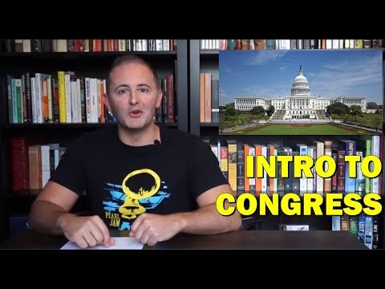
Intro to Topic 2.1
The Senate and the House of Representatives
Carey LaManna
4:45

Slide 5
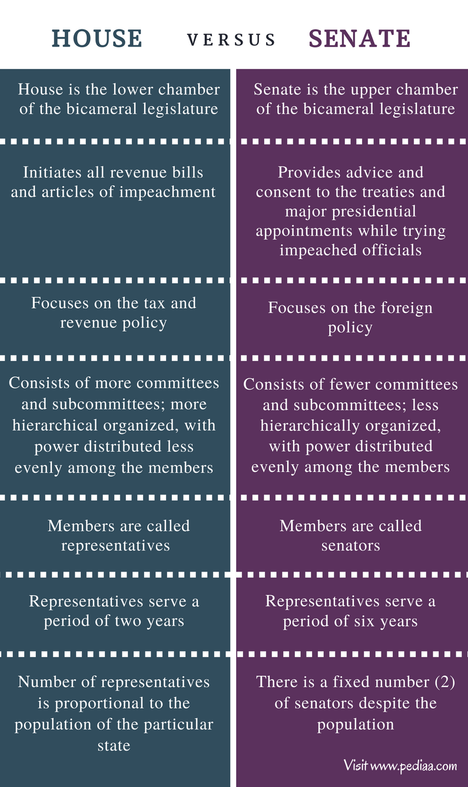

Slide 7
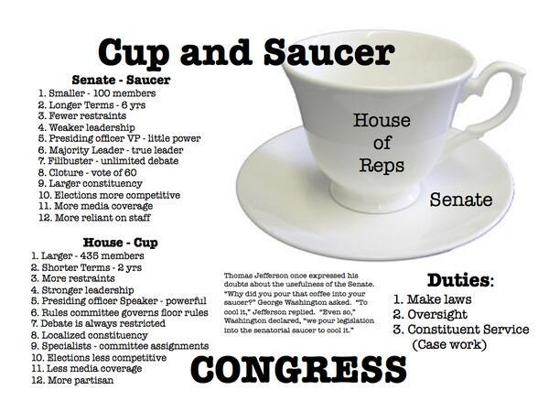

Slide 8
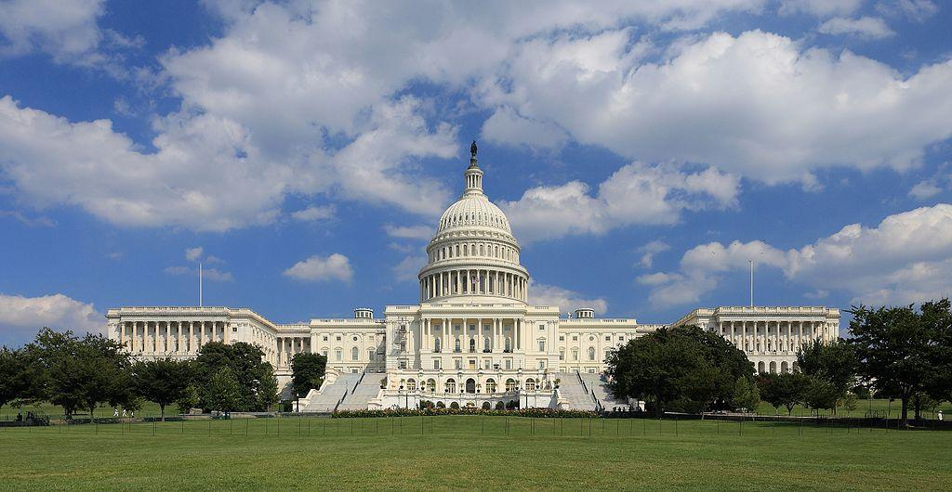

Slide 9
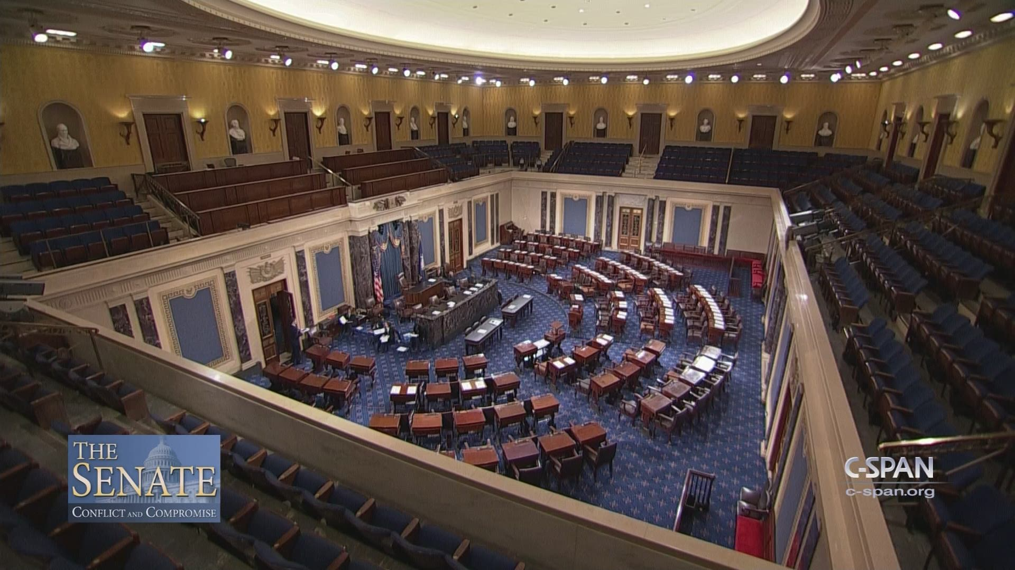

Slide 10
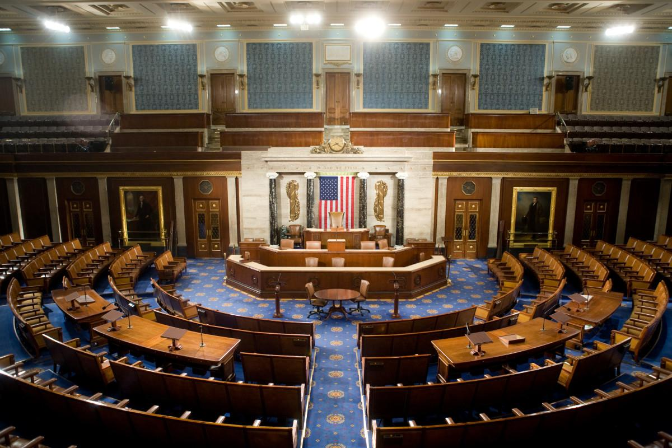

Slide 11
Topic 2.1: The Senate and the House of Representatives (Con-3.A.1)
The Senate is designed to represent states equally, while the House is designed to represent the population.

Slide 12
Topic 2.1: The Senate and the House of Representatives (Con-3.A.2)
Different chamber sizes and constituencies influence formality of debate.

Slide 13
Topic 2.1: The Senate and the House of Representatives (Con-3.A.3)
Coalitions in Congress are affected by term-length differences.

Slide 14
Topic 2.1: The Senate and the House of Representatives (Con-3.A.4)
The enumerated and implied powers in the Constitution allow the creation of public policy by Congress, which includes:
Passing a federal budget, raising revenue, and coining money
Declaring war and maintaining the armed forces
Enacting legislation that addresses a wide range of economic, environmental, and social issues based on the necessary and proper clause

Slide 15
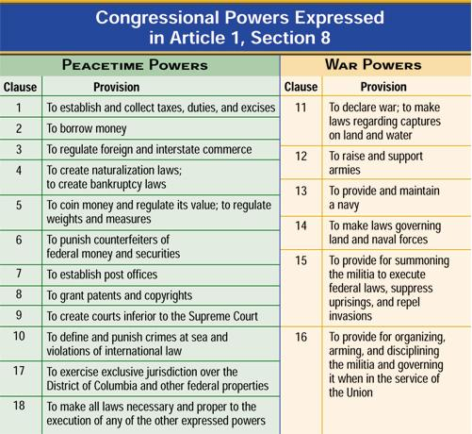

Slide 16
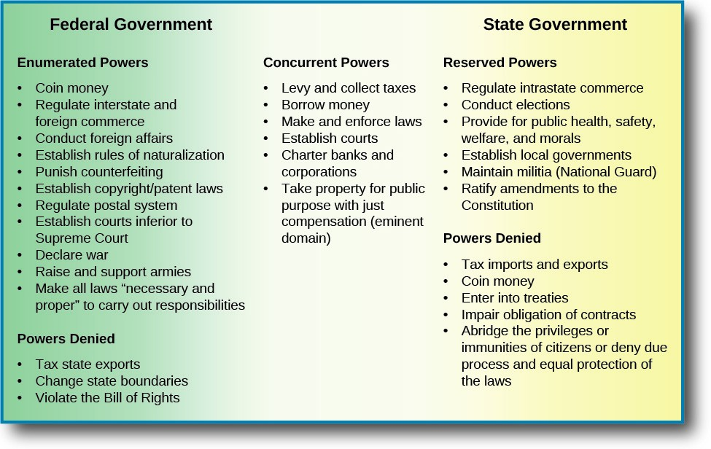

Slide 17
Express and Implied Powers of Congress
Carey LaManna
3:20

Slide 18
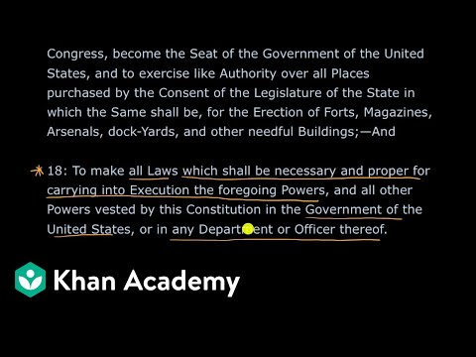
Express and Implied Powers of Congress
Khan Academy
6:02

Slide 19
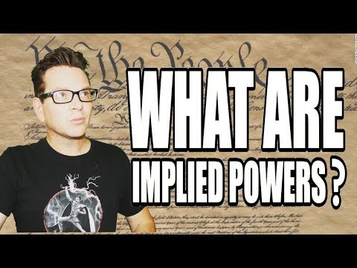
The Implied Powers of Congress
Hip Hughes
7:00

Slide 20
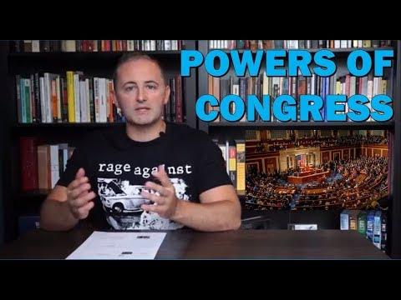
Intro to Topic 2.2
Structure, Power, and Functions of Congress
Carey LaManna
14:40

Slide 21
Topic 2.2: Structures, Powers, and Functions of Congress (Con-3.B.1)
By design, the different structures, powers, and functions of the Senate and the House of Representatives affect the policy-making process.

Slide 26
Topic 2.2: Structures, Powers, and Functions of Congress (Con-3.B.2)
Though both chambers rely on committees to conduct hearings and debate bills under consideration, different constitutional responsibilities of the House and Senate affect the policy-making process.

Slide 27
Topic 2.2: Structures, Powers, and Functions of Congress (Con-3.B.3)
Chamber-specific procedures, rules, and roles that impact the policy-making process include:
Number of chamber and debate rules that set the bar high for building majority support
Roles of Speaker of the House, President of the Senate, party leadership, and committee leadership in both chambers
Filibuster and cloture
Holds and unanimous consent in the Senate
Role of Rules Committee, Committee of the Whole, and discharge petitions in the House
Treaty ratification and confirmation role of the U.S. Senate

Slide 28
Filibuster and Closure
A political procedure where one or more members of congress debate over a proposed piece of legislation so as to delay or entirely prevent a decision being made on the proposal.
It is sometimes referred to as "talking a bill to death” and is characterized as a form of obstruction.
Synonymously with political stonewalling.
Due to the often extreme length of time required for a successful filibuster, many speakers stray off topic after exhausting the original

Slide 29
subject matter.
Past speakers have read through laws from different states, recited speeches, and even read from cookbooks and phone books.
Senate rules permit a senator or senators to speak for as long as they wish and on any topic they choose, unless "three-fifths of the Senators duly chosen and sworn" (usually 60 out of 100 senators) bring debate to a close by invoking cloture under Senate Rule XXII.
Defenders call the filibuster "The Soul of the Senate."[58]
Not part of the US Constitution,
Rarely used for much of the Senate's first two centuries.

Slide 30
In recent years, the majority has preferred to avoid filibusters by moving to other business when a filibuster is threatened and attempts to achieve cloture have failed. As a result, in recent decades this has come to mean that all major legislation (apart from budgets) now requires a 60% majority to pass.
In 2013, the Democratic controlled Senate voted to require only a majority vote to end a filibuster of all executive and judicial nominees, excluding Supreme Court nominees, rather than the 3/5 of votes previously required.
In, 2017, the Republican controlled Senate voted to require only a

Slide 31
majority vote to end a filibuster of Supreme Court nominees. A 3/5 supermajority is still required to end filibusters on legislation.

Slide 32
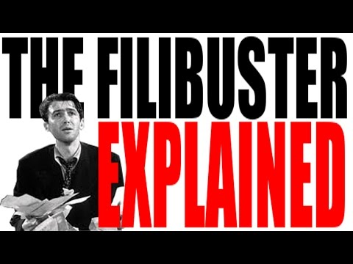
The Filibuster
Hip Hughes
7:18
Notes:
hio hughes

Slide 33
Filibuster and Cloture
Khan Academy
6:04
Notes:
Filibuster and cloture 604 khan

Slide 34
Topic 2.2: Structures, Powers, and Functions of Congress (Con-3.B.4)
Congress must generate a budget that addresses both discretionary and mandatory spending, and as entitlement costs grow, discretionary spending opportunities will decrease unless tax revenues increase or the budget deficit increases.

Slide 35
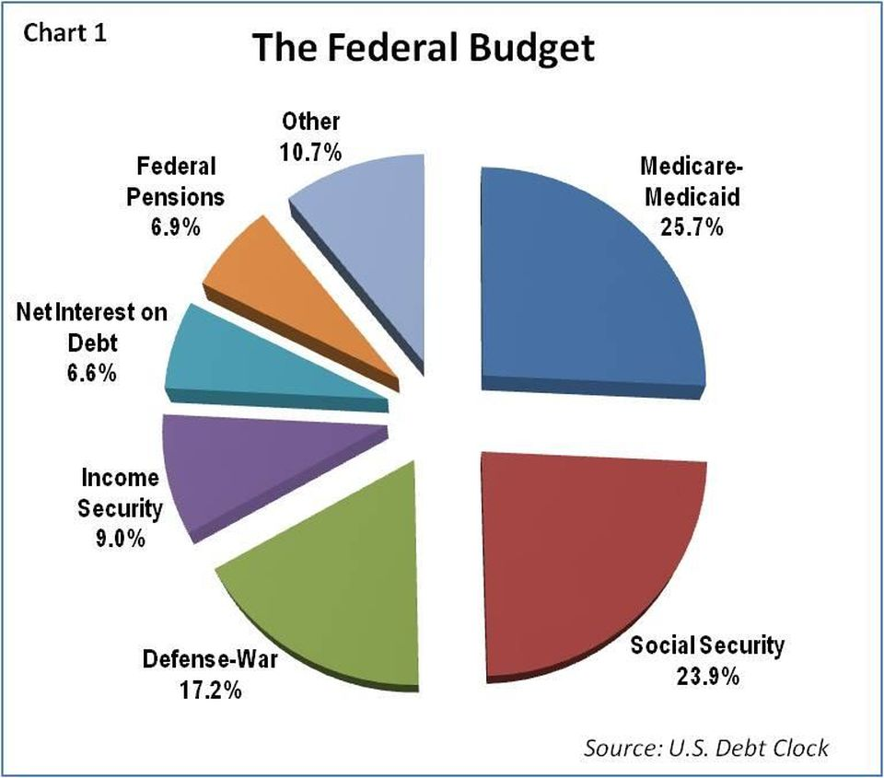

Slide 36
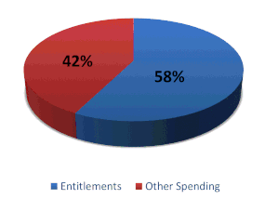

Slide 37
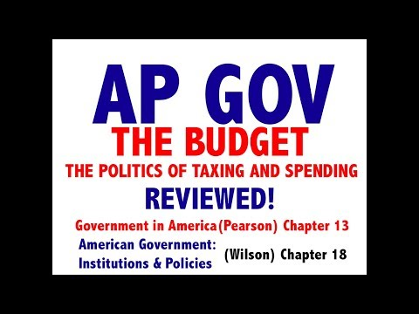
The Budget
JoczProductions
17:26
Notes:
1726 jocz

Slide 38
The Budget
Adam Norris
8:46

Slide 39
Committees
Adam Norris
8:46

Slide 41
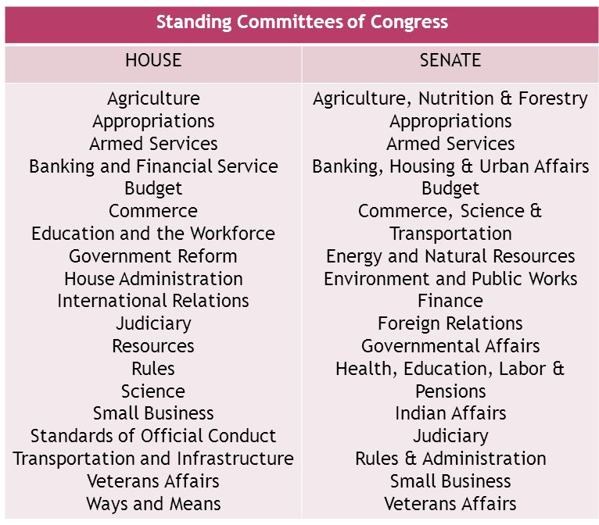

Slide 42
Topic 2.2: Structures, Powers, and Functions of Congress (Con-3.B.5)
Pork-barrel legislation and logrolling affect lawmaking in both chambers.

Slide 43
Pork Barrel Legislation
A metaphor for the appropriation of government spending for localized projects secured solely or primarily to bring money to a representative's district.
Typically, "pork" involves funding for government programs whose economic or service benefits are concentrated in a particular area but whose costs are spread among all taxpayers. Public works projects, certain national defense spending projects, and agricultural subsidies are the most commonly cited examples.

Slide 44
During the 2008 U.S. presidential campaign, the Gravina Island Bridge (also known as the "Bridge to Nowhere") in Alaska was cited as an example of pork barrel spending. The bridge, pushed for by Republican Senator Ted Stevens, was projected to cost $398 million and would connect the island's 50 residents and the Ketchikan International Airport to Revillagigedo Island and Ketchikan.

Slide 45
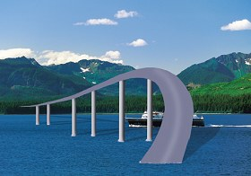

Slide 47
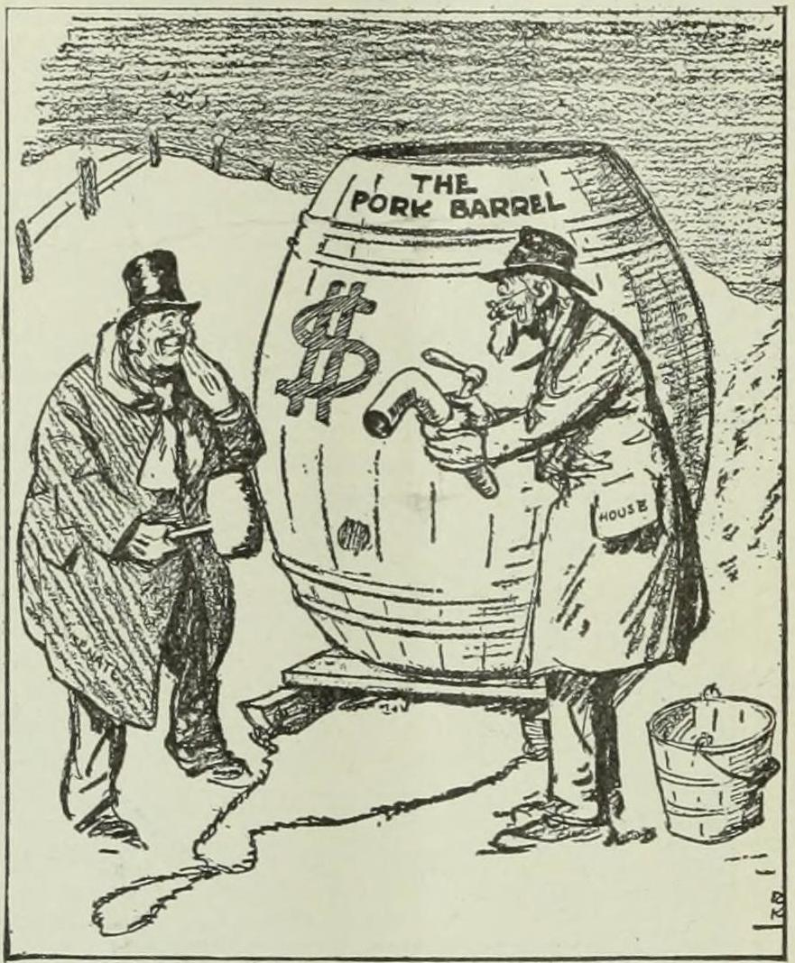

Slide 48
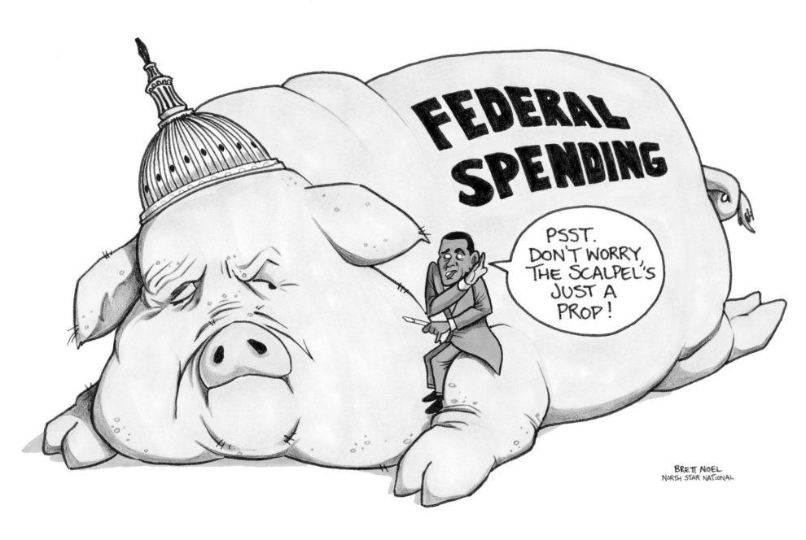

Slide 49
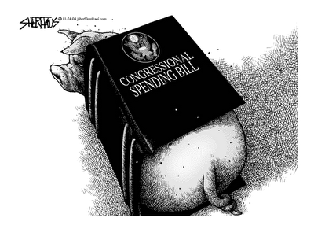

Slide 50
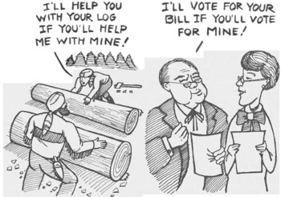

Slide 51
Logrolling
The trading of favors, or quid pro quo, such as vote trading by legislative members to obtain passage of actions of interest to each legislative member.
If a legislator logrolls, he initiates the trade of votes for one particular act or bill in order to secure votes on behalf of another act or bill. Logrolling means that two parties will pledge their mutual support, so both bills can attain a simple majority.
For example, a vote on behalf of a tariff may be traded by a congressman for a vote from another congressman on behalf of an

Slide 52
agricultural subsidy to ensure that both acts will gain a majority and pass through the legislature.

Slide 53
Pork Barrel Legislation and Logrolling
Khan Academy
9:34

Slide 54
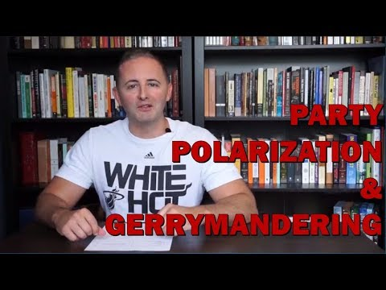
Intro to Topic 2.3
Congressional Behavior
Carey LaManna
9:08

Slide 55
Topic 2.3: Congressional Behavior (Con-3.C.1)
Congressional behavior and governing effectiveness are influenced by:
Ideological divisions within Congress that can lead to gridlock or create the need for negotiation and compromise
Gerrymandering, redistricting, and unequal representation of constituencies have been partially addressed by the Supreme Court decision in Baker v. Carr (1962), which opened the door to equal protection challenges to redistricting and started the “one person, one vote” doctrine, and the no-racial-gerrymandering decision in Shaw v. Reno (1993)

Slide 56
Elections that have led to a divided government, including partisan votes against presidential initiatives and congressional refusal to confirm appointments of “lame-duck” presidents of the opposite party
Different role conceptions of “trustee,” “delegate,” and “politico” as related to constituent accountability in each chamber.

Slide 57
Gridlock
Refers to a situation when there is difficulty passing laws that satisfy the needs of the people.
A government is gridlocked when the ratio between bills passed and the agenda of the legislature decreases. Laws may be considered as the supply and the legislative agenda as demand.
Can occur when two legislative houses, or the executive branch and the legislature are controlled by different political parties, or otherwise cannot agree.

Slide 58
Gerrymandering
A practice intended to establish a political advantage for a particular party or group by manipulating district boundaries.
The term is named after Elbridge Gerry, who, as Governor of Massachusetts in 1812, signed a bill that created a partisan district in the Boston area that was compared to the shape of a mythological salamander.
In addition to its use achieving desired electoral results for a particular party, gerrymandering may be used to help or hinder a particular demographic, such as a political, ethnic, racial, linguistic, religious, or

Slide 59
Lame Duck President
A president whose successor has already been elected or will be soon
Aka outgoing presidents (as opposed to incoming president)
Often seen as having less influence with other politicians due to the limited time left in office. Conversely, a lame duck is free to make decisions that exercise the standard powers with little fear of consequence, such as issuing executive orders, pardons, or other controversial edicts.
The period between (presidential and congressional) elections in

Slide 60
November and the inauguration of officials early in the following year is commonly called the "lame duck period"
A president elected to a second term is sometimes seen as a lame duck from early in the second term, since term limits prevent them from contesting re-election four years later. However, not personally having to face the electorate again makes a second-term president more powerful than they were in their first term as they are thus freer to take politically unpopular actions. However this comes with caveats, as the de facto leader of their political party, the president's actions affect how the party performs in the midterm elections two years into the second term, and, to some extent, the success of that party's nominee in the next presidential election four years in the future.

Slide 61
The term "lame duck president" traditionally is reserved for a president who is serving out the remainder of their term after having been defeated for re-election. In this sense, the following presidents, since the twentieth century, have been lame ducks: William Howard Taft, who was defeated for re-election in 1912; Herbert Hoover, who was defeated for re-election in 1932; Gerald R. Ford, who was defeated in 1976; Jimmy Carter, who was defeated for re-election in 1980; and George H. W. Bush, who was defeated for re-election in 1992.

Slide 62
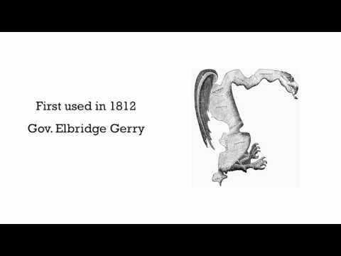
Gerrymandering
MyCitizenU
9:34

Slide 63
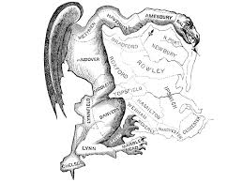

Slide 64
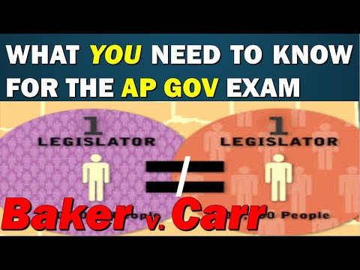
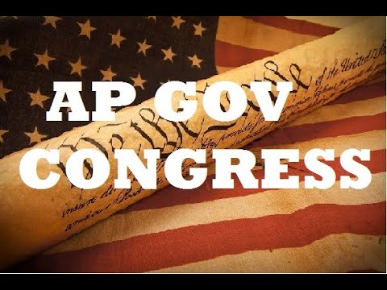
Baker v. Carr
Carey LaManna
7:04

Slide 65
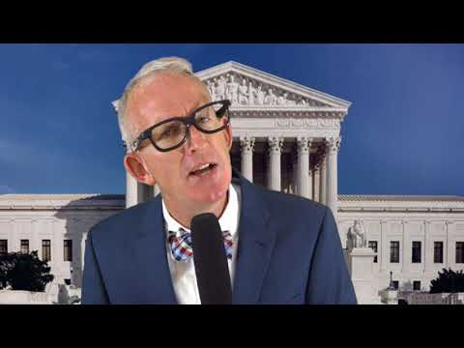
Shaw v. Reno
MyCitizenU
3:24

Slide 66
Shaw v. Reno and Baker v. Carr
Kelsey Falkowski
14:22

Slide 67
Review
The Legislative Branch

Slide 68
Review Questions - The Legislative Branch and the Congress
Describe the different structures, powers, and functions of each house of Congress. (Con-3.A)
Explain how the structure, powers, and functions of both houses of Congress affect the policy-making process. (Con-3.B)
Explain how congressional behavior is influenced by election processes, partisanship, and divided government. (Con-3.C)

Slide 69
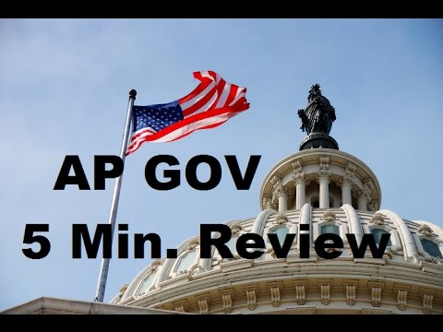
Everything About Congress Review
Kelsey Falkowski
4:16

Slide 70
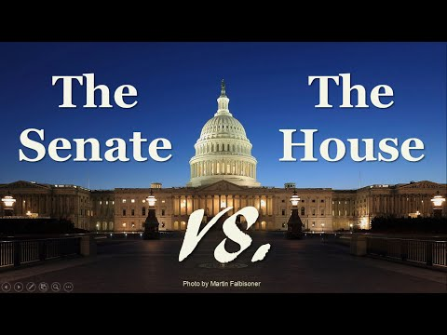
The Senate and the House
Tom Richey
6:567

Slide 71
Topic 2.4-2.7
The President

Slide 72
Enduring Understanding (Con-4)
The presidency has been enhanced beyond its expressed constitutional powers.

Slide 75
Topic 2.4: Roles and Powers of the President (Con-4.A.1)
Presidents use powers and perform functions of the office to accomplish a policy agenda.

Slide 76
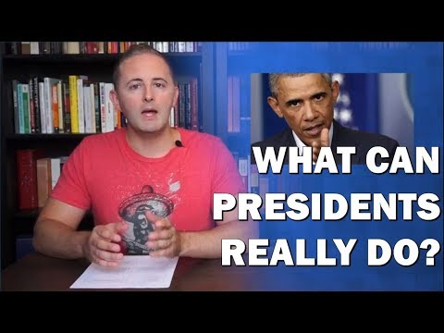
Intro to Topic 2.4
Roles and Power of the President
Carey LaManna
6:06

Slide 77
Topic 2.4: Roles and Powers of the President (Con-4.A.2)
Formal and informal powers of the president include:
Vetoes and pocket vetoes—formal powers that enable the president to check Congress
Foreign policy—both formal (commander- in-chief and treaties) and informal (executive agreements) powers that influence relations with foreign nations
Bargaining and persuasion—informal power that enables the president to secure congressional action
Executive orders—implied from the president’s vested “executive power,” or from power delegated by Congress, executive orders allow

Slide 78
the president to manage the federal government
Signing statements—informal power that informs Congress and the public of the president’s interpretation of laws passed by Congress and signed by the president

Slide 79
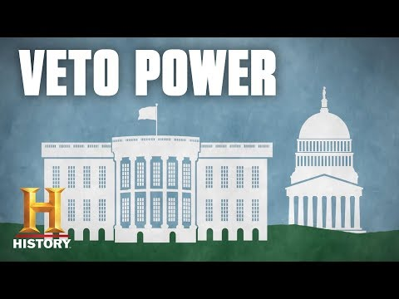
The Veto Power
History
3:01

Slide 80
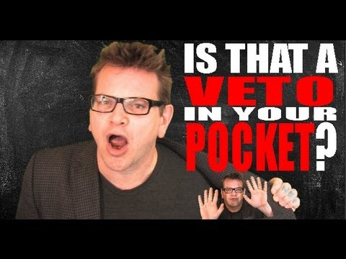
The Pocket Veto
Hip Hughes
5:08

Slide 81
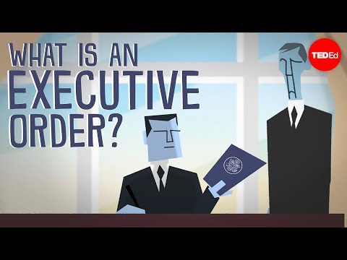
Executive Orders
TED-Ed
4:47

Slide 82
The Executive Agreement
An agreement between the President and another head of government of two or more nations that has not been ratified by the Senate as treaties are ratified.
Considered politically binding to distinguish them from treaties which are legally binding.
Not considered treaties for the purpose of the Treaty Clause of the United States Constitution, which requires the advice and consent of two-thirds of the Senate to qualify as a treaty.

Slide 83
Signing Statements
Khan Academy
5:13

Slide 84
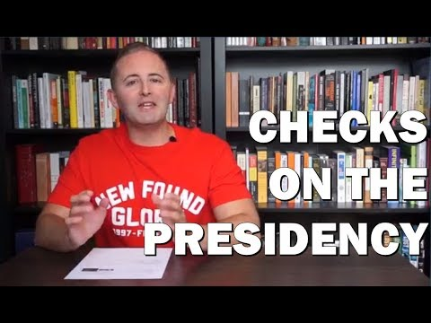
Intro to Topic 2.5
Checks on the Presidency
Carey LaManna
5:37

Slide 85
Topic 2.5: Checks on the Presidency (Con-4.B.1)
The potential for conflict with the Senate depends upon the type of executive branch appointments, including:
Cabinet members
Ambassadors
White House staff

Slide 86
The Cabinet
History
1:47

Slide 87
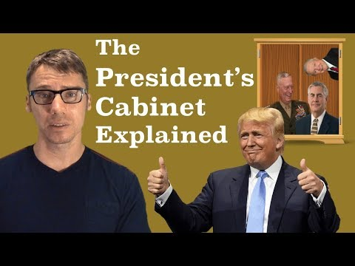
The Cabinet
Mr. Beat
12:38

Slide 88
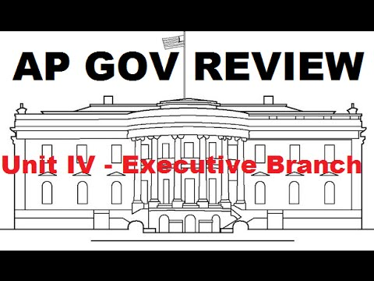
The Cabinet
Kelsey Falkowski
13:54

Slide 89
The Cabinet and White House Staff
Carey LaManna
6:53

Slide 92
Topic 2.5: Checks on the Presidency (Con-4.B.2)
Senate confirmation is an important check on appointment powers, but the president’s longest lasting influence lies in life-tenured judicial appointments.

Slide 93
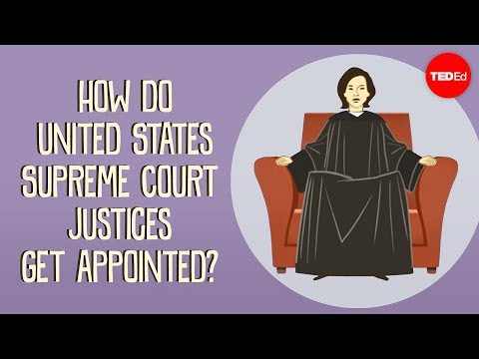
How do US Supreme Court Justices Get Appointed?
TED-Ed
4:25

Slide 94
Topic 2.5: Checks on the Presidency (Con-4.B.3)
Policy initiatives and executive orders promoted by the president often lead to conflict with the congressional agenda.

Slide 95
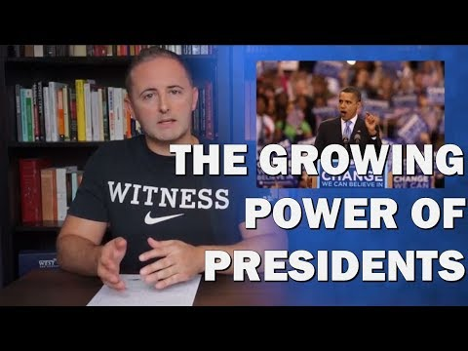
Intro to Topic 2.6
Expansion of Presidential Power
Carey LaManna
4:19

Slide 96
Topic 2.6: Expansion of Presidential Power (Con-4.C.1)
Justifications for a single executive are set forth in Federalist No. 70.

Slide 97
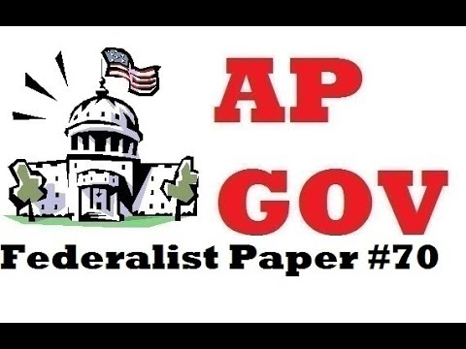
Federalist #70
Kelsey Falkowski
5:05

Slide 98
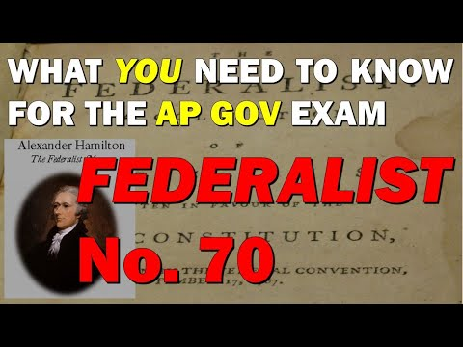
Federalist #70
Carey LaManna
8:28

Slide 99
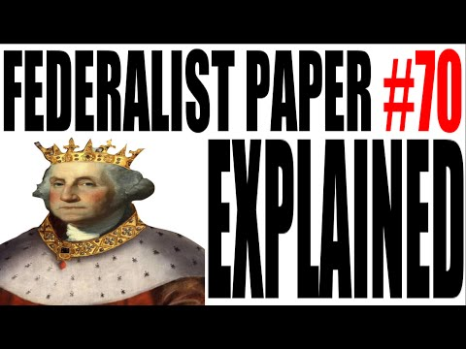
Federalist #70
Hip Hughes
4:12

Slide 100
Topic 2.6: Expansion of Presidential Power (Con-4.C.2)
Term-of-office and constitutional-power restrictions, including the passage of the Twenty-Second Amendment, demonstrate changing presidential roles.

Slide 101
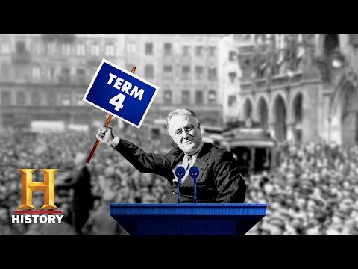
The 22nd Amendment
History
1:38

Slide 102
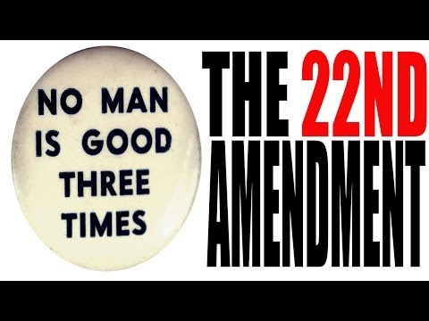
The 22nd Amendment
Hip Hughes
6:08

Slide 103
Topic 2.6: Expansion of Presidential Power (Con-4.C.3)
Different perspectives on the presidential role, ranging from a limited to a more expansive interpretation and use of power, continue to be debated in the context of contemporary events.

Slide 104
Topic 2.7: Presidential Communication (Con-4.D.1)
The communication impact of the presidency can be demonstrated through such factors as:
Modern technology, social media, and rapid response to political issues
Nationally broadcast State of the Union messages and the president’s bully pulpit used as tools for agenda setting.

Slide 105
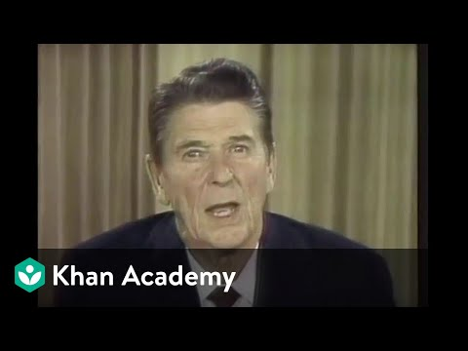
The Bully Pulpit
Khan Academy
5:54

Slide 106
Review
The Executive Branch

Slide 107
Review Questions - The Executive Branch and the President
Explain how the president can implement a policy agenda.. (CON-4.A)
Explain how the president’s agenda can create tension and frequent confrontations with Congress.n. (CON-4.B)
Explain how presidents have interpreted and justified their use of formal and informal powers. (CON 4C)
Explain how communication technology has changed the president’s relationship with the national constituency and the other branches. (CON 4-D)

Slide 108
Explain the extent to which governmental branches can hold the bureaucracy accountable given the competing interests of Congress, the president, and the federal courts. (PMI-2.E)

Slide 109
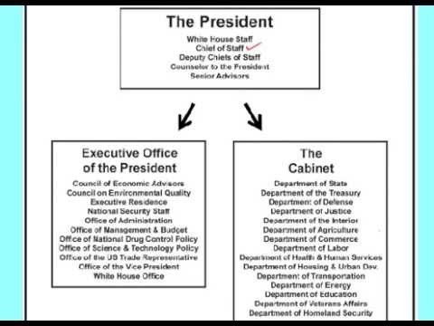

Slide 110
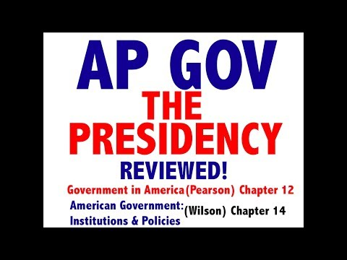
Review
The Executive Branch
Jocz Production
6:07

Slide 111
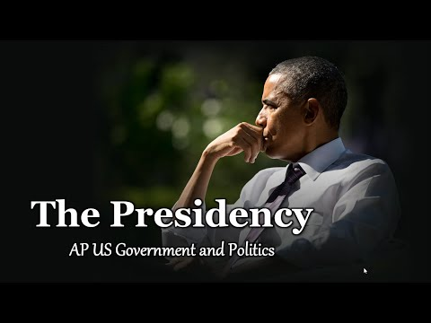
Review
The Executive Branch
Tom Richey
6:07

Slide 112
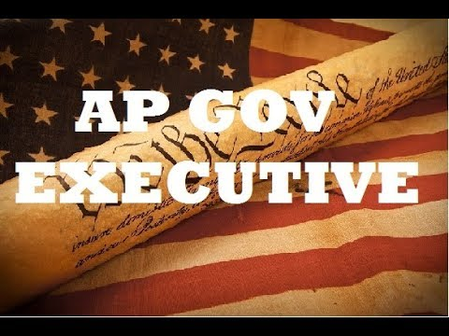
Review
The Executive Branch
Kelsey Falkowski
6:07

Slide 113
Topic 2.8 - 2.11
The Judicial Branch

Slide 114
Enduring Understanding (Con-5)
The design of the judicial branch protects the Supreme Court’s independence as a branch of government, and the emergence and use of judicial review remains a powerful judicial practice.

Slide 115
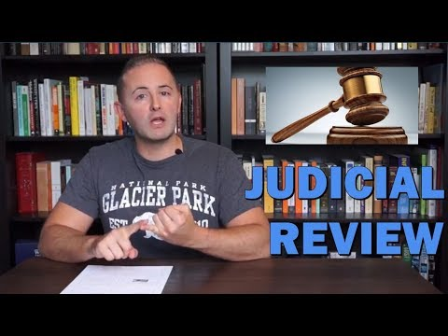
Intro to Topic 2.8
The Judicial Branch
Carey LaManna
3:49

Slide 116
Topic 2.8: The Judicial Branch (Con-5.A.1)
The foundation for powers of the judicial branch and how its independence checks the power of other institutions and state governments are set forth in:
Article III of the Constitution
Federalist No. 78
Marbury v. Madison (1803)

Slide 117
Article III of the Constitution (click here)
Establishes the judicial branch of the federal government.
Says that the judicial branch shall consist of the Supreme Court of the United States, as well as lower courts created by Congress.
Empowers the courts to handle cases or controversies arising under federal law, as well as other enumerated areas.
Defines treason.

Slide 118
Topic 1 of Article III
Vests the judicial power of the United States in the Supreme Court, as well as inferior courts established by Congress.
Authorizes the creation of inferior courts, but does not require it
Establishes that federal judges do not face term limits, and that an individual judge's salary may not be decreased.
Article III does not set the size of the Supreme Court or establish specific positions on the court, but Article I establishes the position of chief justice.

Slide 119
Topic 2 of Article III
Delineates federal judicial power. The Case or Controversy Clause restricts the judiciary's power to actual cases and controversies, meaning that federal judicial power does not extend to cases which are hypothetical, or which are proscribed due to standing, mootness, or ripeness issues.
States that federal judiciary's power extends to cases arising under the Constitution, federal laws, federal treaties, controversies involving multiple states or foreign powers, and other enumerated areas.
Gives the Supreme Court original jurisdiction when ambassadors, public officials, or the states are a party in the case, leaving the

Slide 120
Supreme Court with appellate jurisdiction in all other areas to which the federal judiciary's jurisdiction extends.
Gives Congress the power to strip the Supreme Court of appellate jurisdiction, and establishes that all federal crimes must be tried before a jury. Topic 2 does not expressly grant the federal judiciary the power of judicial review, but the courts have exercised this power since the 1803 case of Marbury v. Madison.

Slide 121
Topic 3 of Article III
Defines treason and empowers Congress to punish treason. Requires that at least two witnesses testify to the treasonous act, or that the individual accused of treason confesses.
Limits the ways in which Congress can punish those convicted of treason.

Slide 122
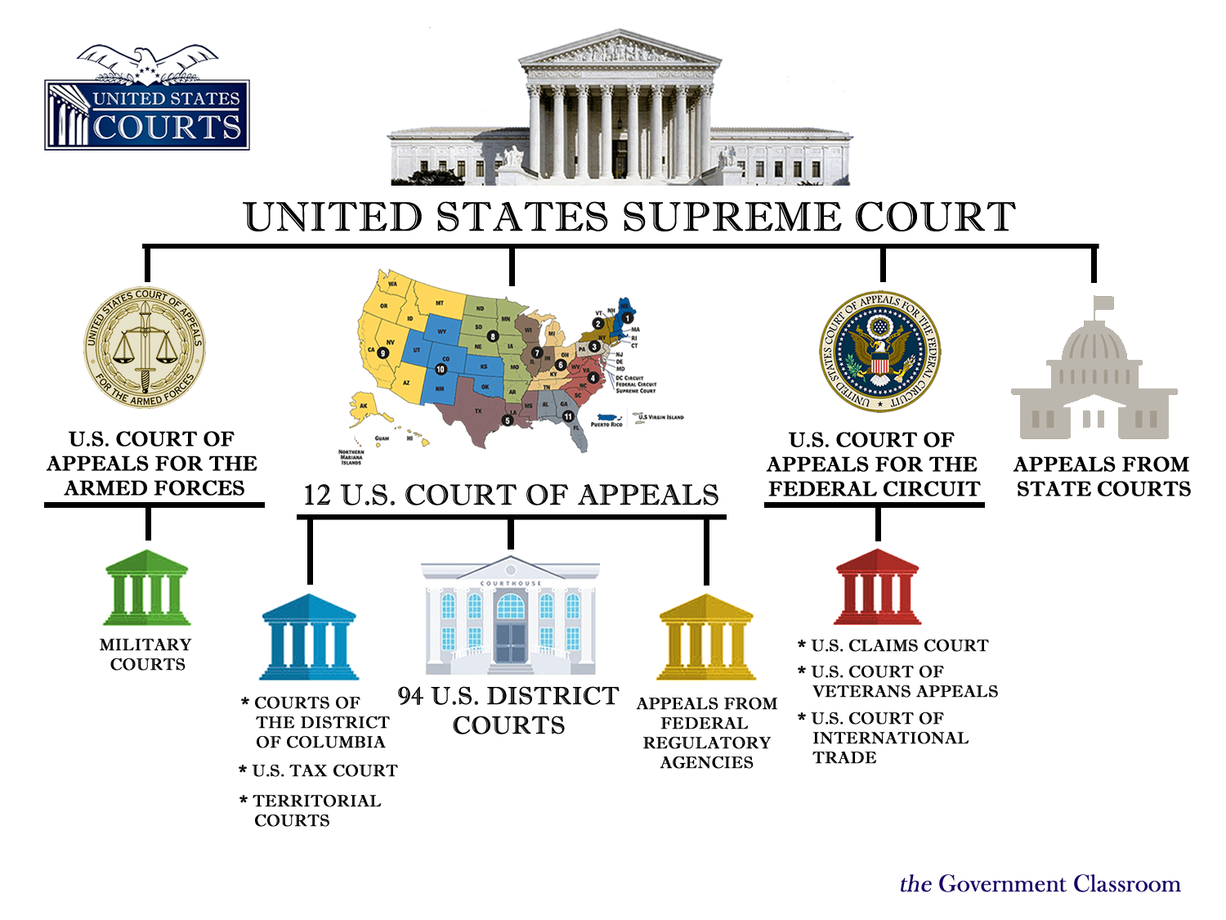

Slide 123
Federalist Paper #78
Published under the pseudonym Publius but written by Alexander Hamilton
Written to justify the structure of the judiciary under the proposed Constitution of the United States; it is the first of six essays by Hamilton on this issue. In particular, it addresses concerns by the Anti-Federalists over the scope and power of the federal judiciary, which would have comprised unelected, politically insulated judges that would be appointed for life.
Said that the Judiciary branch of the proposed government would be

Slide 124
the weakest of the three branches because it had "no influence over either the sword or the purse, ...It may truly be said to have neither FORCE nor WILL, but merely judgment."
Quotes Montesquieu: "Of the three powers [...], the judiciary is next to nothing." It would depend on the political branches to uphold its judgments.
Discusses the power of judicial review. It argues that the federal courts have the duty to determine whether acts of Congress are constitutional and to follow the Constitution when there is inconsistency. Hamilton viewed this as a protection against abuse of power by Congress.

Slide 125
Federalist Paper #78
Hip Hughes History
4:20

Slide 126
Federalist Paper #78
Teaching American History
Click here to read

Slide 127
https://www.youtube.com/watch?v=iIBbUs-uzyg
Federalist Paper #78
Citizen U
3:28

Slide 128
Marbury v. Madison (1803)
A U.S. Supreme Court case that established the principle of judicial review - the power of the courts to declare the laws of the legislature and acts of the executive unconstitutional.

Slide 129
https://www.youtube.com/watch?v=hOvsZyqRfCo&t=51s
Marbury v. Madison
History
3:37

Slide 130
https://www.youtube.com/watch?v=iIBbUs-uzyg
The Court’s Power of Judicial Review
Course Hero
3:37

Slide 131
How do US Supreme Court Justices Get Appointed?
TED-Ed
4:25

Slide 132
Intro to Topic 2.9
The Legitimacy of the Judicial Branch
Carey LaManna
3:49

Slide 133
Topic 2.9: Legitimacy of the Judicial Branch (Con-5.B.1)
Precedents and stare decisis play an important role in judicial decision making.

Slide 134
Precedent
A decision made by a higher court such as a circuit court of appeals or the Supreme Court that is binding on all other federal courts.
A legal case that establishes a principle or rule, with this principle or rule then used by the court when deciding later cases with similar issues or facts.
Also known as a Landmark decision or precedent setting case
The use of precedent provides predictability, stability, fairness, and efficiency in the law.
The Latin term stare decisis is the doctrine of legal precedent.

Slide 135
Stare Decisis
Obligates courts to follow historical cases when making a ruling on a similar case.
Ensures that cases with similar scenarios and facts are approached in the same way.
Binds courts to follow legal precedents set by previous decisions.
A Latin term meaning "to stand by that which is decided."

Slide 136
Stare Decisis
Citizen U
1:04

Slide 137
Precedent and Stare Decisis in US Supreme Court Cases
Khan Academy
3:57

Slide 138
What is Stare Decisis
Federalist Society
3:57

Slide 139
Topic 2.9: Legitimacy of the Judicial Branch (Con-5.B.2)
Ideological changes in the composition of the Supreme Court due to presidential appointments have led to the Court’s establishing new or rejectiving existing precedents.

Slide 140
Political Ideology
Political ideology can best be defined as a certain set of ethical ideals, principles, doctrines, myths or symbols that explains how society should work and offers some political and cultural blueprint for a certain social order.
What is your political ideology? To find out, take the Pew Research Center quiz found here. Are you a Core Conservative? A Solid Liberal? Or somewhere in between? If you partly agree with both statements, or feel that neither quite describes your view, that’s OK. In those cases, pick the answer that comes closest to your view, even if it isn’t exactly right.

Slide 141
US V. Nixon
State Bar of Georgia
8:19

Slide 142
Intro to Topic 2.10
The Court in Action
Carey LaManna
4:52

Slide 143
Topic 2.10: The Court in Action (Con-5.B.3)
Controversial or unpopular court decisions can lead to challenges to the court’s legitimacy and power that Congress and the president can address only through future appointments, legislation changing the Court’s jurisdiction, or refusing to implement decisions.

Slide 144
The Most Controversial or Unpopular?
Obergefell v. Hodges
Plessy v. Ferguson
Lawrence v. Texas
Dred Scott v. Sanford
Snyder v. Phelps
United States v. Nixon
Korematsu v. United States
Johnson v. McIntosh
Citizens United v. Federal Election Commission
Bush v. Gore
Miranda v. Arizona
Roe Wade
Brown v. Board of Education
Marbury v. Madison
Gideon v. Wainwright
Mapp v. Ohio
Loving v. Virginia
Texas v. Johnson
Cherokee Nation v. Georgia

Slide 145
The Five Most Controversial/Unpopular
According to a recent poll of APGov teachers.

Slide 146
ACTIVITY A Mock US Supreme Court Hearing - The Metal Bladed Kirpan and the Free Exercise Clause
Edutopia
Click here for details

Slide 147
Intro to Topic 2.11
Checks on the Judiciary
Carey LaManna
2:46

Slide 148
Topic 2.11: Checks on the Judicial Branch (Con-5.B.4)
Political discussion about the Supreme Court’s power is illustrated by the ongoing debate over judicial activism versus judicial restraint.

Slide 149
Intro to Topic 2.12
Judicial Activism and Judicial Restraint
Khan Academy
8:17

Slide 150
An Independent Judiciary
CRF-BRIA Click here to read

Slide 151
Topic 2.11: Checks on the Judicial Branch (Con-5.C.1)
Restrictions on the Supreme Court are represented by:
Congressional legislation to modify the impact of prior Supreme Court decisions
Constitutional amendments
Judicial appointments and confirmations
The president and states evading or ignoring Supreme Court decisions
Legislation impacting court jurisdiction

Slide 152
Why is the US Constitution so Hard to Amend
TED-Ed
4::17

Slide 153
Review
The Judicial Branch

Slide 154
Review Questions - The Judicial Branch and the Supreme Court
Explain the principle of judicial review and how it checks the power of other institutions and state governments (Con-5.A)
Explain how the exercise of judicial review in conjunction with life tenure can lead to debate about the legitimacy of the Supreme Court’s power (Con-5.B)
Explain how other branches in the government can limit the Supreme Court’s power. (Con-5.C)

Slide 155
REVIEW The Judicial Branch
Kelsey Falkowski
5:50

Slide 156
REVIEW The Judicial Branch
Jocz Productions
22:59

Slide 157
Topic 2.12 - 2.15
The Bureaucracy

Slide 158
Intro to Topic 2.12
The Bureaucracy
Carey LaManna
2:49

Slide 159
Enduring Understanding (PMI-2)
The federal bureaucracy implements federal policies.

Slide 162
The Bureaucracy
Adam Norris
2:56

Slide 163
Organization of the Bureaucracy
Adam Norris
3:24

Slide 164
Topic 2.12: The Bureaucracy (PMI-2.A.1)
Tasks performed by departments, agencies, commissions, and government corporations are represented by:
Writing and enforcing regulations
Issuing fines
Testifying before Congress
Issue networks and “iron triangles”

Slide 165
Issue Networks and Iron Triangles
Khan Academy
3:41

Slide 166
Iron Triangles
Adam Norris
4:07

Slide 167
Issue Networks and Iron Triangles
Kelsey Falkowski
11:12

Slide 169
Topic 2.12: The Bureaucracy (PMI-2.A.2)
Political patronage, civil service, and merit system reforms all impact the effectiveness of the bureaucracy by promoting professionalism, specialization, and neutrality

Slide 170
Political Patronage, Civil Service, and Merit
A spoils system (also known as a patronage system) is a practice in which a political party, after winning an election, gives government civil service jobs to its supporters, friends, and relatives as a reward for working toward victory, and as an incentive to keep working for the party—as opposed to a merit system, where offices are awarded on the basis of some measure of merit, independent of political activity.
Civil service jobs - government agency work, whether it be federal, state, or local.

Slide 171
The term was used particularly in politics of the United States, where the federal government operated on a spoils system until the Pendleton Act was passed in 1883 due to a civil service reform movement.
The Pendleton Act - a Congress law that said most positions within the federal government should be awarded on the basis of merit instead of political patronage.
By the late 1870s, American politics operated on the spoils system, a political patronage practice in which officeholders awarded their allies with government jobs in return for financial and political support.

Slide 172
Intro to Topic 2.13
Discretion and Rule Making Authority of the bureaucracy
Carey Lamanna
2:49

Slide 173
Topic 2.13: Discretionary and Rule Making Authority (PMI-2.B.1)
Discretionary and rule-making authority to implement policy are given to bureaucratic agencies, including:
Department of Homeland Security
Department of Transportation
Department of Veterans Affairs
Department of Education
Environmental Protection Agency (EPA)
Federal Elections Commission (FEC)
Securities and Exchange Commission (SEC)

Slide 174
Discretionary and Rule Making Authority
Discretionary authority - An agency's ability to decide whether or not to take certain courses of action when implementing existing laws.
Rulemaking authority - An agency's ability to make rules that affect how programs operate, and to force states and corporations to obey these rules as if they were laws.

Slide 175
Intro to Topic 2.14
Holding the Bureaucracy Accountable
Carey LaManna
2:49

Slide 176
Topic 2.14: Holding the Bureaucracy Accountable (PMI-2.C.1)
Oversight and methods used by Congress to ensure that legislation is implemented as intended are represented by:
Committee hearings
Power of the purse

Slide 177
Topic 2.14: Holding the Bureaucracy Accountable (PMI-2.C.2)
As a means to curtail the use of presidential power, congressional oversight serves as a check of executive authorization and appropriation.

Slide 178
Topic 2.14: Holding the Bureaucracy Accountable (PMI-2.D.1)
Presidential ideology, authority, and influence affect how executive branch agencies carry out the goals of the administration.

Slide 179
Topic 2.14: Holding the Bureaucracy Accountable (PMI-2.D.2)
Compliance monitoring can pose a challenge to policy implementation.

Slide 180
Compliance Monitoring
Making sure the firms and companies that are subject to industry regulations are following those standards and provisions
How We (the EPA) Monitor Compliance

Slide 181
Intro to Topic 2.15
Checks on the Bureaucracy
Carey LaManna
2:49

Slide 182
Topic 2.15: Policy and the Branches of Government
Formal and informal powers of Congress, the president, and the courts over the bureaucracy are used to maintain its accountability.

Slide 183
Review
The Bureaucracy

Slide 184
Review Questions - The Bureaucracy
Explain how the bureaucracy carries out the responsibilities of the federal government. (PMI-2.A)
Explain how the federal bureaucracy uses delegated discretionary authority for rule making and implementation. (PMI-2.B)
Explain how Congress uses its oversight power in its relationship with the executive branch. (PMI-2.C)
Explain how the president ensures that executive branch agencies and departments carry out their responsibilities in concert with the goals of the administration. (PMI-2.D)

Slide 185
Explain the extent to which governmental branches can hold the bureaucracy accountable given the competing interests of Congress, the president, and the federal courts. (PMI-2.E)

Slide 186
Part 1
The Bureaucracy
Kelsey Falkowski
11:52

Slide 187
Part 2
The Bureaucracy
Kelsey Falkowski
11:53

Slide 188
Unit II Review
Interactions Among the Branches

Slide 190
Unit II Review
Carey LaManna
16:57

Slide 191
Unit II
Kelsey Falkowski
12:37

Slide 192
Unit II Review
MyCitizenU
20:35

